Slide 1
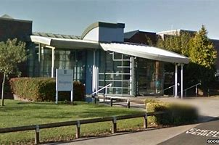
Dear y6’s, I was extremely worried when i was leaving my old school to go to the Academy but there was nothing to be scared of. The teachers are really nice and will help you if you need some help. Having different teachers and classrooms was a bit confusing at the start but I soon got used to it. The food is also very nice even if the queues are sometimes long. I hope you enjoy y7 as much as I am when u get back to school.
Chellaston academy

