Slide 1
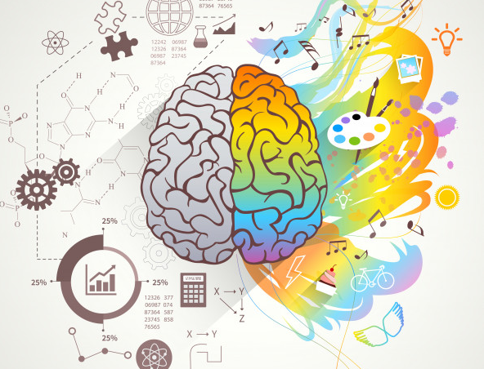
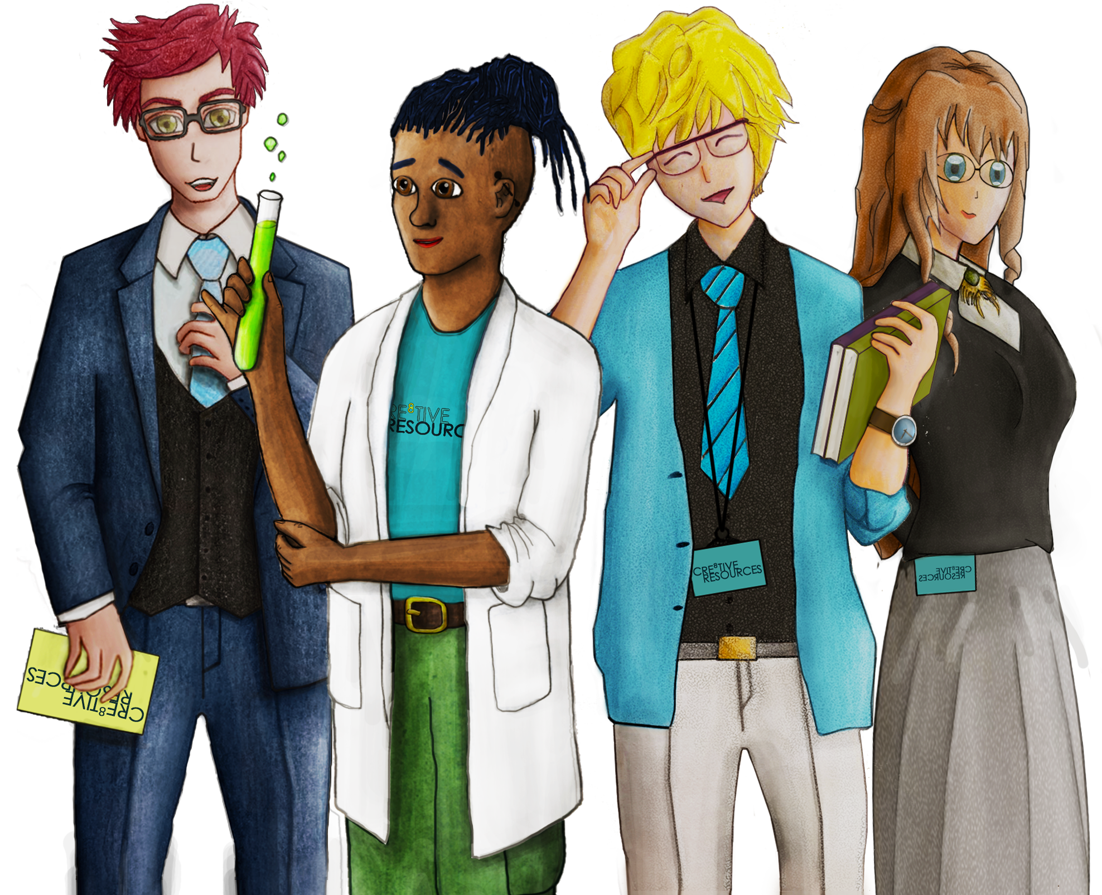
What is positive wellbeing?
It is a state of overall good health in both body and mind and can include:
Intellectual (cognitive stimulation such as problem solving puzzles),
Spiritual (understanding sense of purpose and beyond your own existence, can be through prayer or exploration of a higher power, etc)
Social (building relationships and community support through friends and family and neighbours etc.)
Physical (Movement, whether in sports or walking, movement that brings joy.)
11 TOP TIPS FOR POSITIVE WELLBEING
Taking breaks from technology. It can create strain on the eyes, disrupt sleep, overstimulate your brain and normally technology is linked to a lack of movement.
Spend time outside in nature. Nature is healing, going to your local park or green space and taking a walk is a great way to destress. .
Spend time with people who support you. Social interaction and a strong network of support is important for mental health, sharing problems and building social skills
Eat fresh fruit and vegetables daily. Food helps to build and nourish your body, it provides energy and helps you when you’re not feeling well. Aim for at least 5 portions daily.

Slide 2
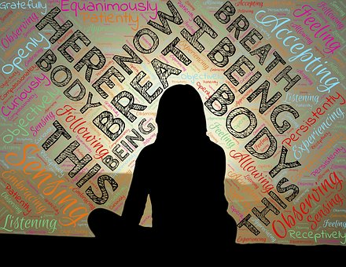
Breathing exercise. Practice breathing slowly into your stomach, through your nose and out slowly to calm down nervousness. Left and right nostril breathing is all good for enhancing these effects.
Find a creative activity. Finding a way to expressive yourself through your chosen form of art from acting, playing an instrument, art, writing short stories or poems is great for relaxing and spending time away from technology.
Limit phone time. Social Media can be a very negative environment and hyperfiltered which can distort how we see and feel about ourselves. Breaks are a good reminder that social media is a filtered highlight reel, not real life.
Talk about your problems. They can seem much worse in your head, especially if you don’t talk about them and let them build up. Find someone you can trust.
Meditation. Close your eyes for a few minutes each day and just focus on breathing. You don’t need to anything else but witness your thoughts and feelings.
Drink plenty of water. We are over 70% water and dehydration can cause low energy amongst other undesirable symptoms
Write your feelings on paper. Keeping a journal, can help ease a troubled mind when you’re not ready to talk about what is bothering you.

