Slide 1
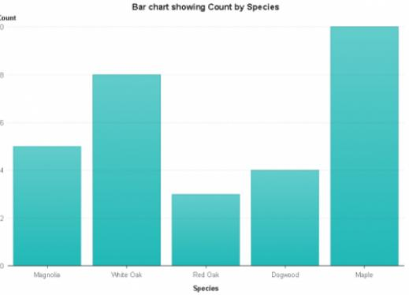
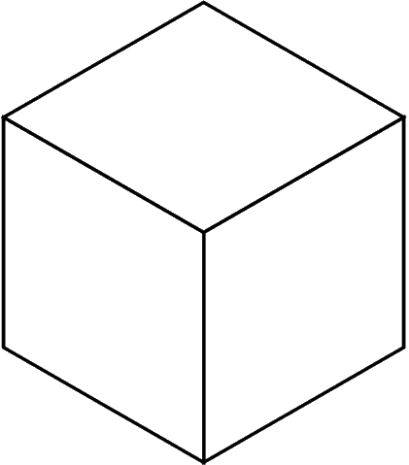
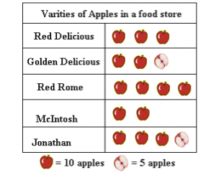
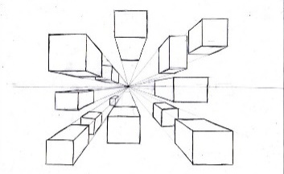
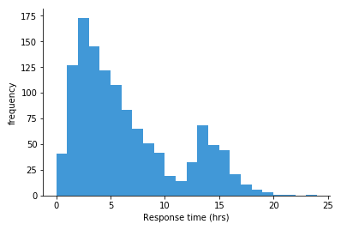
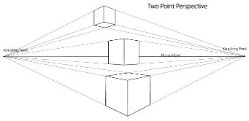
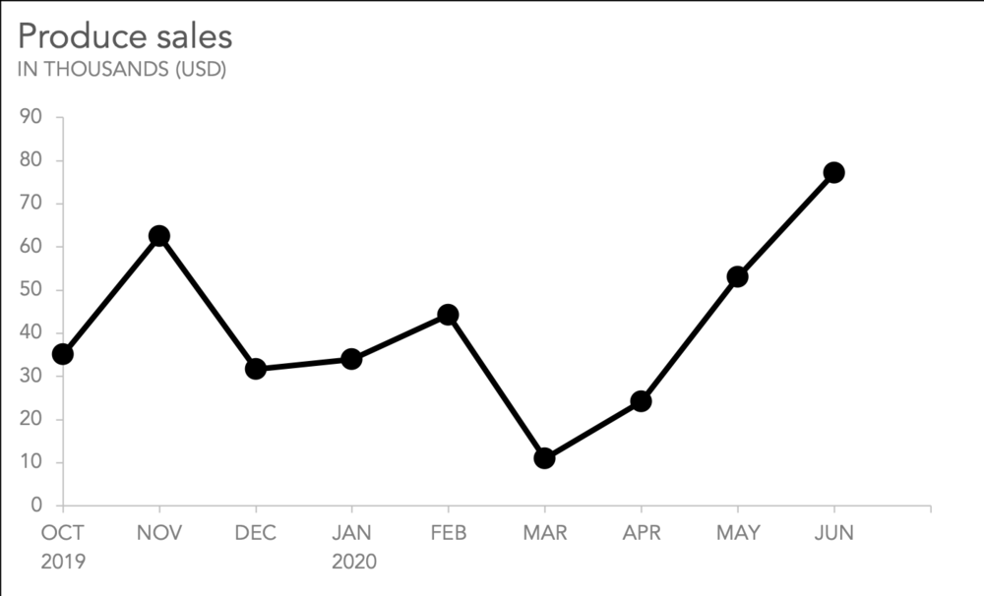
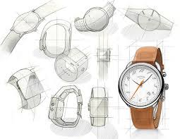
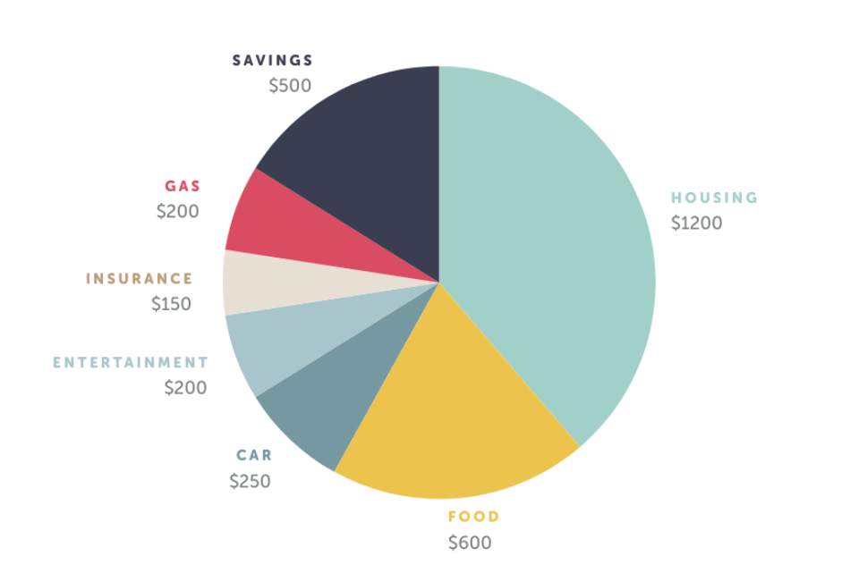
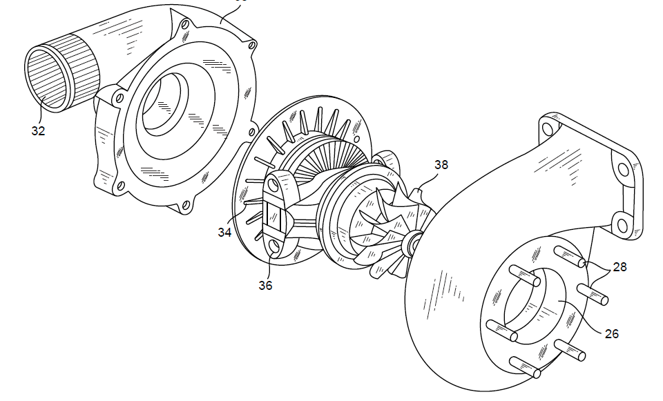
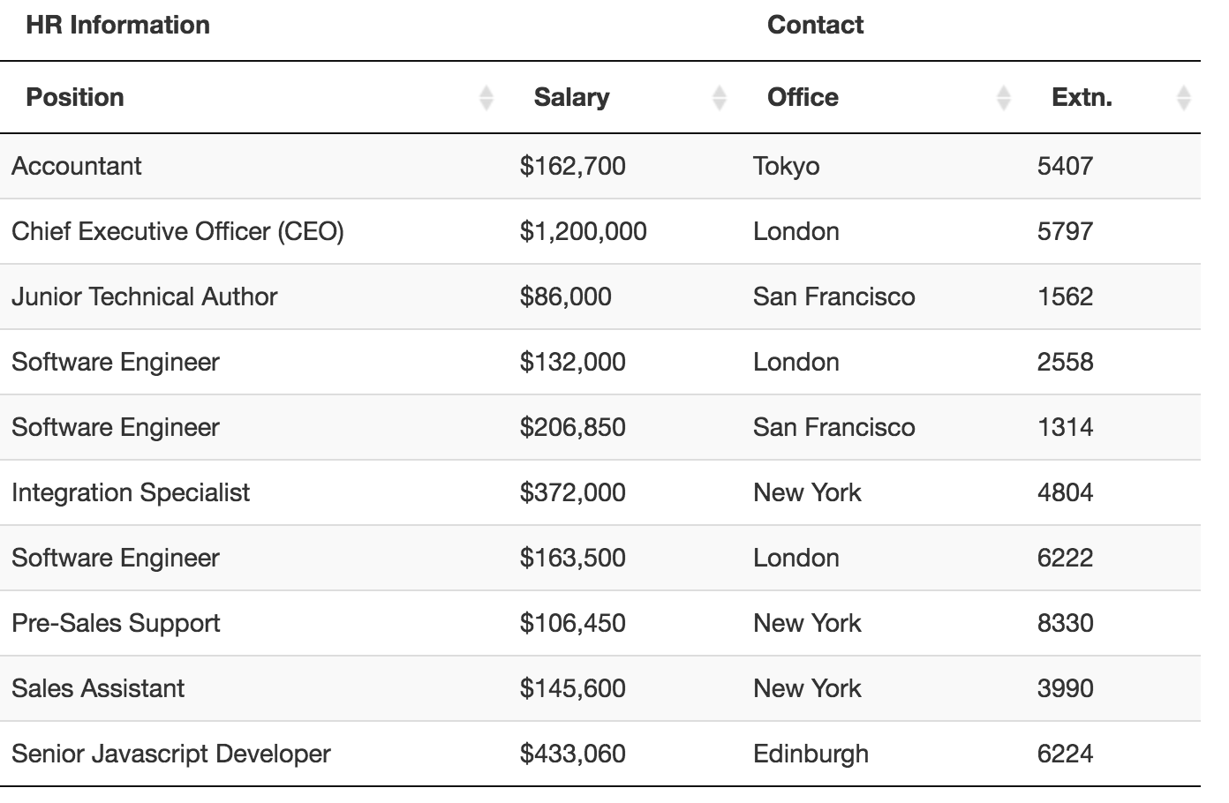
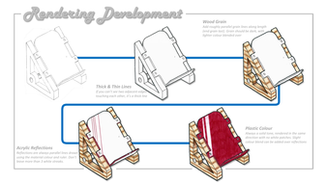
3.1.14 Design Communication
Knowledge Organiser
Design and Technical Reports
A Design report is an industrial design team’s project record for future reference. Technical Reports are used for recording practical test results, target market research and reviewing products.
Design Communication - Drawing
2D and 3D methods of communicating ideas and concepts.
Technique | Description/ notes | Diagram
Orthographic Projection/ Working Drawings | Includes “Front”, “Plan” and “End” 2D Views, and often an Isometric 3D View Standardised method for scale, dimensions and line types Great for manufacturing
Isometric | Common 3D sketching method Can be drawn free-hand or using isometric paper and ruler Angles are at 30 degrees Great for seeing most of the products
1-Point Perspective | A 3D drawing method Often used by interior designers and architects Gives drawings depth Only uses 1 vanishing point
2-Point Perspective | Used for 3D designs Exaggerates the 3D effect Objects can be drawn above of below the horizon line but must go to the 2 vanishing points
Annotated Drawings/ Free and Sketches | Quick and easy way of getting ideas down Range of ideas can be seen Annotation helps explain designs further
Exploded View | Helps see a final design of a product and all it’s parts Can see where all the parts fit Great for manufacturers
Thick and Thin Lines and Rendering | Thick and thin lines help designs stand out Texture and rendering help communicate designs and aesthetics
Technique | Description/ notes | Diagram
Bar Chart | Simple way to represent data Commonly used in a range of reports Good for target market research in NEA.
Pictograph | Easy to understand Quick to read Not very accurate
Histogram | Data is shown in ranges Useful to show frequency in data
Line Graph | Can show changes over time Easy to understand Accurate due to use of scales
Pie Chart | Shows data distribution Segment size is relative to proportion of data. Easy to understand
Data Tables | Important to help interpret data, identify patterns and add missing data Used in cutting lists, anthropometrics and costings

