Slide 1
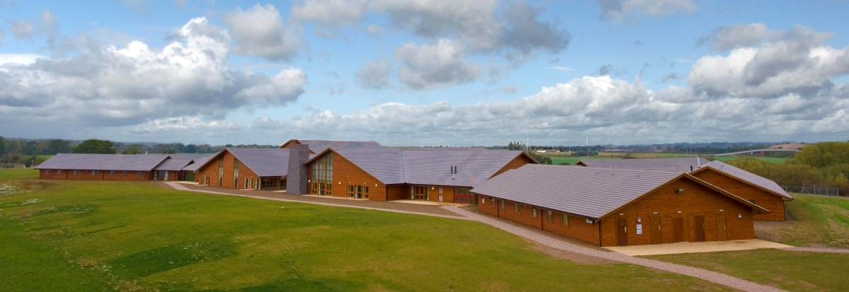
Whitemoor Lakes
Monday 3rd – Wednesday 5th October 2022
Arrive in sporty clothes. Leave at break-time. Bags can be stored in the gym before registration. It will be left open from 8:20-8:45am.
Children will need a packed lunch to take for the first day (please pack in a carrier bag that can be disposed of afterwards). They will eat this on arrival at Whitemoor Lakes.
We will return to school at approx. 2:30pm on Wednesday 5th October in plenty of time for the school buses.

Slide 2
Aims of the trip
The purpose of this residential is so that the year 7’s get off to a flying start. It will help to develop the identity and cohesiveness of the year group and allow them to bond with each other and to get to know their tutors and teaching staff in a positive and fun environment.
Students will be active all day and will be encouraged to participate in all the activities and to overcome their fears and to challenge themselves. They will work in groups of 11-12 with a qualified instructor and a Chellaston staff member.

Slide 3
Learning Outcomes
The activities are designed to develop your child’s abilities in:
Team Work
Leadership
Social Awareness
Initiative
Physical Development
Personal Development (conquering fears)
Resilience
The aim of this residential is for the year group to bond and make new friends so if they are not in a room with all their friends it really isn’t something for the students to worry about.

Slide 4
Direct from Whitemoor Lakes website.
Kit List
Essential outdoor wear
Waterproof jacket/cagoule with a hood
Waterproof trousers
Sturdy trainers or light walking boots for outdoor activities. Wellingtons if the weather is looking wet.
2 long sleeved fleeces (warm layers)
2 pairs of jogging/tracksuit bottoms or combat type trousers (jeans or leggings cannot be worn for outdoor activities)
Warm socks
Hat and gloves (the weather is beginning to feel chilly- sun hat if there is a heat wave!)
Canoeing/kayaking or sailing.
1 set of clothes you don't mind getting wet - fleece, jogging bottoms and old trainers/deck shoes
Small towel
Bag for wet things
Hair bobbles for long hair—must be tied back for activities

Slide 5
General Kit List
2 T-shirts & 1 long sleeved T-shirt (no strappy tops)
Indoor trainers /shoes (no open toed shoes or crocs)
Enough underwear and socks for your stay, plus spares in case you get wet. Evening outfit for the disco –no high heels
Towel
Night wear –pyjamas for boys and girls please
Wash kit (toothbrush, tooth paste, soap, flannel, shampoo, hairbrush, roll on deodorants –no aerosols/sprays)
Sun cream & insect repellent (needed when on the lake)
Other items
Small hairdryer if required
Large bin bag for dirty clothes
Named wallet/purse with £5 maximum pocket money – optional (There is a small tuck/souvenir shop on site-please provide money in £1.00 coins)
Book/magazine to read and note book & pen
Camera – optional (this must be named and student’s own responsibility)
What not to bring
No electrical devices of any sort including mobile phones, i-pods, MP3s, hair straightners.
Do not bring or wear any jewellery other than stud earrings or medical bracelet

Slide 6
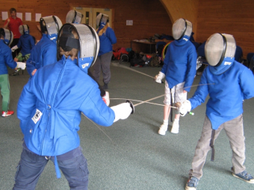
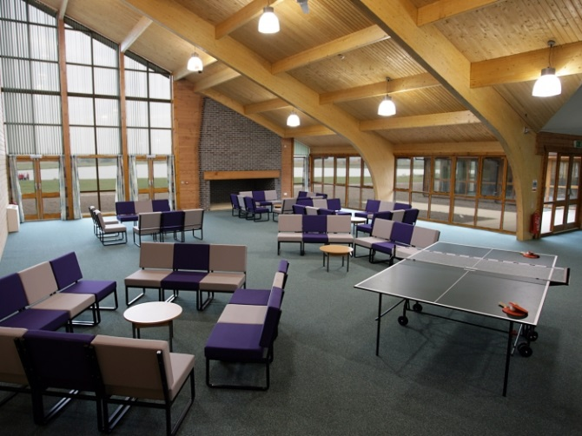
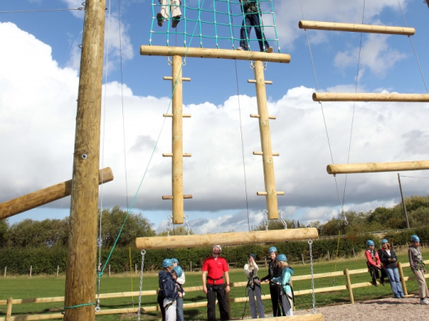
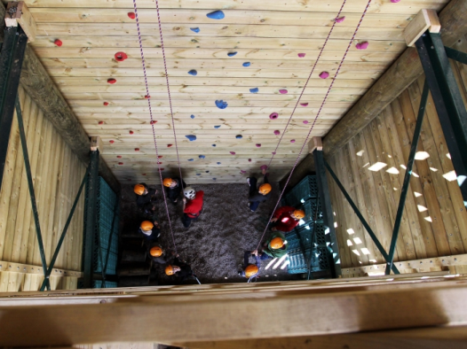
Activities
15 groups
Problem Solving
High Ropes
Climbing
Archery
Canoeing
Abseiling & Zip Wire
Challenge Course
Fencing
Team building
Sailing/kayaking
Camp fire
Groups of 11-12.

Slide 7
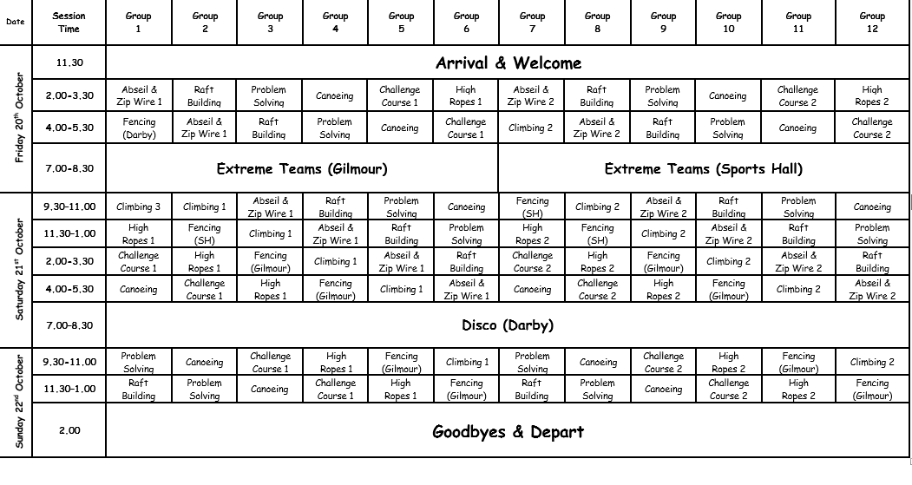
Example Timetable
Activity Groups:

Slide 8
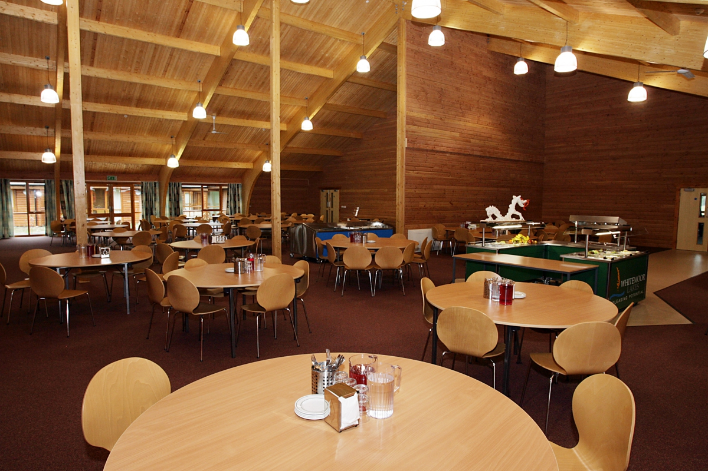
Dining
Breakfast: 8:30am
Lunch: 1:00pm
Dinner : 6:00pm
Water and tea are available all day.

Slide 9
