Slide 1
The main characters/players…
Tsar Alexander II | The Liberator Tsar?
Tsar Alexander III | The Repressive Tsar?
The Russian Orthodox Church | The backbone of the nation?
The Mir & Peasants | Peasant commune?
The Russian Army | Brave but ineffective?
The 3rd Section | The Tsar’s eyes and ears
The Okhrana | The Tsar’s eyes and ears mk2
The Milyutin brothers | Tsar Alex II’s reformers
Karakazov | The near miss 1866.
Land & Liberty and The Populists | Rebellion, revolution and further repression.
Loris Melikov | Russia’s Reformer?
Maria Fedorovna | A popular Tsarina?
Ethnic minorities in Russia? | Dangers of Russification? (Polish Revolt etc)
John Hughes & Hughesovska | Russia’s attempts to industrialise…
John Hughes & Sergei Witte | The economic genius(es)?
Peter Stolypin 1906-11 | The peasant prosperity PM???
Industrial workers | A new Russian class?
Timofei & Savva Morozov | Ruthless innovators?
Writers and artists | Reflecting or influencing Russian culture?
Tsar Nicholas II | Incompetent control freak?
Tsarina Alexandra | True Russian or German spy?
Grigory Rasputin | The mad monk?
Sergei Zubatov | An unlikely reformer? p83
Opposition groups 1895-1905 | Growth of opposition to the Tsar (Nicholas II)
Karl Marx | Influencer of revolution?
Vladimir Ilyich Lenin | Communist revolutionary and dictator
Leon Trotsky | From Menshevik to Bolshevik
Vera Zasulich | Philosophical Philanthropist?
The Dumas | Pretend parliaments or real progress?
Could Stolypin have saved the Tsar? | A return to Stolypin…
Alexander Kerensky | An impossible task – or own goals?

Slide 2
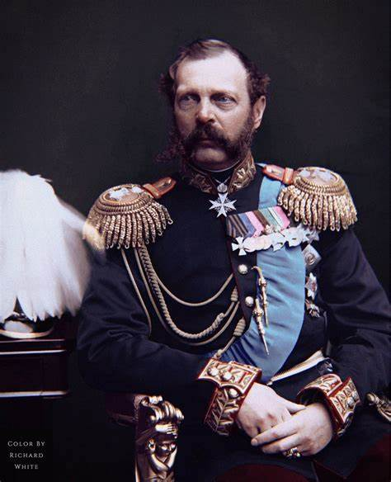
The main characters… Throughout the narrative (story) of Russia there have been many significant characters and groups which have had consequences on the events you are studying. Historians have different views or interpretations on their consequences and significance and you will need to know these to succeed at your exams; or to really understand the issues and events which affected Russia’s journey.
Tsar Alexander II | The Liberator Tsar? Was he or wasn’t he?
KEY FACTS… 1818-1881 (lived) 1855 (coronation 1856) to 1881 Tsar Assassinated. Influenced by Crimean War (1853-6) – therefore wanted reform to make Russia more efficient – especially military. Several key areas of reform. 1861 – Emancipation (freedom) for the serfs. Other reforms = Local Govt, Judicial, Military & Education. Milyutin brothers = civil servants who organised the reforms. Influenced later by unsuccessful assassination attempt 1866 (Karakazov) – became more repressive after 1866. Some reforms continued but return to reactionary influences 1866-81. Opponents of Tsarist regime = radical groups such as Land & Liberty & The Populists – was the rise in opposition due to reform or reform not being enough? Alexander II might have made reforms but was NOT a liberal – there is debate about how far Alex II really wanted to change the autocratic institutions of Russia.
 | Summary… According to JN Westwood in “Endurance to Endeavour 1812-2001” “With the possible exception of Khrushchev and Gorbachev, no Russian ruler brought so much relief to so many of his people as did Alexander II, autocratic and conservative though he was.” It seems that Alex’s aim was to strengthen Tsarist rule by reform. Maybe he was attempting to move Russia forward to stabilise it after the embarrassing defeat in the Crimea by 1856. Alex II was not a liberal deeply altering autocratic government but was trying to make his job easier / more effective as an autocrat. The great challenge was to effectively reform Russia without undermining the nobles and privileged class. As a result of this and possibly the 1866 assassination attempt, historians such as Hugh Seton-Watson suggest the reforms did not go far enough. It could however be argued that the reforms initiated a process that would eventually lead to revolution in 1917.

Slide 3
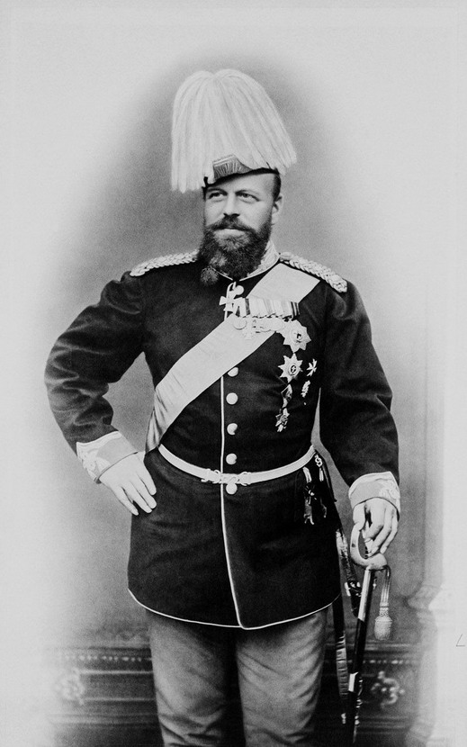
The main characters… Throughout the narrative (story) of Russia there have been many significant characters and groups which have had consequences on the events you are studying. Historians have different views or interpretations on their consequences and significance and you will need to know these to succeed at your exams; or to really understand the issues and events which affected Russia’s journey.
Tsar Alexander III | The Repressive Tsar?
KEY FACTS… 1881-1894 = Tsar Emperor of Russia Impressive character – tall and strong – unbent horseshoes to entertain his children. Was devoted to his family. He admired The Cossack way of life – loyal and orthodox – seen as “The Cossack Tsar” (Lindsey Hughes – states he was strong willed – determined) Was not meant to be Tsar – his brother died in 1865 and he had to adapt to being heir not spare. Married his late brother’s fiancée = daughter of K of Denmark aka = Maria Fedorovna (Minni) Authoritarian Autocrat. Uncompromising conservative / reactionary – was that a result of his father’s violent death? Conservative nationalists were again the main influence and it was clear from start he would be autocratic as on April 29th 1881 he made his “Manifesto on Unshakeable Autocracy” – think about the use of language there. Firmly believed people should trust the Tsar to make correct decisions – Tsar as father to the people – paternalistic. He saw his father’s reforms as ill advised and amounting to a revolution. He therefore dismissed reformers such as Loris Melikov and the Milyutins. Therefore apptd reactionary Dmitri Tolstoy as Minister of Interior. Repressive and reactionary policies such as 1881 created new secret police called The Okhrana. Many legal changes such as trials in private for plotters without a jury!
 | Summary… Tsar Alexander III was a reactionary Tsar. He believed in autocratic rule and the responsibilities which came with it. He repealed a number of his father’s reforms and brought in more reactionary methods. However he was interested in economic progress in the west and wanted that to happen in Russia to stabilise the regime. For example Bunge repealed the poll tax and a Peasants’ Land Bank was set up to help them buy land. Some historians could argue that his regime brought stability to the Tsarist regime and 13 years of peace. However, it could be argued that his repressive approach led to greater opposition which would leave his son with greater difficulties and more challenges to rule the country. Really the only way it seemed to sustain the regime was to fall back on repression to keep order. Was this sustainable?

Slide 4
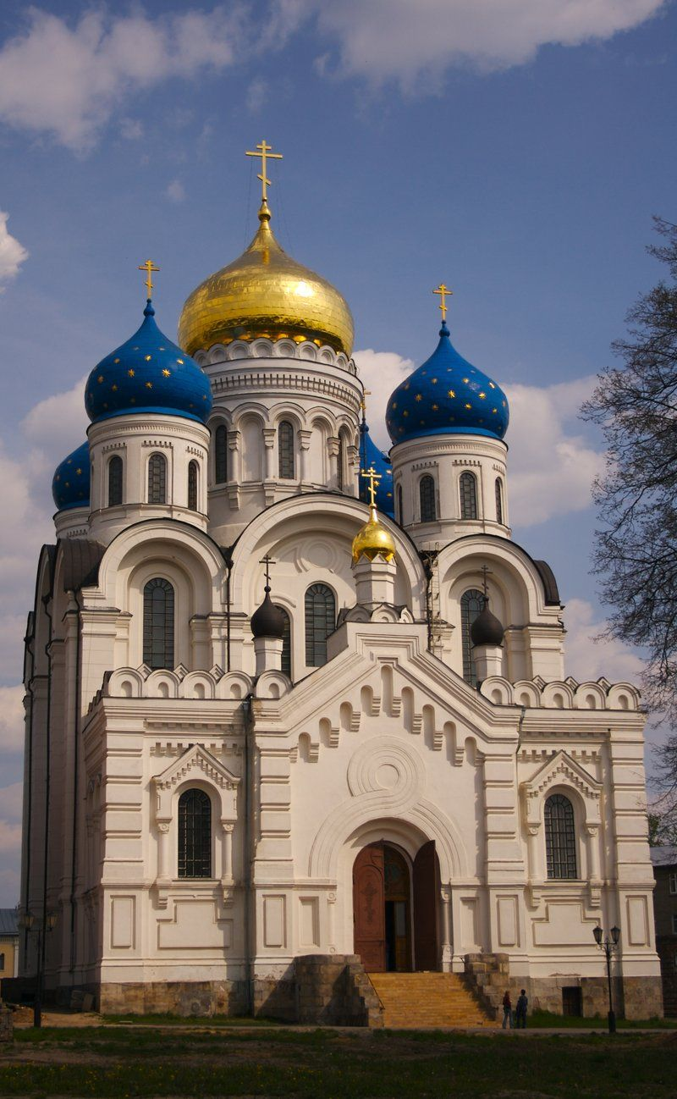
The main characters… Throughout the narrative (story) of Russia there have been many significant characters and groups which have had consequences on the events you are studying. Historians have different views or interpretations on their consequences and significance and you will need to know these to succeed at your exams; or to really understand the issues and events which affected Russia’s journey.
The Russian Orthodox Church | The backbone of the nation?
KEY FACTS... An ancient Church with origins in Byzantium – Eastern Roman Empire Not changed for 100s of years. Traditional & autocratic. Over 100,000 clerics who played a significant role in Russian society. Especially as a priest in each village. Did have some sects / groups within it with radical ideas about religion but never any radical political ideas (see Rasputin) The Tsar was seen by the Orthodox Church as God’s representative on earth. The Orthodox Church was the prop for autocracy. The Chief Procurator of the Holy Synod (Head of Church) was appointed by the Tsar. Involved in education – especially primary education & services bolstered the Tsarist views of obedience and authority. Direct line of communication to the people – from nobility to the peasants. When Tsars led Russification of the Empire the Orthodox Church was set as the official religion which would cause frustration and anger with minorities such as Poles (who were Catholic), areas which were Muslim, and Jews. Most peasants had icons in their homes and church beliefs made them less revolutionary.
 |  | Summary… The Orthodox Church could be seen as the backbone of the nation. Or would it be better to say the backbone of the Tsarist regime? It had a huge influence on people’s lives and was an essential part of Russian culture. When Communism took over Russia it found it almost impossible to undo the influence of the Orthodox church and people’s beliefs. It was firmly woven into Russian culture and life.

Slide 5
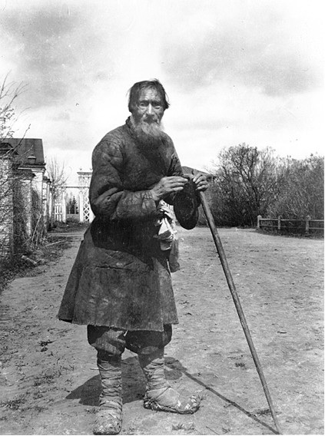
The main characters… Throughout the narrative (story) of Russia there have been many significant characters and groups which have had consequences on the events you are studying. Historians have different views or interpretations on their consequences and significance and you will need to know these to succeed at your exams; or to really understand the issues and events which affected Russia’s journey.
The Mir & peasants… |  | Peasant commune?
Key facts... Literally means peasant commune The village commune would be a collection of households – it was run by peasants themselves and village mtgs allowed discussion of issues. The Mir allocated land and decided who got what – land was divided into strips and there was pasture and meadow held in common. The allocation and distribution of strips was often ineffeicient without any focus on improving key strips. Could be co-operative and work well BUT could also fall victim to petty squabbles and jealousies leading to argument and resentment. Farming organised on a 3 crop rotation – most common crops = wheat rye and oats. Vegetables formed big part of diet – meat rare and fish quite common – but which food depended on regional variation. Beer was main drink but vodka at special occasions. Life was hard for peasants and there were good productive years but also really bad harvests and famines e.g. 1889-92. Many peasants lived in squalor – drunkenness and STDs.
 | Summary… The peasants made up the majority of Russians even during the periods of quicker industrialisation of the 1880s onwards. Peasants were owned until emancipation but still not really free to do what they wanted. However, Stolypin’s agrarian reforms of 1906 to 1911 aimed to allow peasants to consolidate strips of land and reduce the power of the Mir to increase larger more efficient farms. This was inspired by famine of 1891-2. Government received reports showing how the worst areas were affected. Famine then cholera and typhus affected 17 provinces in 1891-2 killing 500,000 people. The government proved incompetent in dealing with this and were even exporting grain while people starved. The Zemstva and other voluntary bodies had to step in to help. By 1914 only 10% of households set up farms separate from the commune / Mir. There are different historians’ views about the impact of Stolypin’s agrarian reforms; some say too utopian, others say not enough to create a loyal peasant class loyal to Tsar. By 1917 most farming was still outdated, although Russia was a huge exporter of produce by 1914.

Slide 6
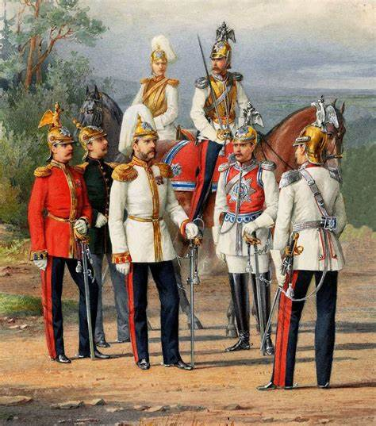
The main characters… Throughout the narrative (story) of Russia there have been many significant characters and groups which have had consequences on the events you are studying. Historians have different views or interpretations on their consequences and significance and you will need to know these to succeed at your exams; or to really understand the issues and events which affected Russia’s journey.
The Russian Army | Brave but ineffective?
Key facts… The army was vital to securing the Tsarist regime. Nobles made up most of officer class and peasants were conscripted to the army. In 1855 conscripts faced 25 years of service – the govt did not want peasants returning home trained to fight and therefore possibly to revolt. The army was used as a police force as well as border control. Under Tsar Alex I they had success against Napoleon and Alex I even marched through Paris. 1853-56 HUGE embarrassing defeat – THE CRIMEAN WAR. This defeat highlighted the ineffective communications and logistics, poor weaponry and inefficiency of leadership. The defeat in the Crimea is seen by many as the cause of reforms introduced by Alexander II (The Liberator Tsar) It is said that Alex II wanted an improved, efficient army to maintain the Tsarist regime. The Military Reforms of 1861-81 = led by Dmitri Milyutin – purchased more modern weaponry, reorganised officer corps and training (specialisms), reduced service to 15 years (6 active – 9 reserve). However many of these reforms were not enough as weaponry went out of date and they feared peasants would still revolt on return – therefore remained a largely bloated organisation. Alex III – The Cossack Tsar – loved military parades and saw Cossacks as the loyal ideal of Russian army – too traditional? Not modern enough? He returned the officer class back to the nobility and halted the reforms.
 | Summary… The Russian army was the lynchpin and security of the Tsarist regime. If the army went against a Tsar it was as if the Tsar had lost his purpose. In the style of Tsarist autocratic leadership, military victory was seen as the core reason for putting your faith in and trusting a Tsar. This worked in 1812-15, but not in 1853-6 and certainly not in WW1 (1914-17). The army mostly remained a large, conscript, illiterate peasant force with inadequate weaponry. This was hugely important in WW1 and although according to Tsarist autocratic beliefs, Nicholas II’s decision to take control of the army was disastrous.

Slide 7
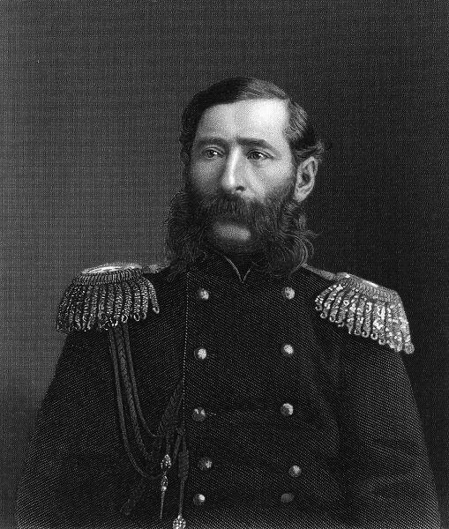
The main characters… Throughout the narrative (story) of Russia there have been many significant characters and groups which have had consequences on the events you are studying. Historians have different views or interpretations on their consequences and significance and you will need to know these to succeed at your exams; or to really understand the issues and events which affected Russia’s journey.
The 3rd Section | The Tsar’s eyes and ears
Key facts… Tsarist secret police – officials and informers. Used to “root out” troublemakers System of surveillance with a network of agents. In charge of strict censorship and controls at the orders of the Tsar. Was a symbol of the oppressive nature of the Tsarist regime. All opposition was to be controlled, monitored and crushed. Loris-Melikov intended to ABOLISH 3rd section and transfer its functions to Ministry of Interior to just monitor genuinely troublesome people not the 1000s who were under surveillance. 3rd Section could not stop assassination attempts – ultimately these were successful in 1881.
Loris-Melikov... |  | Summary… An autocratic repressive regime cannot exist without a secret police. It helps maintain order but also create fear to prevent communication and co-ordination of revolutionary activity – or at least that’s the theory. The 3rd Section could spy on anyone, although it probably became too broad in its attention in the 1870s and 80s? Autocrats believe they need to be respected and to be respected is to be feared. In terms of Tsarist autocracy this is particularly important that the people TRUST the rule of the Tsar but also OBEY it.

Slide 8
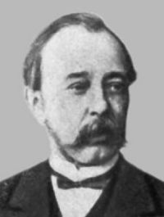
The main characters… Throughout the narrative (story) of Russia there have been many significant characters and groups which have had consequences on the events you are studying. Historians have different views or interpretations on their consequences and significance and you will need to know these to succeed at your exams; or to really understand the issues and events which affected Russia’s journey.
The Okhrana | The Tsar’s eyes and ears mk2
Key facts… Tsar Emperor Alexander III wanted to reverse reforms of his father. Alexander III pushed Loris-Melikov to resign and appointed Dmitri Tolstoy as Minister for Interior. Tolstoy initiated a range of laws and statutes to return Russia to an autocratic and repressive regime. In 1881 a new secret police was established called The Okhrana In March 1882 there was a decree issued which stated that anyone could be put under surveillance. It was sinister and effective. 1881 Georgii Sudeikin was given responsibility to maintain order in St Petersburg & recruited agents – turned prominent member of People’s Will into an agent – but when they found out he then killed Sudeikin. Most post offices had a room where mail was read. Following assassination of Alexander II there were over 10,000 arrests. When it was set up The Okhrana recruited 1000s of informers (many masqueraded as cab drivers) and many people were exiled by its reports – innocent or not. Revolutionary parties continued to spring up though! Many were short lived and even established ones such as People’s Will were greatly weakened. However, govt began to fear plots everywhere as plots continued. In 1887 one plot to assassinate Tsar was uncovered involving Alexander Ulyanov – his younger brother was Lenin! 5 conspirators were hanged.
Dmitri Tolstoy... | Summary... The Okhrana could be seen as effective or its actions could be seen as a catalyst for further revolutionary activity. It did stop many plots but was that a sustainable way to control people? It was used constantly from 1881 to 1917 – for example in the 1905 risings where it arrested hundreds. It helped lead the army to restore order brutally in 1905 to 1906 with 1000s executed. The SRs and other groups were decimated after 1905; especially as their terrorist wing leader Envo Azef was revealed as a double agent. Did all of this control people or result in groups which were more extreme coming to the fore.

Slide 9
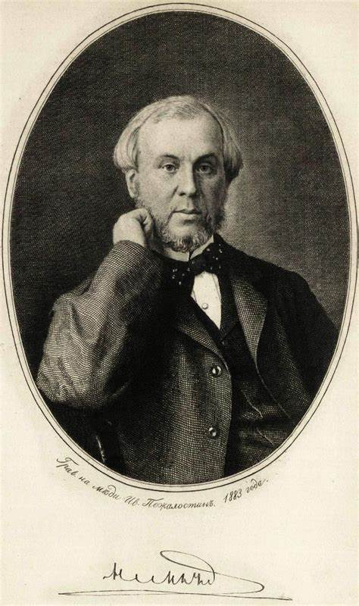
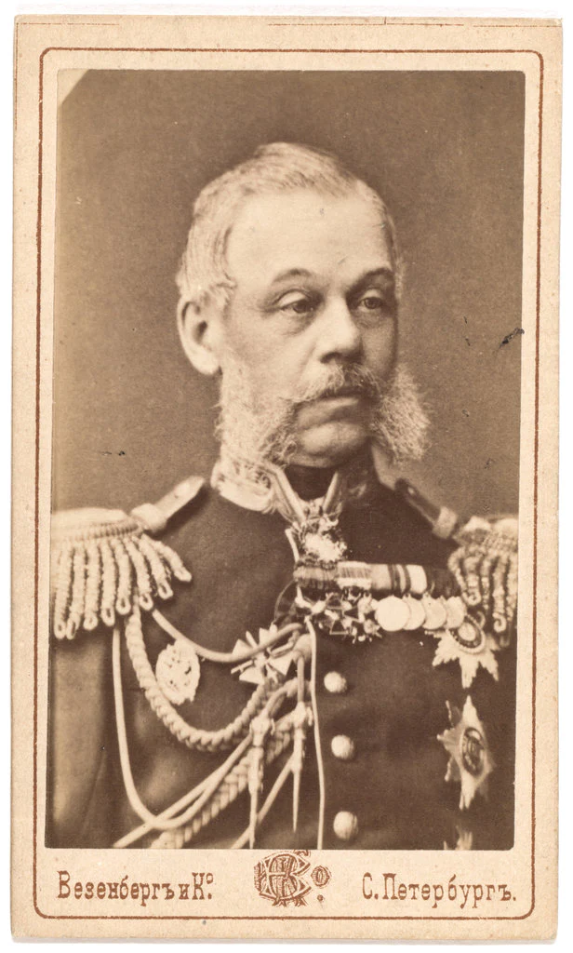
The main characters… Throughout the narrative (story) of Russia there have been many significant characters and groups which have had consequences on the events you are studying. Historians have different views or interpretations on their consequences and significance and you will need to know these to succeed at your exams; or to really understand the issues and events which affected Russia’s journey.
The Milyutin brothers (Nicholas & Dmitri) | Tsar Alex II’s reformers
Key facts… 2 of the most influential reformer officials of Alexander II’s reign. Nicholas was driving force behind the emancipation of the serfs – had gained praise for reforming municipal govt of St Petersburg. Nicholas Milyutin was dedicated and believed it was important to serve the state – more interested in honesty than promotion. 1858 Nicholas became Deputy Minister of the Interior. In 1859 – apptd to Editing Commission drawing up statutes for emancipation. He was skilled at seeing how to administer big legislation and convincing opponents but after emancipation he was dismissed by Alex II to appease conservatives as he was seen as too liberal. Dmitri had travelled Europe and became convinced of need to reform Russia. Dmitri wrote and spoke about importance of statistics to military – had been in army himself. Dmitri was more conservative than his brother but did free his own serfs before the emancipation of 1861. Dmitri became War Minister in Nov 1861 and initiated a range of reforms for next 20 years e.g. universal conscription and reduction in service to 15 years.
 | Summary… From 1861 to 1866 there were a series of reforms which were part of Alexander II’s attempt to modernise Russia to preserve the Tsarist autocracy. Historians differ over motives, extent and consequences of the reforms to serfdom, military, judiciary and education but all can possibly find common ground on the importance of the Milyutin brothers to drive and organise the reforms. They served the Russian state effectively and although Nicholas was accused of being too liberal, both essentially wanted to preserve the Tsarist autocracy by modernising. | Summary… From 1861 to 1866 there were a series of reforms which were part of Alexander II’s attempt to modernise Russia to preserve the Tsarist autocracy. Historians differ over motives, extent and consequences of the reforms to serfdom, military, judiciary and education but all can possibly find common ground on the importance of the Milyutin brothers to drive and organise the reforms. They served the Russian state effectively and although Nicholas was accused of being too liberal, both essentially wanted to preserve the Tsarist autocracy by modernising.

Slide 10
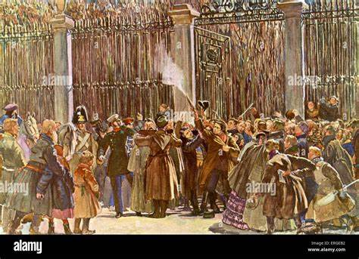
The main characters… Throughout the narrative (story) of Russia there have been many significant characters and groups which have had consequences on the events you are studying. Historians have different views or interpretations on their consequences and significance and you will need to know these to succeed at your exams; or to really understand the issues and events which affected Russia’s journey.
Karakazov | The near miss 1866.
Key facts Former student = Dmitri Karakazov – belonged to one of new revolutionary groups in Russia in 1860s. 1866 – narrowly missed the Tsar with a pistol shot. Conservatives saw this as evidence that reforms had gone too far. Liberals and some historians might suggest reforms not enough – broken promises – therefore revolutionary groups grew. Karakazov’s attempt and the Polish Revolt of 1863 possibly pushed the Tsar to remove reformers and appoint conservatives such as Shuvalov.
 | Summary… Historians and Russians at the time might disagree about whether reform led to revolutionary action or whether it prevented more at the time, however K’s attempt on Alex II’s life had an impact on his approach.
Land & Liberty and The Populists | Rebellion, revolution and further repression.
Key facts… Growth in radical movements in 1860s e.g. nihilists who looked at living differently – questioning expectations of society. Higher educ reforms increased discussion of liberal & radical ideas Relaxed censorship up to 1866 increased journals etc for people to read. Most notable of groups of 1860s = Land & Liberty – wave of repression after 1866 may have increased interest in opposition groups as people felt antagonised. 1870s – new group = The Populists or narodniks – inspired by writings of Peter Lavrov. People would live as peasants as they believed the commune could solve the probs of Russia. Many arrested as the more conservative peasantry did not welcome these strangers. Two big trials in 1877 – trial of the 50 & trial of the 193. Many got light sentences by judiciary but when govt involved it sent them to Siberia. Land & Liberty reformed, centralised and organised cells. Had a peaceful wing called Black Partition and a more violent branch called People’s Will. People’s Will sentenced Tsar to death in 1879. Did these groups lead to more repression or further reform such as abolition of 3rd Section by Loris Melikov.

Slide 11
The main characters… Throughout the narrative (story) of Russia there have been many significant characters and groups which have had consequences on the events you are studying. Historians have different views or interpretations on their consequences and significance and you will need to know these to succeed at your exams; or to really understand the issues and events which affected Russia’s journey.
Loris Melikov | Russia’s Reformer?
Key facts... Last years of Alex II’s reign – lots of terrorism. Attempts made to blow up royal train & dining room of Winter Palace. 1880 Mikhail Loris Melikov given job of head of special commission with measures to restore order. 31,000 people were put under police supervision. Big crowds cheered Tsar at 25th anniversary of accession BUT many in R bitter about increased repression. Loris Melikov as Minister of the Interior thought the Tsarist regime needed to rebuild trust and be more responsive to its needs. Melikov tried the following reforms… 1. Abolished the 3rd Section 2. Proposed more civil rights and make it easier to acquire land. 3. proposed that elected representatives of zemstva form an elected body to make laws. Alexander gave preliminary approval but was assassinated on 1st March 1881.
 | Summary… Was this a missed opportunity for the Tsarist regime to reform and regain popular support? Was this an opportunity to prevent continued growth and activity of revolutionary groups? Did the Tsar really mean to give support to Melikov’s suggestions and would he have gone through with them fully in a climate where nobles felt the regime was being threatened by increasing terrorism and extremism. Did the “desperate need for fundamental reform” (Carl Watts) really happen? Did the modest reforms cause revolutionaries to have more confidence and use more extreme methods?

Slide 12
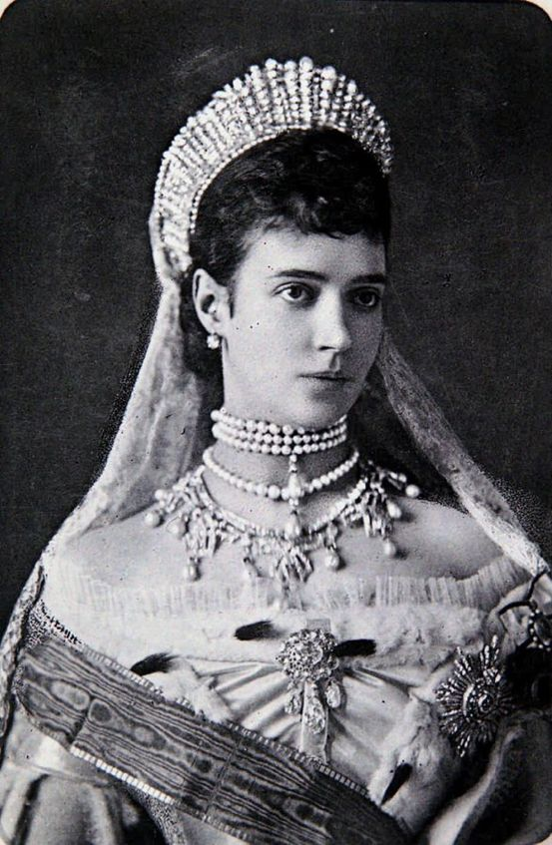
The main characters… Throughout the narrative (story) of Russia there have been many significant characters and groups which have had consequences on the events you are studying. Historians have different views or interpretations on their consequences and significance and you will need to know these to succeed at your exams; or to really understand the issues and events which affected Russia’s journey.
Maria Fedorovna | A popular Tsarina?
Key facts… Was Alex III’s brother’s fiancée but when he died Alex III married her Real name = Maria Sophia Fredericke Dagmar She was daughter of the King of Denmark Popular & successful Grand Duchess and Empress. She was patron of hospitals, girls’ schools, orphanages and The Russian Red Cross She tended to injured soldiers during the war with Turkey 1877-78 Compensated for her husband’s awkwardness in high society by being sociable Alex III was faithful to her throughout his reign Alex gave her a jewelled egg every Easter = Faberge egg
 | Summary… A popular Tsarina was a very important aspect of Tsarist autocracy. If the Tsar was the father of the people who they trusted to make the right rules and lead them successfully in wars, then the Tsarina would be the mother who would care for the people. Maria Fedorovna was an example of how a Tsarina could affect people’s loyalty and respect for the autocratic regime. She was a popular patron (or should that be matron) of many organisations to look after the people; as in the traditional role of a mother. She seemed to relish her role and set an example of the perfect Tsarina according to Russian orthodox autocracy. As you study the course maybe compare her to Nicholas II’s wife.

Slide 13
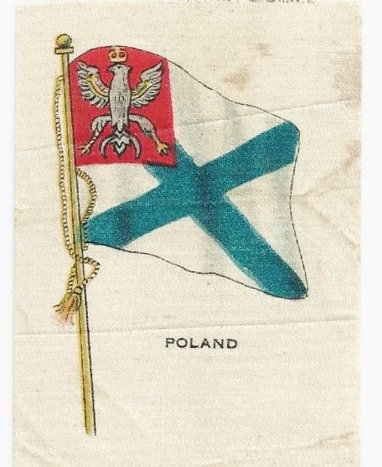
The main characters… Throughout the narrative (story) of Russia there have been many significant characters and groups which have had consequences on the events you are studying. Historians have different views or interpretations on their consequences and significance and you will need to know these to succeed at your exams; or to really understand the issues and events which affected Russia’s journey.
Ethnic minorities in Russia? | Dangers of Russification?
Key facts… Russia is and was huge. USA can fit into it 2.5 times and UK 90+ times! In such a huge area there is bound to be huge ethnic variation and therefore potential division – possibly difficult to keep together. From Baltic to The Black Sea Russia = 1/6 of world’s land surface. There are over 100 nationalities in the Russian state which expanded massively since Peter The Great in 18th C. 50% of Russians were not Russian! 1863 Polish Revolt – Poland had been a strong, independent nation but was under Russian control in 19C. This revolt worried authorities in Russia – could destabilise whole state. After the revolt land was taken from Poles and given to Russians. Polish language was banned and Poles replaced on railways. Poles resented Russian rule and were one of 1st groups to take advantage of 1905 Revolution. All nationalities had to adopt Russian as official language, culture and customs. Orthodox Church was official religion of all in Russia. RUSSIFICATION!!! Ukraine had been absorbed by Russia and many Russians settled there. There was a lot of resentment but fewer uprisings. Jews – 5m or so Jews lived in what was known as the Pale of Settlement. After the 1863 Polish Revolt Jews had rights restricted and Alex III supported prejudice and pogroms against the Jews in the 1880s. Nicholas II was an outright anti-semite. Many of the intelligentsia and leaders of revolutionary groups came from Jewish background e.g. Trotsky.
 | Summary… Russia was a difficult country to rule. This justified autocratic government to some who believed that people needed control and authority to rule such a diverse nation. As a result of the autocratic approach and favouring Russian racial groups over nationalities which were proud of their heritage, resentment grew and could be a major contributing factor to revolutionary thought and action.

Slide 14
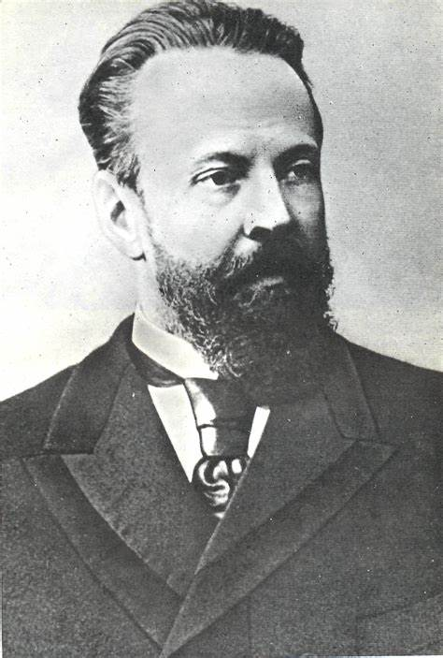
The main characters… Throughout the narrative (story) of Russia there have been many significant characters and groups which have had consequences on the events you are studying. Historians have different views or interpretations on their consequences and significance and you will need to know these to succeed at your exams; or to really understand the issues and events which affected Russia’s journey.
John Hughes, Sergei Witte | The economic genius(es)?
Key facts… John Hughes – Tsar Alexander II began industrialisation in Russia. 1868 Alex II invited John Hughes to see what could develop with modern methods of iron and steel production. Huge works were made in the Donbass region. He had patents for arms and armour and set up The New Russia Company Limited with 300k from British investors. His sons took over the works and this expanded massively in 1890s. Eventually taken over by Bolsheviks to become one of largest metallurgical centres in USSR. Sergei Witte – Alexander III rejected western political ideas but wanted a stronger more westernised industrial economy to sustain the Tsarist regime. This was tricky as R did not have an entrepreneurial middle class like Britain or France. Appointing Sergei Witte as Finance Minister from 1892-1903 was a real turning point. State sponsored heavy industry – coal iron and steel as an impetus he would focus… Development of railways to use heavy industry and then serve it High taxes (tariffs) on foreign goods Foreign loans (esp from France) and investment. Gold standard for the rouble. Raise tax rates Increase exports of grain even in tough times. The scale and direction and energy he brought gave an oomph to R industry. Dominated Russian politics, had a huge budget but although he was a strong and influential character some mistrusted him – especially conservatives who were jealous of power and influence he held. He was a firm supporter of autocracy and served as PM as a result of negotiations with Japan after Russo-Japanese war. He secured vital loans which prevented Nicholas II going bankrupt, and persuaded Nicholas to agree to concessions of the October Manifesto.
 | Summary… Up to 1900 Witte’s economic policies seemed to be working. The 1899 global economic crash had a huge impact on its success as foreign investment would shrink. There was also a slump in coal, oil and metal production. There are many criticisms of Witte’s policies such as the lack of focus on improving agriculture, and using too much of budget to pay foreign debt. However, he was a stabilising force for the regime economically. Historians could disagree about whether Witte’s policies modernised Russia, did not go far enough to modernise it, or even led to the basis of a society where revolution was more likely to happen due to the social and political upheaval of industrialisation

Slide 15
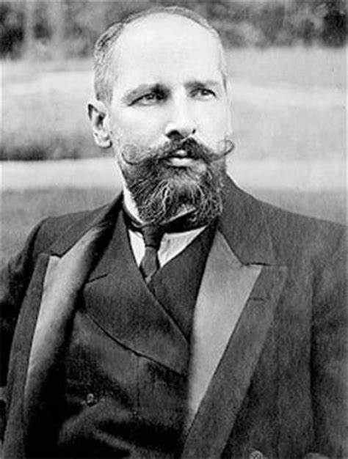
The main characters… Throughout the narrative (story) of Russia there have been many significant characters and groups which have had consequences on the events you are studying. Historians have different views or interpretations on their consequences and significance and you will need to know these to succeed at your exams; or to really understand the issues and events which affected Russia’s journey.
Peter Stolypin 1906-11 | The peasant prosperity PM???
Key facts… Historian Stephen Wheatcroft argues R had agricultural crisis with low yields 1880s. There was considerable rural poverty. However some historians see that production was increased in many agricultural areas and food supply and food consumption per head increased with the exception of bad harvest 1891-2 & revolutionary years of 1905-7. Some change and progress in farming even in commune rotation systems with increase in potato crop and also more entrepreneurial farming. Reports on impact of famine of 1891-2 mostly showed the very worst affected areas and peasants which influenced government to make reforms. Government was also concerned about peasant disturbances in the early 20th C. Peter Stolypin became PM in 1906 – believed peasant prosperity was the key to political stability and prosperity. He identified that antiquated methods used by commune (Mir) was holding farming back. Stolypin’s reforms of 1906 to 11 aimed to… Allow peasants to leave the Mir and consolidate strip farming into single units Reduce the power and influence of the Mir. Redistribute some of the land of the nobles. Help go ahead entrepreneurial peasants buy land from less effective / efficient farmers. Khutor (outside village) Otrub (inside village with communal land use) It was a slow process with a mixed response from peasants. Also wanted universal education – ref of 1908 – see Dumas Assassinated Sept 1911 – could he have been the man to save Nicholas II???
 | Summary... Abraham Ascher believes that given more time these reforms could have led to a more mild revolution than that in 1917. Judith Pallot argues the reforms were too narrowly conceived to really deal with key issues and to create a moderate, loyal peasantry. There are disagreements about how far R agriculture was changing byt by 1914-17 it could be said that the majority of farming was still traditional and old fashioned.

Slide 16
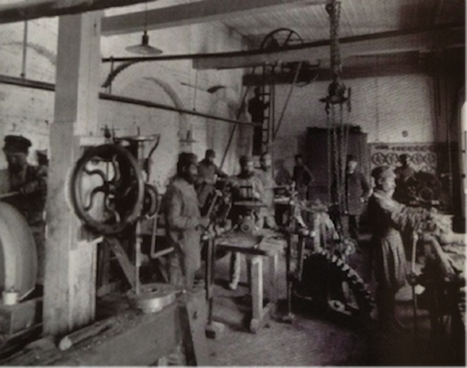
The main characters… Throughout the narrative (story) of Russia there have been many significant characters and groups which have had consequences on the events you are studying. Historians have different views or interpretations on their consequences and significance and you will need to know these to succeed at your exams; or to really understand the issues and events which affected Russia’s journey.
Industrial workers | A new Russian class?
Key facts… Modernisation would have a huge impact on Russian society. Industrialisation was the “modern” way to succeed as a country with an increase in population, means of production, raw materials and consumer amenities such as electricity. Huge population increase in Russia: 74m 1858, 128m 1897, 178m 1914 – this was bound to have an effect on R. 80% of people were still peasants but cities such as St Petersburg grew rapidly (x4) The new industrial workforce often still interacted with the countryside and it also dislocated the normal / traditional family structure – could a dramatic change in tradition spill into politics / traditional autocracy? Conditions in cities were grim with poor sanitation, shared accommodation, no privacy and infectious disease causing 1/3 of deaths e.g. typhus & cholera. Some positives – artels rented communal apartments, some workers attended music halls and tea houses, Museum of Assistance to Labour organised free lectures and discussions for workers (People’s Universities) Literacy rate was quite high – estimated 57.8% could read & write. However there were no real attempts to recognise or improve workers’ conditions – pay was roughly 1/3 of western equivalent, and there was only ever limited insurance. An articulate but deprived proletariat was developing in R by 1914! DANGER!
 | Summary… The new(ish) but definitely growing industrial class grew suddenly and dangerously. Workers were living and working in bad conditions which they understood and would want respect and recognition for. The autocratic Tsarist regime was perhaps too traditional to recognise the dangers of this or the need to improve to sustain the regime. The industrial workforce (proletariat) could become a threat to the Tsarist regime.

Slide 17
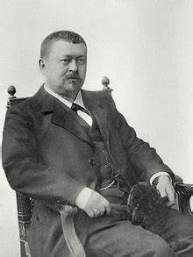
The main characters… Throughout the narrative (story) of Russia there have been many significant characters and groups which have had consequences on the events you are studying. Historians have different views or interpretations on their consequences and significance and you will need to know these to succeed at your exams; or to really understand the issues and events which affected Russia’s journey.
Timofei & Savva Morozov | Ruthless innovators?
Key facts… 2m “middle” groups – what we might call Middle Class / Bourgeoisie The Tretyakovs, Marmontovs and others came from quite humble backgrounds and made money from rail, textiles and banking – but remained loyal to the regime – very much Old Believers! Some of the middle groups branched out into newspapers and influenced intro of tram systems or organised better water supplies. Many did philanthropic (good / charity) works. By 1914 there were approx. 2000 innovators / entrepreneurs. Industrial & commercial groups did get together to discuss views and influence politics e.g. 1906 The Association of Trade & Industry. Professionals growing – e.g. teachers, dentists etc. They created professional associations which the regime became worried about e.g. Pirogov 9th congress ended with chaos and shouts of “down with the monarchy”. Timofei Morozov = an innovator who brought in foreign specialists to develop his textile machinery. He set up a ruthless system of fines for workers where they might have to pay 10% of wages back! This eventually caused a strike by 8000 workers which had to be broken up by the authorities. Savva Morozov – his son – started to improve conditions with housing and medical care – he even contributed to the funds of the Social Democrats and employed over 14,000 workers!
Savva Morosov... | Summary… There was not really a middle class developing in Russia but historians see the development of middling groups. There were around 2m of these and they were playing an important role in the development of society. Merchant industrialists, traders and professions grew as foreign investment grew. Businesses increased and there was even progress for women in these areas. Some professional organisations and individuals had liberal beliefs and although many industrialists and nobles wanted to preserve the autocratic regime, there were many middle groups who wanted change, progress and some who even demanded the end of the Tsar!

Slide 18
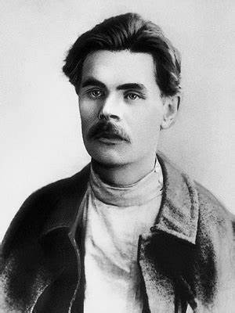
The main characters… Throughout the narrative (story) of Russia there have been many significant characters and groups which have had consequences on the events you are studying. Historians have different views or interpretations on their consequences and significance and you will need to know these to succeed at your exams; or to really understand the issues and events which affected Russia’s journey.
Writers and artists | Reflecting or influencing Russian culture?
Key facts… Literature boomed 1860s to 1880s – golden age of Russian literature e.g. Turganev and Tolstoy. Many writers wrote about the social and political issues of the time – Russian society; and were being read by an increasingly literate Russian society. Turgenev’s “Virgin Soil” 1877 where he portrays idealism of young populists to educate people to encourage a peaceful revolution to socialism. Not all revolutionary – after his death sentence for rev activity Dostoyevsky turned to the Orthodox Church and rejected revolution in favour of the uniqueness of the Russian soul! Tolstoy’s War & peace – epic – he had fought in Crimea and often increasingly referred to social conditions and corruption in R society. Chekhov’s Cherry Orchard = writing about increasing Middle Class – Orlando Figes wrote that he was embracing cultural forces emerging in Moscow on eve of 20th C Maxim Gorky = one of the most read writers – especially by workers. He was a champion of the poor and the oppressed esp as came from harsh “Childhood” (1913) The arts = 13 artists rebelled against Academy of Art & formal style – called selves the Wanderers. Were not involved in rev activity but reflected social probs in art. Abramtsevo’s artists’ colony = Russian avant-garde = art which reflected more modern and abstract thinking.
Maxim Gorky – a truly great writer | Summary… The arts became an important influence on thinking in Russia. An autocracy depends on obedience without question, and trust in a leader whatever the situation. Art can affect the way people think, and if people were thinking more about their condition (or that of others) then that could lead to a questioning of the autocratic ruler (Tsar). This combined with increasing literacy of workers in the city could influence the aims of protest. Combined with political own goals such as Bloody Sunday, this could sway groups from having economic demands to more political demands over time.

Slide 19
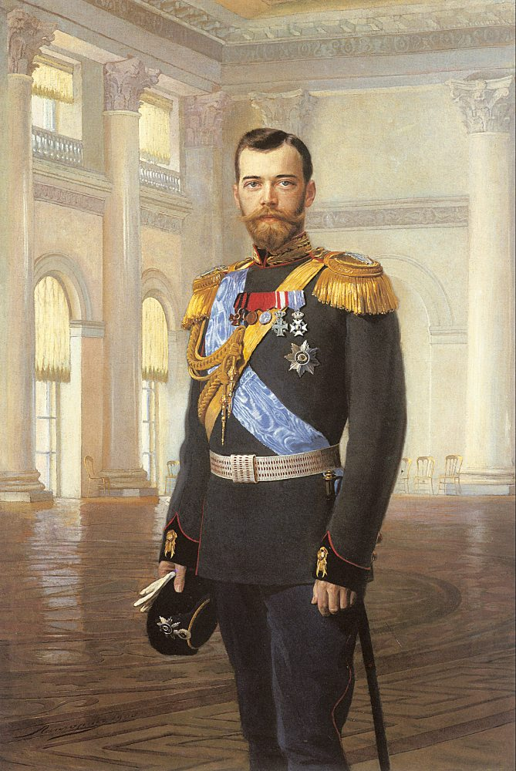
The main characters… Throughout the narrative (story) of Russia there have been many significant characters and groups which have had consequences on the events you are studying. Historians have different views or interpretations on their consequences and significance and you will need to know these to succeed at your exams; or to really understand the issues and events which affected Russia’s journey.
Tsar Nicholas II | Incompetent control freak?
Key facts… b 1868 d July 17th 1918 Believed completely in Tsarist autocracy Influenced (like his father Alex III) by Pobedonostsev Well educated & charming but poor self belief – did not believe he could rule as well as his father – could command respect but lacked training and experience to be a true leader. Loving family man but narrow minded – prejudiced and anti-semitic. Heavily influenced by his wife Tsarina Alexandra. She argued against constitutional monarchy at critical moments. Loved the military and military life. Praised army regiments which put down disorder. Appointed members of family to high ranking army positions even if not able. Khodynka – at celebrations of coronation in May 1896 1400 people were crushed in rush for free beer and food. Nicholas attended a ball that night and was accused of not caring.
 | Summary… Abraham Ascher states “he lacked the personal drive and ambition to instill a sense of purpose and direction in the ministers and bureaucracy”. Even one of the ministers in government said anonymously that the Tsar was not even fit to run the village post office. Nicholas II often liked to take control of things but lacked the ability to get things done effectively or efficiently. Maybe he blurred personal life too closely to political life empowering his wife, or maybe he was a control freak without the ability to control! An example being taking control of the army in WW1.

Slide 20
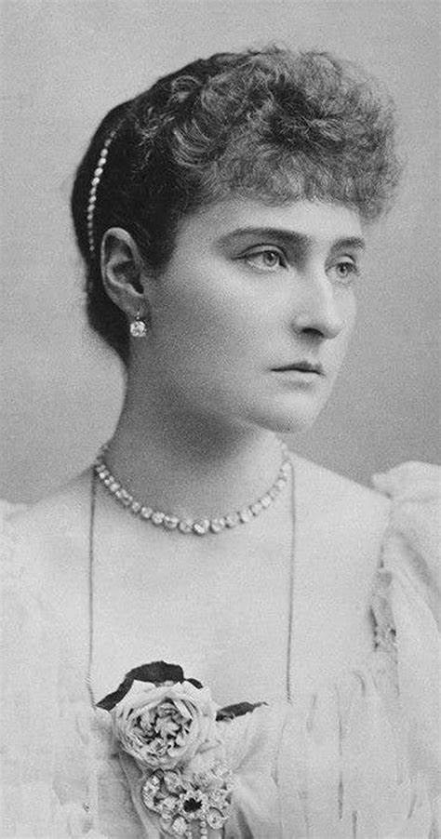
The main characters… Throughout the narrative (story) of Russia there have been many significant characters and groups which have had consequences on the events you are studying. Historians have different views or interpretations on their consequences and significance and you will need to know these to succeed at your exams; or to really understand the issues and events which affected Russia’s journey.
Tsarina Alexandra | True Russian or German spy?
Key facts… Alexandra was a German princess & Protestant (caused issues in WW1) Converted to Russian Orthodox Christianity and loved to learn R ways / culture Seen as strong willed and obstinate. She was an adamant (uncompromising) autocrat. Alexandra had a great influence on the Tsar which was not necessarily great! In WW1 she took on duties of state in Russia as well as working as a nurse to help WW1 soldiers (with her daughters) Put too much faith in Rasputin – believed he had powers from God to save their son – having a male heir was so important to Tsarist autocratic rule that her and Nicholas II became obsessed with this and gave Rasputin too much influence at Court – caused suspicion and raised anti-Tsarist thought and propaganda. Always advised Nicholas II to ignore protest and focus on autocracy – no compromise – he was influenced by her too much and may have been afraid of going against her due to his own lack of self confidence. Superstitious and genuinely believed in the faith healing abilities of Rasputin – many rumoured her to be having an affair with him (unlikely)
 | Summary… Alexandra is often compared to Maria Fedorovna. Is this a fair comparison. Tsarina’s had an important role in the Russian autocratic mindset but they were not really to interfere or lead politics and policy. However, it seemed that Alexandra was involved which may have been her or / and Nicholas II’s fault! Historians might vary on the extent of her influence but the common ground is that she did have influence on Nicholas.

Slide 21
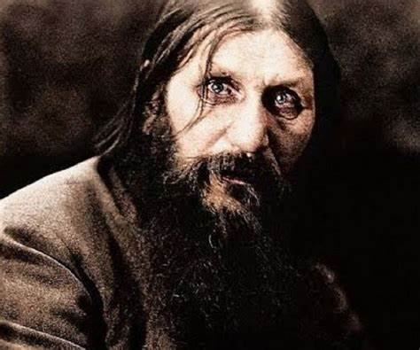
The main characters… Throughout the narrative (story) of Russia there have been many significant characters and groups which have had consequences on the events you are studying. Historians have different views or interpretations on their consequences and significance and you will need to know these to succeed at your exams; or to really understand the issues and events which affected Russia’s journey.
Grigory Rasputin | The mad monk?
Key facts… b 1869 murdered 1916 (by Yusupov & other nobles!) The mad monk? Unorthodox orthodox Christian – belonged to a sect which believed sin led to repentance. Often mistrusted but very much in favour with Tsar & Tsarina from 1905-1916! Real name = Grigory Yefimovich) Nov 1905 met Tsarina & Tsar in St Petersburg – Tsarina became convinced of magical healing powers of Rasputin. He seemed to be able to stop Alexei’s bleeding (haemophiliac) poss by hypnosis or herbs but Romanovs and many in nobility (especially women) believed he was linked directly to power of God! Orthodox Church mistrusted him but risked jobs if criticised. Accused of blasphemy – at the cost of the accuser! Had 3 children of his own and many affairs – sin to repent!!! Rasputin’s actions discredited the Tsar and Tsarina who became ever more secretive – people began to mistrust the clique and the influence the mad monk and Tsarina had on Nicholas II. Assassinated – many myths surround story – most quoted is Yusupov’s account = poisoned twice shot 3 times – came back after 1st shot and attacked him – dumped in river!!!
 | Summary… Where do we start with this character? Highly influential on the Tsarina and the Tsar, who later in WW1 became worried by influence Rasputin had on his wife! Historians will agree / consensus that he was influential but how far did his actions alienate an already alienated monarchy. Certainly Rasputin was a great asset for revolutionary propagandists, but not for the Tsar.

Slide 22
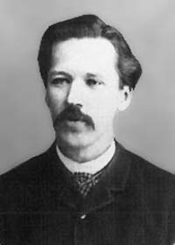
The main characters… Throughout the narrative (story) of Russia there have been many significant characters and groups which have had consequences on the events you are studying. Historians have different views or interpretations on their consequences and significance and you will need to know these to succeed at your exams; or to really understand the issues and events which affected Russia’s journey.
Sergei Zubatov | An unlikely reformer – police socialism?!
Key facts… b 1864 d 1917 Advocate of “police socialism” Was a radical student who lost place at Uni due to revolutionary politics Worked in a bookshop in 1880s distributing banned literature 1883 he became a police spy. 1895 he became head of Moscow section of the Okhrana. Sergei Zubatov was head of the Okhrana Believed that if you gave workers Trades Unions and Rights they would be more loyal – accept regime. 1901 he established 3 TUs in Moscow and used police to pressurise bosses to make concessions. 1903 the strike in Odessa became a General Strike and Zubatov was dismissed and put into exile. He committed suicide in 1917.
 | Summary… Historians disagree over the consequences and importance of Zubatov’s work. Christopher Read sees Zubatov’s work as an own goal, whereas Jeremiah Scheidermann suggests it was the only coherent labour policy they had. Is the Zubatov example reflective of the the inability of the regime to work to genuine reform inclusive of all people. Was this a great missed opportunity or a cause of increased radicalisation of the working classes.

Slide 23
The main characters… Throughout the narrative (story) of Russia there have been many significant characters and groups which have had consequences on the events you are studying. Historians have different views or interpretations on their consequences and significance and you will need to know these to succeed at your exams; or to really understand the issues and events which affected Russia’s journey.
Opposition groups 1895-1905 |  | Growth of opposition to the regime…
1. Liberals | 2. Socialist Revolutionaries |  | 3. Social Democrats
The Zemstva were seen as a seedbed of liberalism. They led to a class / group of people who were skilled in local politics. 1891-2 the famine emphasised the weaknesses of the bureaucracy of Russian autocratic government. This increased drive and demand for more constitutional change or at least involvement in decision making. R liberals were not like European liberals – they were NOT violent but just wanted reform. 1903 Union of Liberation was formed and was the major opposition to Tsarism before 1905. Mostly supported by middle class intelligentsia and progressive landowners and industrialists. | Grew from the Populist movement. Loose and varied in its beliefs and actions – some peaceful, some violent. The different groups were merged in 1902 into the SRP. However they were never really very centralised or well co-ordinated. 1st Congress in 1906. Between 1901-1905 they assassinated over 2000 govt officials. Their hope was that the peasants would rise up and then they could take land and divide it up. Main exponent = Viktor Chernov. Agitate, terrorise and assassinate. By 1905 50% of members were industrial workers. |  | George Plekhanov was the father of modern Marxism – he translated Marx’s work into Russian. In exile in 1880 but est’d the Russian Social Democratic Labour Party in 1898. By 1900 newspaper published = to write about Marxism = called Iskra (spark) Lenin was on the editorial board. 2nd Part Congress 1903 the party split into Bolsheviks and Mensheviks.
 |  |  | Bolsheviks Aka Majority. Lenin. Believed small no. of rev leaders and centralised cells would lead a revolution directly. Younger militant members. | Mensheviks Aka Minority Believed ther would be a bourgeoise govt at first and then workers would develop class consciousness. Mostly had a broader support and the intelligentsia – actually more M than B but M aka minority!!!
Summary… Opposition to Nicholas II and Tsarist regime accelerated. Was that caused by war, the personal rule of Tsar and Tsarina and the mistakes they made, the changes in R society or a more radicalised proletariat?

Slide 24
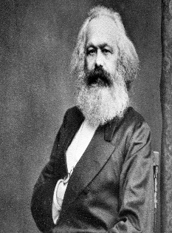
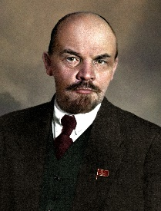
The main characters… Throughout the narrative (story) of Russia there have been many significant characters and groups which have had consequences on the events you are studying. Historians have different views or interpretations on their consequences and significance and you will need to know these to succeed at your exams; or to really understand the issues and events which affected Russia’s journey.
Karl Marx Influencer of Revolution?
Key facts… 1818-1883 German philosopher – lived and died in Great Britain – buried Highgate Cemetery. 1848 published The Communist Manifesto. Also published Das Kapital – his views on history and how it would develop. Highly influential on thinkers and revolutionary activists. The development of the working class would lead to a triumph of socialism. All value was created by human labour. In R there were Marxist reading circles and publications. Strikes were led with Marxism at their core. Marx was a determinist which meant he believed events and forces would influence change although he could accept some individuals could lead to it – men can lead change but cannot influence the circumstances themselves. Lenin developed Marxist theory into a revolution being led by a committed core of revolutionaries. Lenin believed revolution would happen during conflict between capitalist powers. Lenin did not believe the middle classes in R were strong enough to carry revolution forward.
Lenin Leader of Revolution…
Key facts… 1870-1924 Russian lawyer, revolutionary, politician and political theorist. Name = Vladimir Ilyich Ulyanov – from a reasonable background. 1st and founding head of state of Soviet Russia 1917-24 & the Soviet Union 1922-24 Born into a wealthy family – became revolutionary after his brother’s execution in 1887. Charismatic and dedicated revolutionary – Bolshevik. Was expelled from University for anti-Tsarist protests. Exiled to Siberia 1897. Joined Social Democrats in 1900. Considered as one of the most influential figures of the 20th C. Historian Robert Service states Lenin was an intensely emotional young man with an intense hatred for the Tsarist regime who developed an emotional attachment to his ideological heroes such as Karl Marx. Christopher Read emphasises how his personal belief and drive in his role as revolutionary – derived his legitimacy from his perceived truth of doctrine rather than popular mandate! Self imposed exile from 1900 – e.g. France (Loguivy) – although in exile was still great influence on rev activity. Returned to R in 1905 to witness revolution but did not get involved. Exile again from 1906-17 – did not want Bolsheviks to participate in Dumas. Saw his writings as plans for action e.g. What is to be done? 1902 & The State & Revolution 1917. Returned to R in 1917 and led Bolsheviks after Feb 1917 to displace the provisional government. 1917-20 played a key role in defeating opposition during the civil war. On the editorial board of SD newspaper called Iskra (spark) The split between Bolsheviks and Mensheviks at the 2nd Party congress of 1903 was due to Lenin’s abrasiveness.

Slide 25
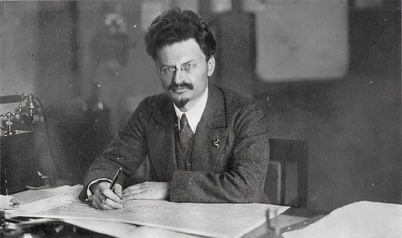
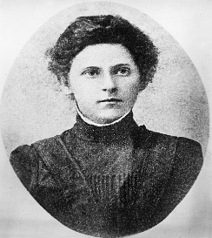
The main characters… Throughout the narrative (story) of Russia there have been many significant characters and groups which have had consequences on the events you are studying. Historians have different views or interpretations on their consequences and significance and you will need to know these to succeed at your exams; or to really understand the issues and events which affected Russia’s journey.
Leon Trotsky
Key Facts... 1879-1940 Real name = Lev Bronstein Arrested 1898 for revolutionary activity. Spent 4 ½ years in prison and exile in Siberia. Escaped in 1902 and stayed in London where he joined Social Democrats and worked with Lenin on Iskra (Spark). Returned to Russia during revolutionary year of 1905. Became leading spokesman of the St Petersburg Soviet. After a 2nd spell in exile he escaped again in 1907. He was in the USA when 1917 revolution broke out and eventually was admitted to Bolshevik Party after a spell with Mensheviks. Revolutionary agitator and leader 1917 – commissar of foreign affairs and of war 1917-24 Exiled after power struggle with Stalin in 1929 until assassinated by a Stalinist agent in 1940.
Vera Zasulich
Key facts… 1849-1919 Russian Socialist Activist – daughter of an impoverished noble – worked as a clerk in St Petersburg and became involved in radical politics, and taught literacy classes for workers. 1869 she was imprisoned for revolutionary activities – released in 1873 and joined anarchist group in Kiev. 1878 - Trepov Incident – Colonel Trepov flogged a prisoner for failing to remove his cap. There was a plot to kill Trepov but Zasulich was 1st to act – shot at him and put on trial. Sympathetic jury found her not guilty – her lawyer effectively made it seem like the govt and Trepov were on trila!!! Later renounced violence and was opposed to assassination of Tsar Alexander II. Exiled in London but joined Mensheviks in 1903. She was appalled by the Bolshevik takeover of 1917.

Slide 26
The main characters… Throughout the narrative (story) of Russia there have been many significant characters and groups which have had consequences on the events you are studying. Historians have different views or interpretations on their consequences and significance and you will need to know these to succeed at your exams; or to really understand the issues and events which affected Russia’s journey.
The Dumas Pretend parliaments or real progress?
1st Duma April 1906 at Tauride Palace – Russia still in turbulent state after 1905 revol! Kadets 182/448 seats. Liberals were annoyed that Tsar had restricted reforms – friction between Duma & Tsar. Tsar dissolved the Duma saying it was hostile & unworkable. 200 Kadet deputies went to Finland and said R’s should not pay tax – resulted in them being banned from elections. | 2nd Duma Still big hopes for change and voter turnout was good – 70% of workers eligible in St Petersburg. Revolutionary parties (except for Bolsheviks) took part – Trudovniks 104 seats and even Kadets 91 seats. More radical – became known as “The Duma of National anger” After 3 months the Tsar disbanded it saying he had uncovered a plot by the Social Democrats to assassinate him!
3rd Duma Changes were made to the electoral system with bias to upper social classes. Became known as Stolypin’s coup as nationalists, peasants and workers influence were reduced and Octobrists (154 deputies) and Rightists (147) dominated the Duma. This Duma showed there could be co-operation with govt and some debate eg over Stolypin plan to extend zemstvo by 1911 – but did it really refelect needs of the people. | 4th Duma Interrupted by outbreak of WW1. Stolypin’s reforms would have continued – eg support for education reforms of 1908 did – other proposals such as reform of Orthodox Church did not as held up by war. 4th Duma was critical of govt clampdowns on social unrest such as Lena goldfields massacre. Met briefly but importantly in 1915 & 16 – 1915 real opportunity for Nicholas II to work with them but suspended it.
Summary… Nicholas II had no real intention of changing autocratic rule but did allow the Duma after the 1905 revolution which did not overturn the autocratic rule of Tsars but did lead to some change. People were more politicised after 1905 and maybe the Dumas were a missed opportunity to reflect that. The Tsar diluted the Duma – issued The Fundamental Laws in April 1906 basically saying how the Tsar was the legislature, and added a 2nd chamber with half the the members chosen by him.

Slide 27
The main characters… Throughout the narrative (story) of Russia there have been many significant characters and groups which have had consequences on the events you are studying. Historians have different views or interpretations on their consequences and significance and you will need to know these to succeed at your exams; or to really understand the issues and events which affected Russia’s journey.
Could Stolypin have saved the Tsar? | A return to Stolypin…
Also see slide 15 for intro to Stolypin. Key facts… Born 1862 (Dresden) - Assassinated in the theatre at Kiev in 1911. Daughter killed by rev terrorists in 1906 at a public reception he was holding at his dacha. He was an ardent monarchist who hoped to strengthen Tsarist authority by modernising the economy and reforming Russia. Prime Minister & also Interior Minister 1906 to 1911 – unusual combination of both posts. His reforms stopped after his assassination & Nicholas II returned to yes men appointments of conservatives in government. Major agrarian reforms – see slide 15. He allowed the deputies from the Duma who went to Finland and issued the Vyborg Manifesto to return to Moscow without punishment. Tolstoy and Dostoyevsky criticised the land reform and said land should just be owned privately!!! Wanted to ban Rasputin from St Petersburg due to propaganda and rumours of sexual activity with Tsarina in 1910. Nicholas II had an opportunity to work with Stolypin to introduce real reform but never backed him in a significant way. Some historians see Dumas as big change others see as the Tsar reasserting authority of autocracy by ignoring genuine debate and democracy.
 | Summary… Stolypin was the only PM in his era who saw working with the Duma as a partner could build a strong Russia. With the reform of electoral system of 2nd Duma the Duma became too conservative = own goal. He also did use article 87 of the Fundamental Laws to push legislation through when Duma not sitting – therefore there are contradictions. It was a difficult task for Stolypin as he fought 2 fronts = cons & rev.

Slide 28
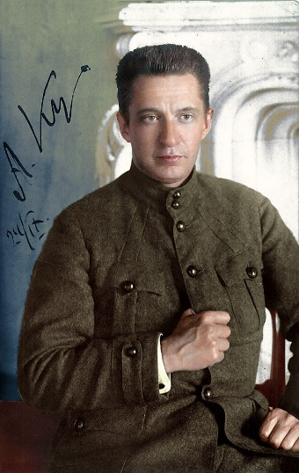
The main characters… Throughout the narrative (story) of Russia there have been many significant characters and groups which have had consequences on the events you are studying. Historians have different views or interpretations on their consequences and significance and you will need to know these to succeed at your exams; or to really understand the issues and events which affected Russia’s journey.
Alexander Kerensky - An impossible task – or own goals?
Key facts… 1881-1970 – lawyer and revolutionary who led R provisional government from July to Nov 1917. Generally a well liked and charismatic individual. After abdication of Tsar Nicholas II a provisional government was set up which was to be temporary but to bring in new constitution and new elections. Unfortunately the Petrograd Soviet also wielded huge power and therefore the situation was really a power sharing between the 2. Kerensky was a link between the 2 – and enabled them to work together – he was deputy ldr of the Petrograd Soviet and also a minister in the Provisional Government. Real power lay with the Soviet who under Soviet Order No 1 stated all soldiers would follow orders of Prov Govt IF the Soviet agreed! There was a period of calm “honeymoon” period – even Lenin called R the free-est country in the world at that point. However the “July Days” of 1917 were a period of violence and trouble as Bolshevik forces rose up with sailors from Kronstadt demanding that the Soviet take total power. Lenin did not lead them and went back to Finland which led to some crackdowns by Kerensky and PG. Kerensky agreed to aggressively continue war and planned a huge offensive which went well for a few days and was then pushed back. R still suffered same supply and leadership issues. WW1 became more unpopular and the PG suffered for its policy. The Kadets moved further to the right and there was a drive to re establish law and order – Prince Lvov resigned as PM – the upper classes started to lose faith in the PG. This resulted in the Kornilov affair – Kornilov was seen by the right as poss ldr of a coup. He was appointed by K as Supreme Cmdr of armed forces but tried to take troops to Petrograd to take over from the Soviet. He was arrested and Kerensky was further discredited. Rumours in Oct that K was sending radical troops away and might send Soviet troops to the front! He tried to close 2 Bolshevik newspapers and this gave Bs excuse to take over. Kerensky escaped in an American car just before storming of winter palace of Oct 25-6 1917.
 | Summary… Could Kerensky have built a modern democratic Russia? Think about the factors and events which continued or were exacerbated which prevented him from keeping control. Did he make some serious mistakes and own goals such as Kornilov – could he have done anything different? Kerensky was certainly an able man but could anyone at that stage have preserved democracy?

