Slide 1
New Beginnings
Welcome to Chellaston Academy
Where is it?
What will it look like when you get here?

Slide 2
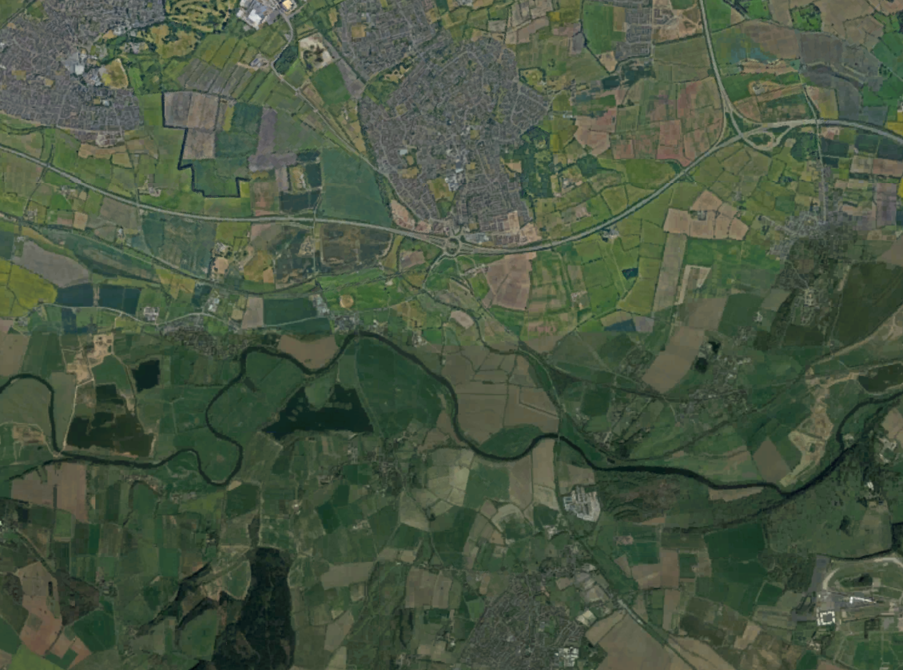
Where is Chellaston Academy? Can you guess where it is?
Link to Google Earth
Notes:
Here is a good opportunity to have a play with google earth or google / bing maps. You can find Chellaston Academy (use the search function if needed) and then find your school.

Slide 3
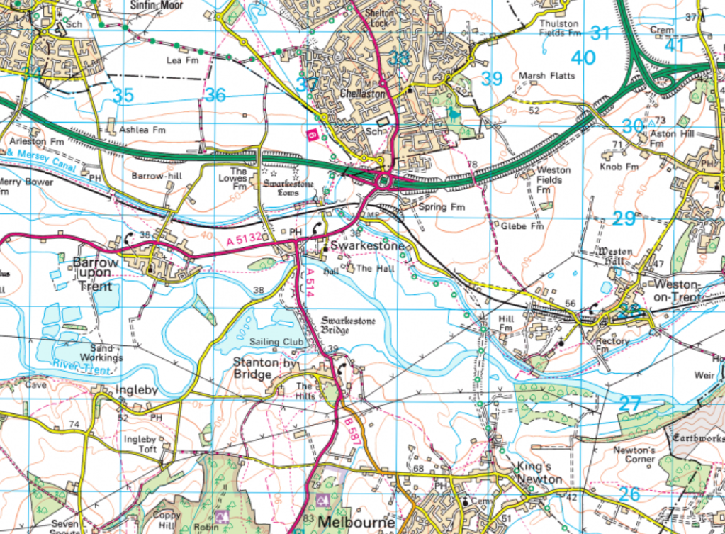
Where is Chellaston Academy? Can you guess where it is?

Slide 4
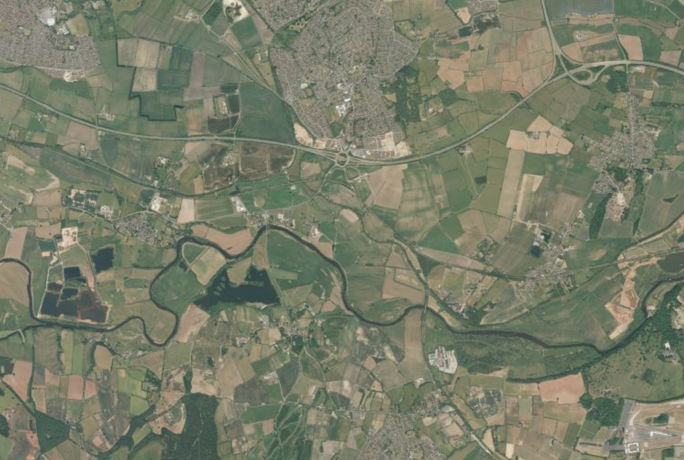
Where is Chellaston Academy? Can you guess where it is?
Can you see where your school is?
What about where you live?

Slide 5
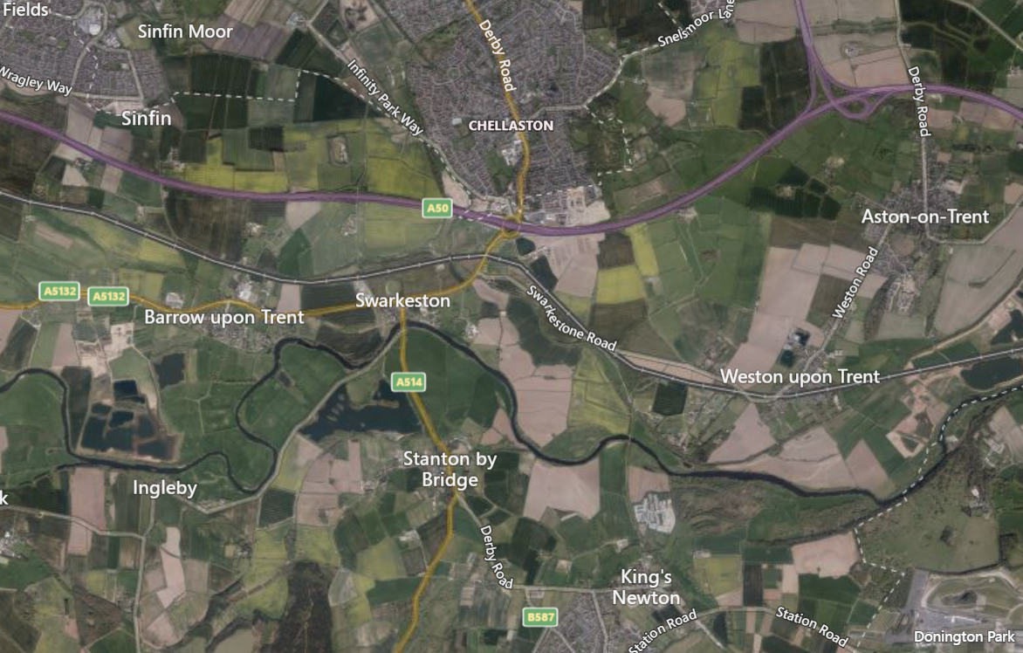

Slide 8
Learning your way around the school.
Chellaston is going to be a lot bigger than your old school
You will move to lots of different classrooms each day
You will get to know the quickest way around the school and how to find different classrooms.
Have a look at the following photo.
What do you think of your new school?
How big is it compared to where you are now?
What do you like about it?
What do you not like about it?

Slide 9
Link to Google Earth
Notes:
This image is taken from google earth. Again you can zoom in and use the 3d function in the bottom right corner and have a good explore. What do you think about the buildings, how does it compare to where you are now?

Slide 10
Finding your way around Chellaston Academy
To help you find your way around your new school you will be given a map and a timetable.
Your timetable will tell you what subject you have, the teacher you will have and what room you will be in.
The map will show you where all the rooms are – but you will have to know how to use the map to find your way around.
Don’t worry though, you can always ask for help if you need it.

Slide 11
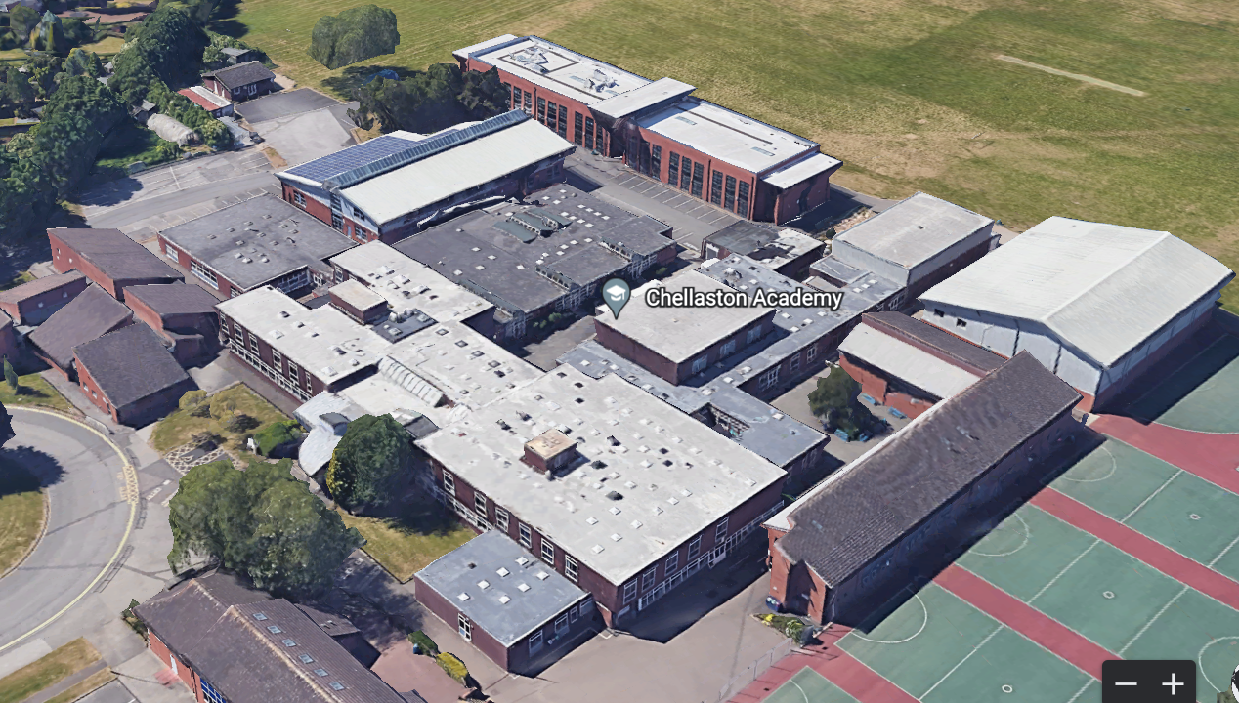
How can we turn this into something that will help us find our way around?

Slide 12
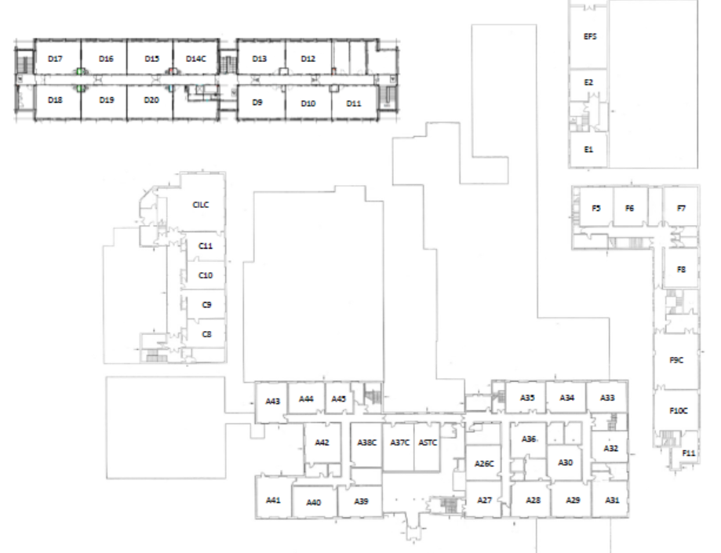
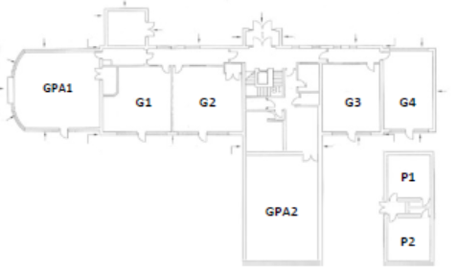
Ground Floor
First Floor (up the stairs)
 | Rooms | Subject | Rooms
English | F1-F8, G1-G4 | Geography | D1-D5
Maths | C8-C11, D15-D17 | Philosophy | A30-A34
Science | A11L-A14L, B1L-B7L, C1L-C2L | Computing | A9C,A8C, A25c, A37C, A38C, D7C,D14C
History | D9-D13 | Art and Technology | A2W-A5W,A18-A24W
 |  | Languages | A39-A44
Use different colours for each subject and then colour in each of the classrooms in the correct colour.
Notes:
This can be printed out

Slide 13
Create a map of your route from your home/school to Chellaston Academy
Draw a simple map which shows some of the key features you will pass and see on your way to Chellaston Academy
Can you add road names, key buildings, shops, etc.

Slide 14
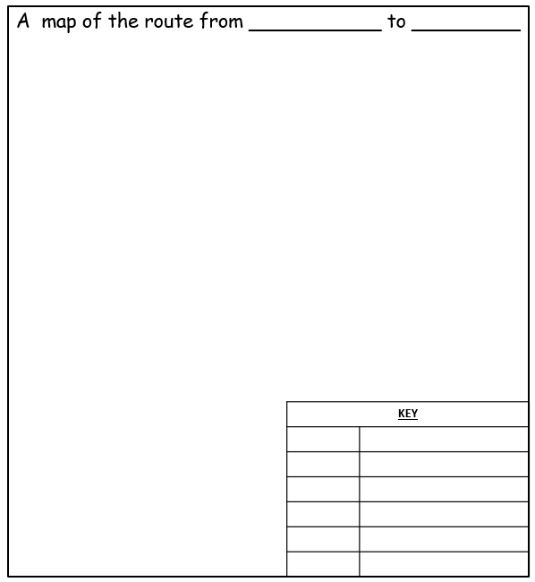
New Beginnings
Making a Map of the Route
In the frame below, draw a map to show the route you will take from your house to Chellaston Academy.
Before you draw your map, you could walk the route, get someone to drive you there or look at internet maps such as google maps. Note down any features you see; areas of housing, important buildings, landmarks etc.. You can then mark the features on your map using symbols. Don’t forget that you must complete the key to show what your symbols mean. You should also name the main streets and give your finished map a title.

Slide 15
New Beginnings
Making a Map of the Route
In the frame below, draw a map to show the route you will take from your house to Chellaston Academy.
Before you draw your map, you could walk the route, get someone to drive you there or look at internet maps such as google maps. Note down any features you see; areas of housing, important buildings, landmarks etc.. You can then mark the features on your map using symbols. Don’t forget that you must complete the key to show what your symbols mean. You should also name the main streets and give your finished map a title.
Notes:
To print out if you want to use this

Slide 16
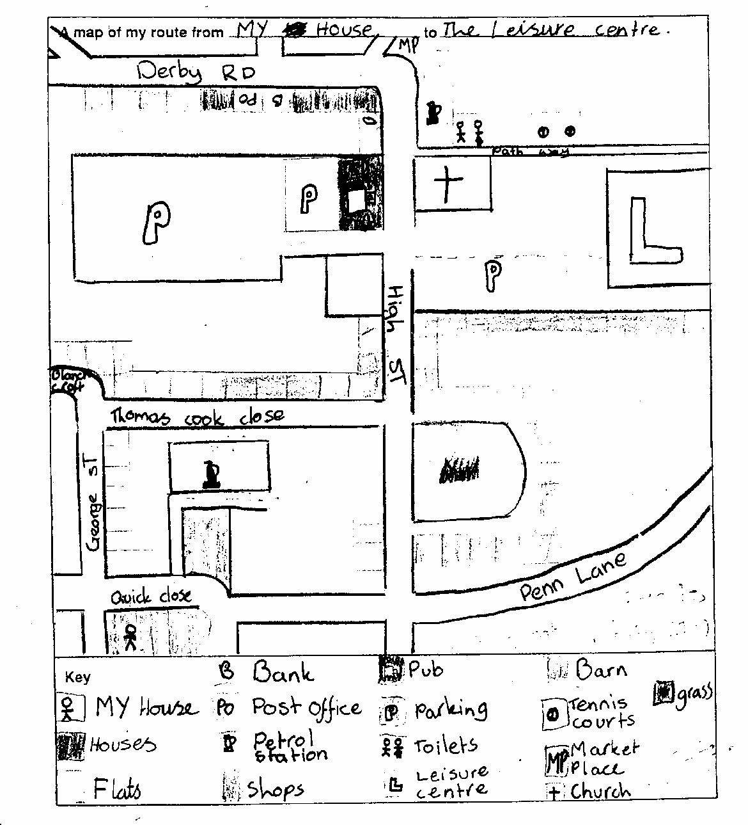
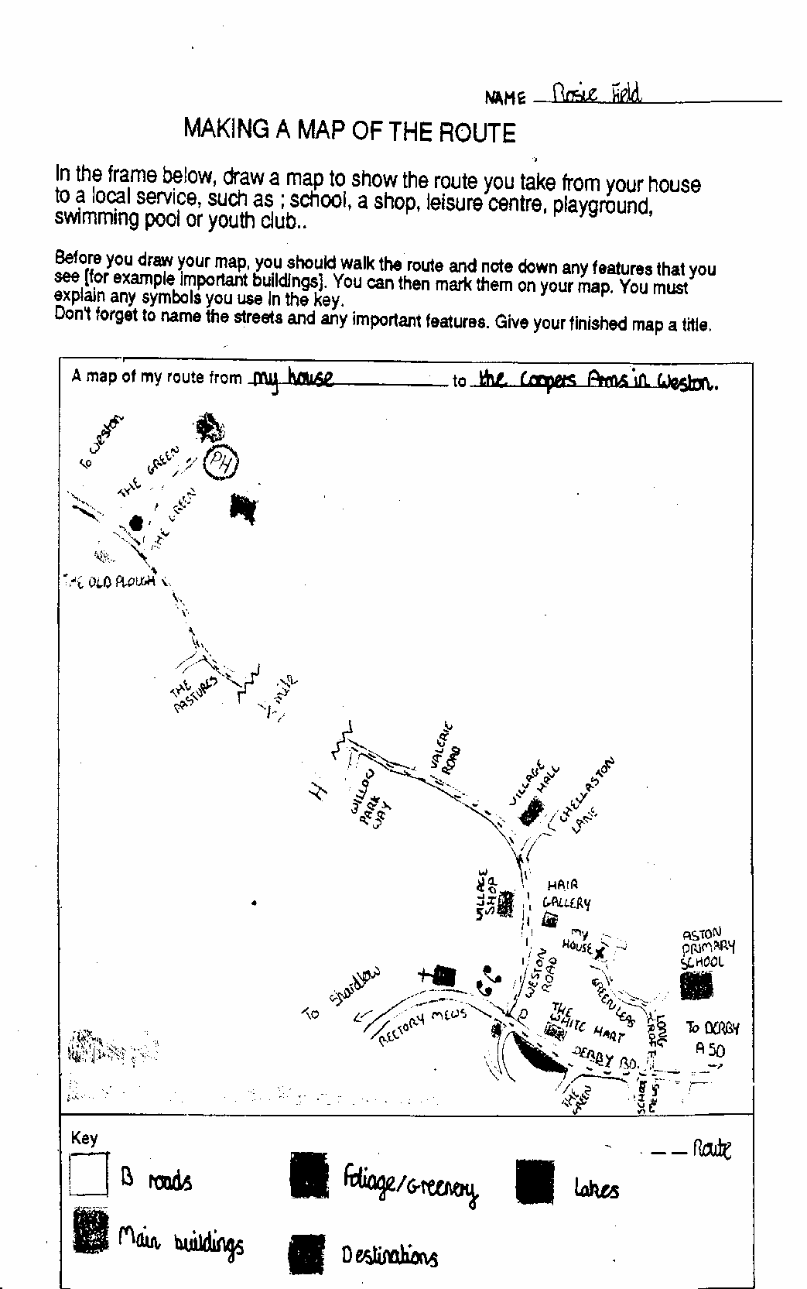
What is good about these maps ? How could they be improved ?
Notes:
These are sample of past work. – Colour is a key improvement.

Slide 17
