Slide 1
Health & Social Care Level 3 Diploma Year 12 Taster Session
https://youtu.be/MCJRKYoUPsg
June 2023
Notes:
Depending on your GCSE results, calculated this year, by the exam board, you will know which Level HSC course you can then do

Slide 3
Qualification Structure
This is a double or single option course, leading to an OCR Level 3 Cambridge Technical Diploma in Health and Social Care – equivalent to two A levels
You will have the opportunity, through applied learning, to develop the core specialist knowledge, skills and understanding required, for working in the health and social care sector.
You will have two teachers, teaching you different units but this is planned and organised.
Notes:
You will have 15 hours of Health & Social Care, 2 hours GCSE Maths and 2 hours GCSE English plus 2 sixth form study centre hours

Slide 4
Qualification Structure
The Extended Certificate has 4 mandatory units that you will be covering.
These are;
Units 1- 60 GLH – Building positive relationships (c/w)
Unit 2 – 60 GLH - Equality, Diversity & Rights in HSC (exam)
Unit 3 – 60 GLH - Health ,safety & security in HSC (exam)
Unit 4 – 90 GLH - Anatomy & physiology in HSC (exam)
There are 2 optional units, which will be;
Unit 5 – 60 GLH - Infection control (course work)
Unit 6 – 30 GLH - Nutrition for Health (course work)
Notes:
One teacher is delivering the 4 course work units and the other will focussed on the exam assessed units

Slide 5
The Diploma has 7 mandatory units that you will be covering. These are;
Units 1, 60 GLH – Building positive relationships (c/w)
Unit 2, 60 GLH – Equality, Diversity & Rights in HSC (exam)
Unit 3, 60 GLH – Health ,safety & security in HSC (exam)
Unit 4, 90 GLH – Anatomy & physiology in HSC (exam)
UNIT 5, 60 GLH – Infection control (c/w)
UNIT 6, 60 GLH – Personalisation & a person centred approach to care ( exam)
UNIT 7, 60 GLH – Safeguarding (exam)
TWO CORE UNITS : which are:
Unit 13, 60 GLH –Sexual Health, reproduction and early years development
Unit 14, 60 GLH – The impact of long term physiological Conditions (c/w)
OPTIONAL UNITS, which will be;
Unit 10, 30 GLH - Nutrition for Health (c/w)
Unit 15 Promoting Health
Notes:
One teacher is delivering the 4 course work units and the other will focussed on the exam assessed units

Slide 6
Course Work Units
The internally assessed units, assignments, all work in the same way and you have 4 to complete
You will be taught the subject content and make notes in lesson, there will be areas for you to make notes in a booklet and other times you will need to have a note book.
After all the subject content has been delivered by your teacher, you will be issued with an assignment brief to complete based on the topic areas covered.
Notes:
Students must be responsible for their own sixth form kit, teachers or friends should not be made, to take that responsibility

Slide 7
Course Work Units
Once you are working on the assignment, your teacher is there to guide you but can’t give any more assistance on how to complete the unit, it will be your responsibility.
You will have a hand-in date for each assignment (we will make sure these are all displayed within the HSC classroom, emailed and in booklets)
You must hand in work on that date, always
I’ll repeat that, you MUST meet all deadlines ☺
Notes:
Students may benefit from a hardcopy diary or use their phones effectively to ensure deadlines are not missed

Slide 11
Managing the course
Teacher 1
Teacher 2
Assignment work
Content Learning
Meeting deadlines
Revising, exam practice
Resubmission improvements
Sit January exams
Meeting deadlines
May Resit opportunity
Notes:
Balancing out time and effective time management with organisation, will be a skill also required in sixth form

Slide 12
Course Work Units
Teacher 1 will then assess your assignment work and give you feedback, on whether or not you have met the assessment criteria, for Pass, Merit and Distinction
If you have attempted a P, M or D, but not quite met the criteria then you may have the opportunity to resubmit your improvements
You must meet this second deadline.

Slide 13
Exam Assessed Units
In Year 11 you had 8-10 GCSE’s to sit but this year, you only have 2, plus English and Maths GCSE.
The content will be delivered and you will make notes in your unit booklet and note book.
There will be mock exams to get you ready
You MUST revise and try your absolute best
It’s best to avoid the need for a re-sit so get your best grade, first time
Notes:
Teacher 2 will ensure you have the best opportunity to be successful in your exams but it’s your responsibility to revise at home.

Slide 14
Exam Assessed Units
Unit 1 – Building positive relationships in HSC(60 GLH)
Learning about necessary behaviours and actions that support and care for vulnerable people.
Unit 3 – Health and Safety in Practice (30 GLH)
Rules and regulations to ensure the safety and security of both service users and staff
GLH means, Guided Learning Hours, the more GLH’s, the bigger the unit is and the more points towards your final end qualification grade
Notes:
The end qualification Pass, Merit or Distinction comes from points earned in each unit, the 6 units combined

Slide 15
Course work Assessed Units
Unit 3 – Working in a person-centred way (30 GLH) Ensuring each and every individual has a personalised care plan, to meet their needs.
Unit 4 – Safeguarding (60 GLH)
The roles of staff and responsibilities for keeping vulnerable service users safe and secure
Unit 5 – Working in Adults Health and Social Care Environments; care settings (30GLH)
Unit 6 – Working with Individual Adults in Health and Social care Environments; individuals with specific needs (30 GLH)
Notes:
Unit 4 is the only 60 GLH unit so maximum effort is needed

Slide 16
Student Responsibility
You will need a folder, for your booklet(s)
You will need writing pens and coloured pens, colouring pens, come to lessons prepared.
It is a good idea to have a USB to save your work on and get into the practice of emailing your class work home and form home to school, so you are never left with missing course work.
You will be a sixth form student so there are also behaviour expectations too!

Slide 17
Get organised

Slide 18
Student Homework
You will have pieces of homework to complete for each unit to broaden your understanding of the course work topics
Some homework tasks will be extended research which will then be shared with the class, you may asked to present this to your peers
Homework tasks will have a deadline
You will have revision tasks to complete or exam answers, to practice

Slide 19
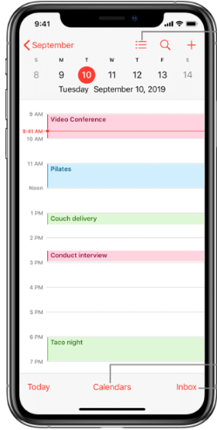
Be organised; Homework

Slide 20
After Level 3, what’s next?
This CTEC Level 2 qualification is intended for learners who want to progress into health and social care Apprenticeships.
OR
Who want to progress straight into employment
OR
Who want to progress onto UNIVERISTIES Health and Social Care (Health Studies)

Slide 21
After Level 3, what’s next?
It’s alright if you have no idea what job or career direction you intend to take. This qualification explores different jobs and there’s work experience

Slide 22
Careers and job roles
Apprenticeships are on-the-job training and are in a range of careers in health and social care such as SEN School Support Worker or Adult Social Care
https://www.skillsforcare.org.uk/Careers-in-care/Starting-your-career/Apprenticeships/Thinking-of-doing-an-apprenticeship.aspx
OR
Employment – any direction you want not necessarily in health and social care
OR
After Level 3; University Degree jobs such as nursing, social work, teaching, public health, youth and community work etc

Slide 23
‘In class’ assessments
You will be assessed throughout the year with homework and end of module assignments . You will submit a draft and final piece for each learning objective.
You will record the marks for these assessments on your DIRT sheet and stick in your book and on the assessment tracking sheet at the front of your book.
You will be given personalised What Went Well, WWW, and Even Better Ifs, EBIs for the particular topic to work on as DIRT and independently at home.
You will learn research skills .

Slide 24
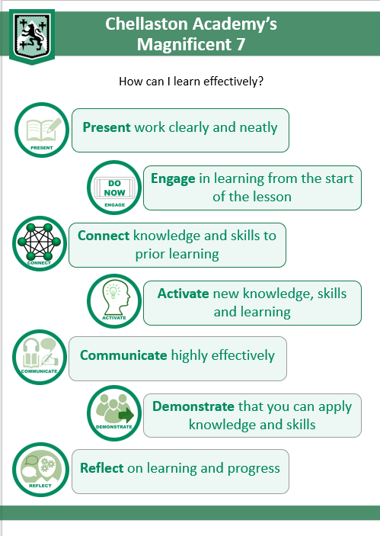
Classroom Expectations

Slide 25
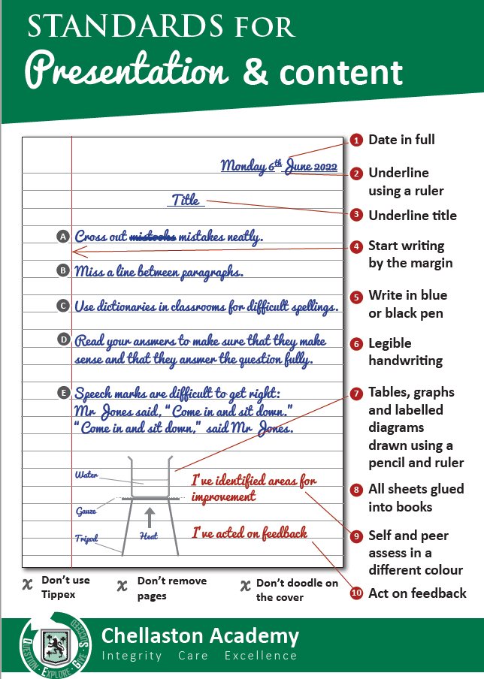
Book presentation:
It is very important that you always present your work to the best possible standard. This will be BRAG rated every half term.
You must bring all the specified equipment to all lessons. This will include pen, pencil, ruler as well as a calculator.

Slide 26
BOOKS WILL BE MARKED EVERY HALF TERM
RED 0 POINTS
AMBER 25 POINTS
GREEN 50 POINTS
BLUE 100 POINTS

Slide 27
Do now:
Write your name, class and teacher neatly on the front of your book
Stick the class sticker on the top right hand corner of the front cover
Stick the assessment tracking sheet into the front cover of your book
Complete the presentation task using your neatest presentation on the first page of your book

Slide 28
Book Presentation Expectations Copy these neatly into your book
Rule off from previous lesson.
Date and title written neatly and underlined using a ruler.
All notes to be written in black or blue pen.
All tables, graphs and diagrams should be drawn using a sharp pencil and ruler.
All sheets and DIRT activities are to be stuck in by the end of each lesson.
Use a red pen for DIRT activities, spelling corrections, self-assessment and peer assessment.

