Slide 1
12BTEC Bridging Day 2025 – Art and Design Session 1 SHP

Slide 2
What do you think the BTEC is?
What do you want to gain from it?
Why have you chosen this?
How does this work with your other subjects?
What are you most nervous about?

Slide 3
BTEC UNITS
Unit 1: Visual recording and communication (Exam unit)
Unit 2: Critical and contextual studies in Art and Design (Exam unit)
Unit 3: The Creative Process (SHP)
Unit 4: Materials, Techniques and Processes in Art and Design (CAT)
Unit 5: Developing an Art and Design Portfolio (JHN)
Unit 7: Developing and realising creative intentions (Exam unit)
Unit 12: Fine Art materials, techniques and processes (BOO)
Unit 14: Textiles materials, techniques and processes (TVY)

Slide 4
Unit 3 The Creative Process (SHP)
Sketchbook Walkthroughs
We will be exploring how we use materials and techniques within our work, how we produce a project of work by starting somewhere and going through a series of processes to get to an outcome.

Slide 5
Unit 5 Developing an Art and Design Portfolio (JHN)
You will research into a variety of portfolios styles, exploring the pro’s and con’s for all.
You will choose your own topic for your mini project, creating mini exhibition and digital portfolio to be submitted.

Slide 6
Unit 4: Materials, Techniques and Processes in Art and Design (CAT)
Exploring a variety of artists connected that highlight mans impact on the environment, you will explore materials and their processes in order to create an impactful outcome.
Discussing your outcome and investigation in a presentation format, will build your confidence in discussing such vital topics.

Slide 7
Unit 12: Fine Art materials, techniques and processes (BOO)
The experimental start to the book, exploring materials and the way they are used.
Mini project, creating a maquette exhibition space with it’s own gallery work.

Slide 8
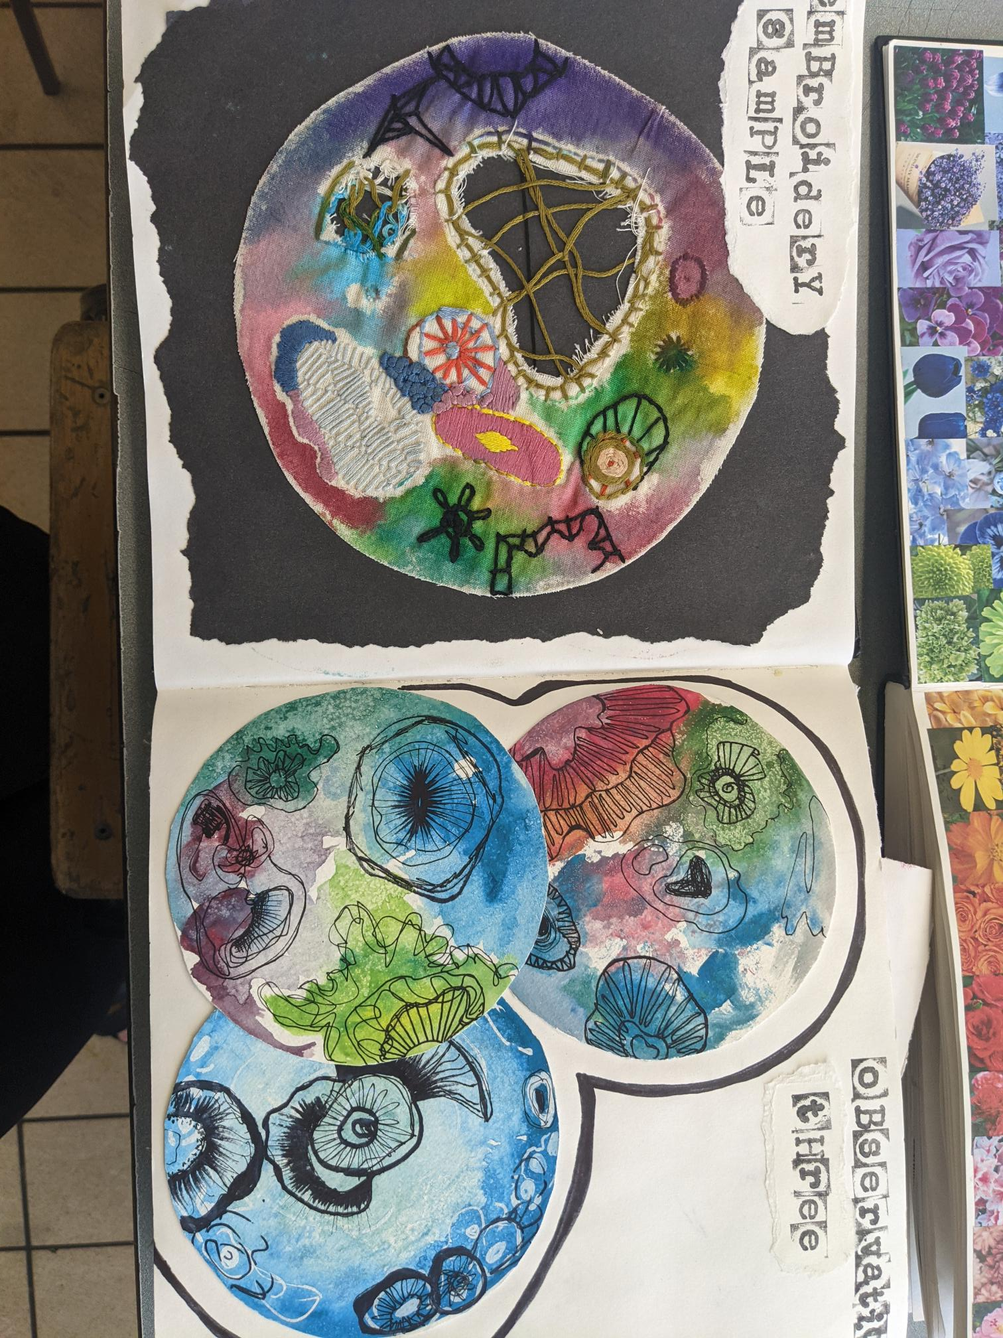
Unit 14: Textiles materials, techniques
and processes (TVY)
In this unit, we’ll explore a variety of textile processes that lead towards visualisation of end products.
Presented throughout your sketchbook and displayed professionally on A1 mountboards.

Slide 9
Todays Task
Activity 1:
Considering the word ‘Evolve’, create a brainstorm of words that you associate with this, ready to use in September. Words that you might associate with it may be:
Activity 2:
Using the materials provided, start to create a page of various, textured rubbings.

Slide 10
BTEC Summer Homework
Take 8 photos of colourful objects - 4 natural form, 4 man-made.
Take 8 photos of textures.
3) Answer the following questions:
-What does the word EVOLVE mean? Name 2 ways something or someone can evolve?
-Why do we look at artist's work for inspiration?
-Why do we try different materials and ideas before choosing what to work with in a piece of work?

Slide 11
12BTEC Bridging Day 2025 – Art and Design Session 2 JHN

Slide 12
BTEC UNITS
Unit 1: Visual recording and communication (Exam unit)
Unit 2: Critical and contextual studies in Art and Design (Exam unit)
Unit 3: The Creative Process (SHP)
Unit 4: Materials, Techniques and Processes in Art and Design (CAT)
Unit 5: Developing an Art and Design Portfolio (JHN)
Unit 7: Developing and realising creative intentions (Exam unit)
Unit 12: Fine Art materials, techniques and processes (BOO)
Unit 14: Textiles materials, techniques and processes (TVY)

Slide 13
Exploring the exam Units
Unit 1: Visual recording and communication (Exam unit)
Unit 2: Critical and contextual studies in Art and Design (Exam unit)
Unit 7: Developing and realising creative intentions (Exam unit)

Slide 14
Marking Activity
Using the criteria and the example work provided, can you identify the following:
- What the theme was
The marks that MIGHT have be awarded within each Assessment objective
What might be missing/could be added

Slide 15
What the theme was
The marks that MIGHT have be awarded within each Assessment objective
What might be missing/could be added

Slide 16
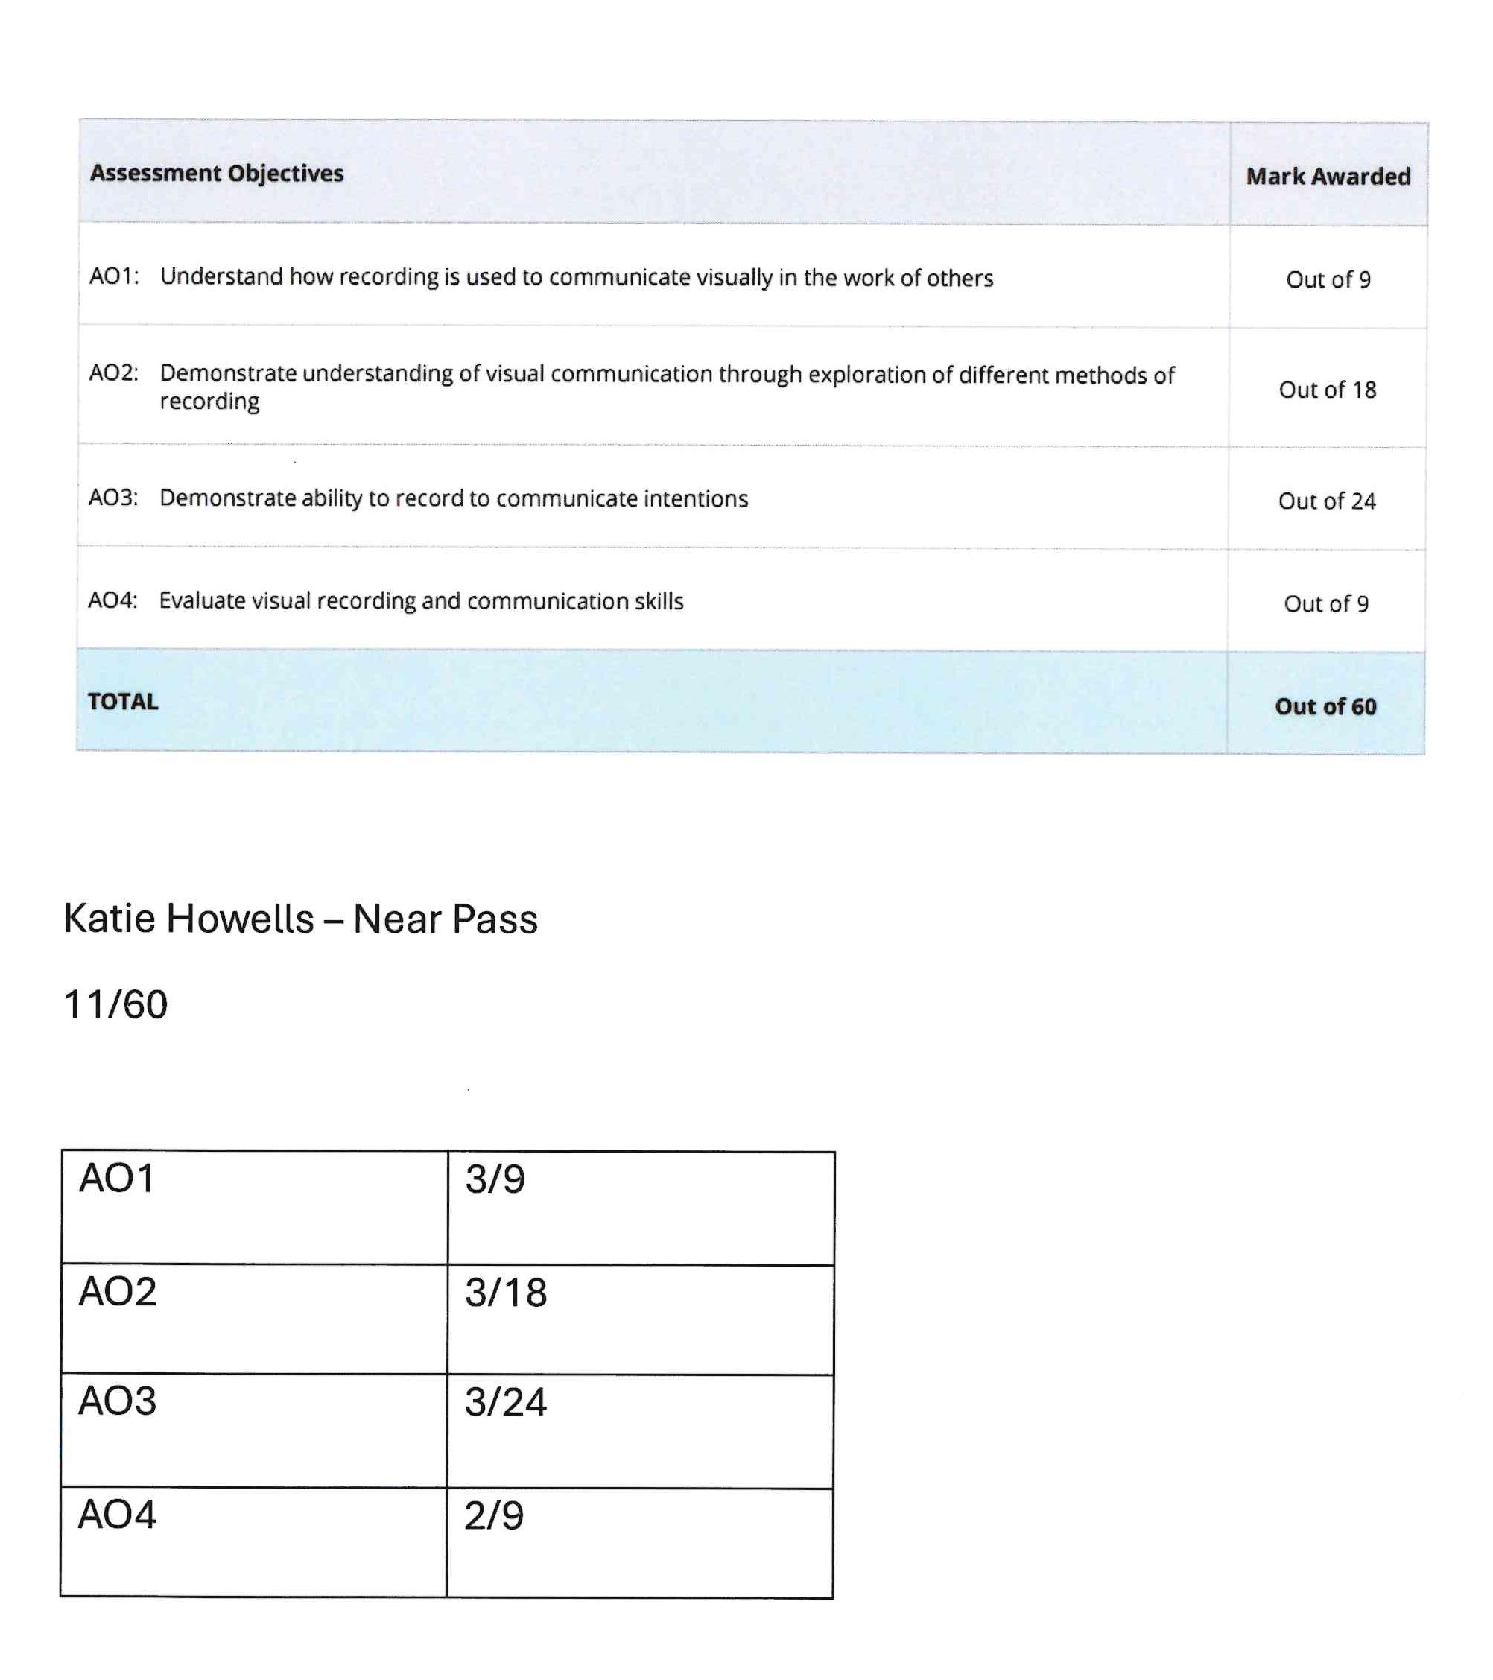
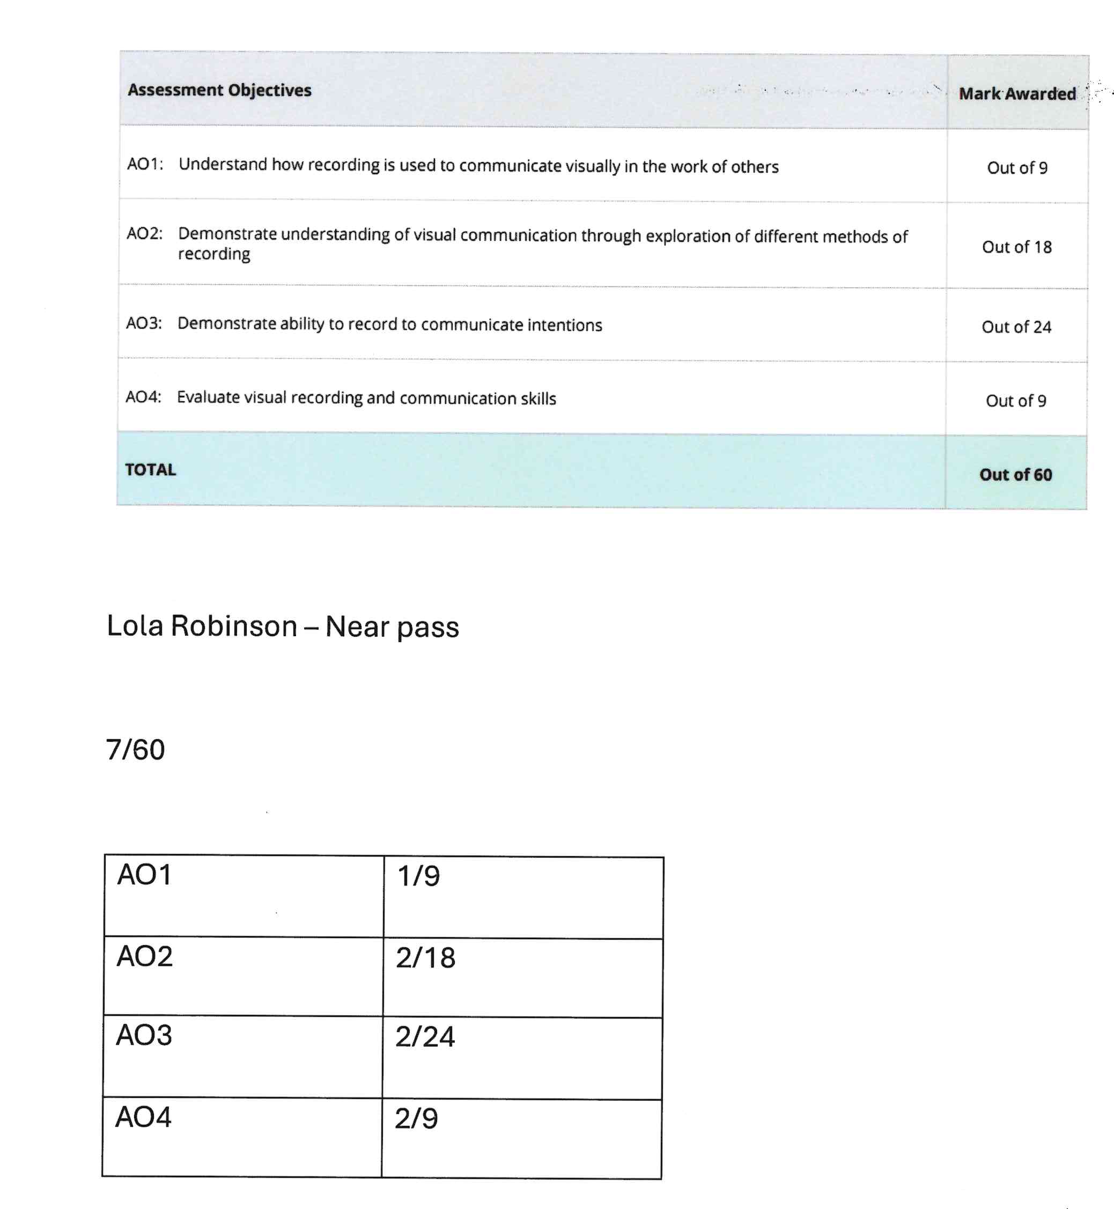

Slide 17
A reminder of your BTEC Summer Homework
Take 8 photos of colourful objects - 4 natural form, 4 man-made.
Take 8 photos of textures.
3) Answer the following questions:
-What does the word EVOLVE mean? Name 2 ways something or someone can evolve?
-Why do we look at artist's work for inspiration?
-Why do we try different materials and ideas before choosing what to work with in a piece of work?

