Slide 1
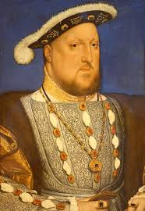
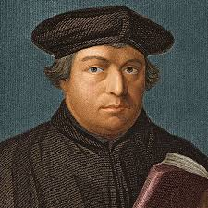
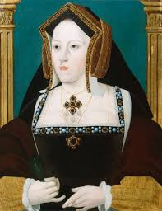
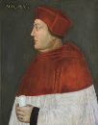
Year 12: Religious Conflict and the Church in England Part 1: The Church in 1529.
Key Dates
1485 | Battle of Bosworth- Henry VII became King of England.
1501 | Arthur marries Catherine of Aragon- Princess of Spain.
1502 | Death of Arthur- Henry VII’s eldest son.
1509 | Henry VII dies, Henry VIII is crowned King. Marries Catherine of Aragon.
1510 | Henry VIII holds his first Parliament.
1514 | Wolsey is made Chief Minister for Henry VIII. 1515 made Archbishop of York, Lord Chancellor & Cardinal.
1517 | Martin Luther nailed his 95 Thesis to the Cathedral door in Wittenberg.
Key People
Henry VIII- King of England from 1509-1547. Reformed the church.
Martin Luther-German monk who criticised the Catholic church in 1517.
Catherine of Aragon-Henry VIII’s first wife. Spanish and Catholic. Had been married to Arthur- Henry’s brother.
Thomas Wolsey- Henry’s chief minister, Archbishop of York, Chancellor and Cardinal. Exemplified the link between Church and State.
Henry VII- King of England from 1485-1509.
The Monarchy:
Henry Tudor brought an end to the Wars of the Roses.
Legacy on Tudor monarchs- scared,
vulnerable and worried about attacks.
Arthur (Henry VII’s eldest son) died in 1502. Reinforced the need for Heir and a spare.
Henry got £12500 per year from the church.
The nobility:
Strength needed curbing after the Wars of the Roses.
Played a part in decisions- Privy Council.
Sat in House of Lords.
Active in court cases.
The Church:
Monarch depended on the church for good governance.
England was part of wider Christendom.
Collected taxes. Rome received £4500 from England.
Canon Law & church courts gave the clergy an elevated status.
Abbots and bishops sat in the House of Lords.
Some sat on the Privy Council i.e. Wolsey.
Pope could excommunicate the King.
Everyone in England was religious- gave the church power. 900 parishes in total.
The church was in control of peoples wills and many left money or possessions to the church.
1509- 850 monasteries or religious houses across England. These were places of prayer and learning and they would help the poor and sick.
Monasteries also held large parts/areas of land. Wool was a major export of monastic land.
Key Vocabulary
Nobility | Someone who had rank or title and owned land. May advise the King.
Privy Council | Group of advisers, usually nobility who advised the King.
Christendom | Group of nations which the Catholic Church was the main religion.
Canon Law | Church law.
Clergy | Those who ran the services and ran the church.
Monastery | Religious building where monks lived.
Purgatory | Where souls went after death to undergo purification.
Laity | Those that attended church.
Legatus a latere | Granted by the pope- enabled the person to act on behalf of the Pope.
Liturgy | Form of service held in the church.
Heresy | Crime against the church due to their beliefs.
Tithe | Tenth of persons income which was paid to the church annually.
Were his views popular?

