Slide 1
A Level Product Design

Slide 2
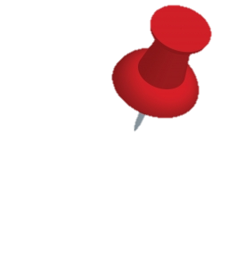
How will I be assessed?
Course Structure
50% exam
There will be two exams at the end of Year 13.
Paper 1– 2 hour 30 min = 30%
Paper 2 -1 hour 30 min = 20%
(15% of the marks are maths questions)
The NEA (Non-exam Assessment)
This is a 45 hour project requiring a design folder and a product to be manufactured = 50%
50% project

Slide 3
How is the course delivered?
The course is delivered through a range of practical and theory lessons.
In Year 12 you will build on the manufacturing skills you currently have. We want you to be more independent in
the workshop and capable of making complex but creative products.

Slide 4
Do you enjoy…….designing, modelling, making and CAD skills?
You should also wish to develop an in-depth knowledge of products, materials and processes.
You will be required to use some of your study periods and time after school, to help your projects progress.

Slide 5
What can I do after this course?
All design-related degree courses such as:
Architecture
Industrial Design
Product Design
Packaging
Interior Architecture
Graphic Design
Engineering degrees
Apprenticeships
Ergonomics
Off-road vehicle studies

Slide 6
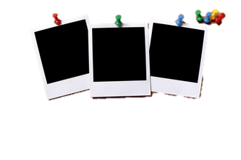
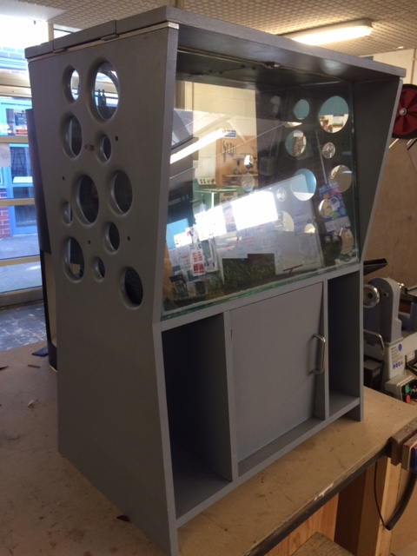
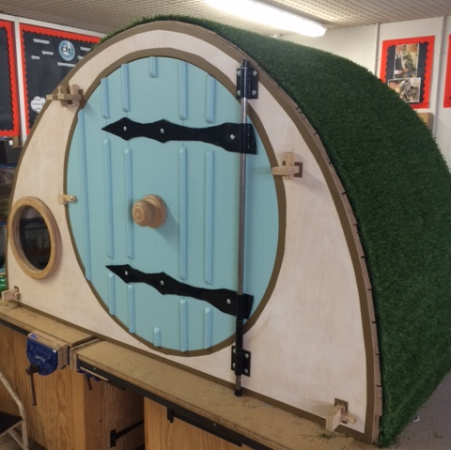
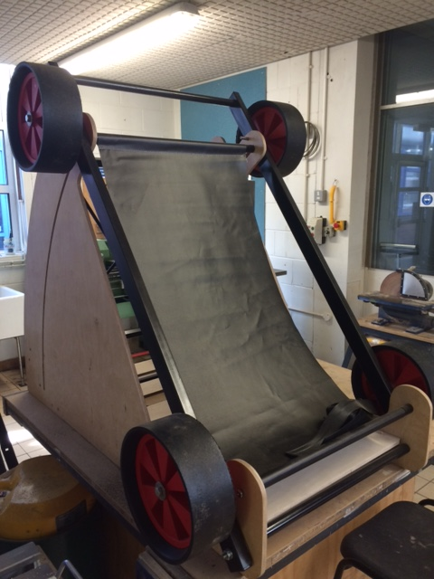
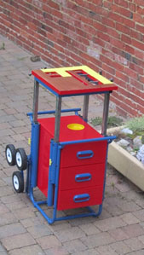
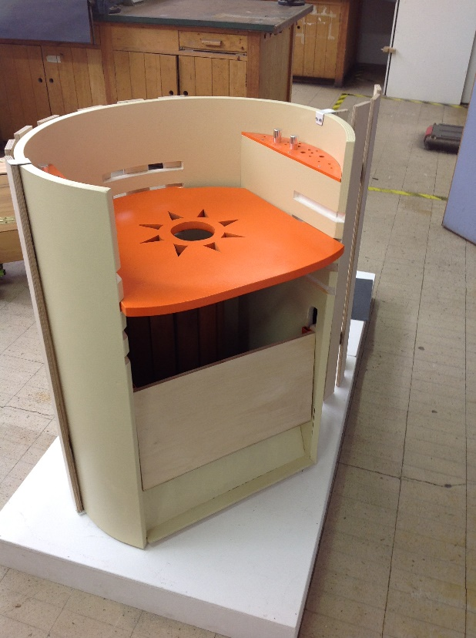
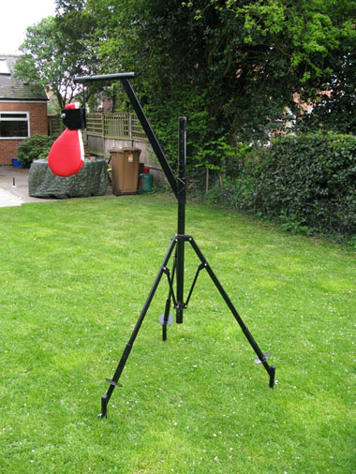
NEA
Example
Yr 13 projects
Year 13 Projects – these will require you to work with a client of your choice.

Slide 7
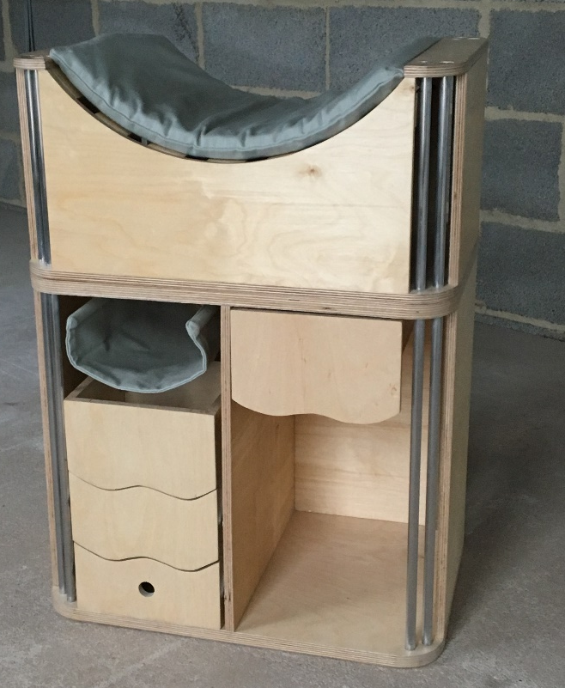
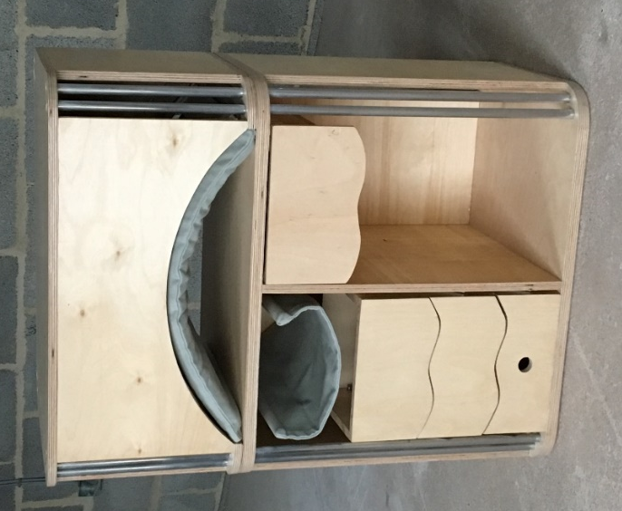
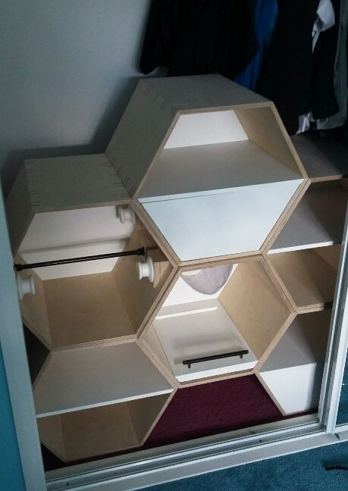
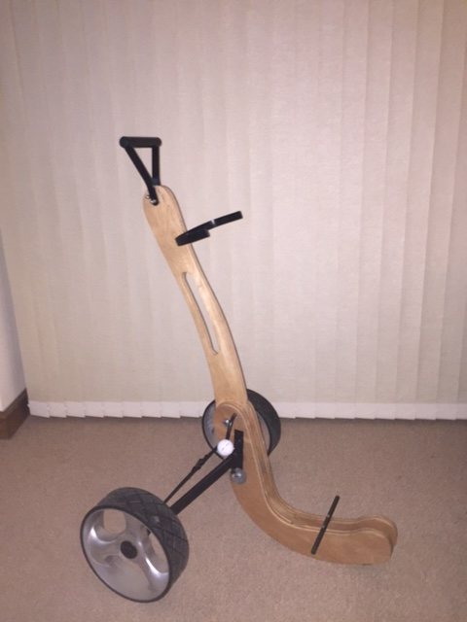
NEA
Example
Yr 13 projects

Slide 10
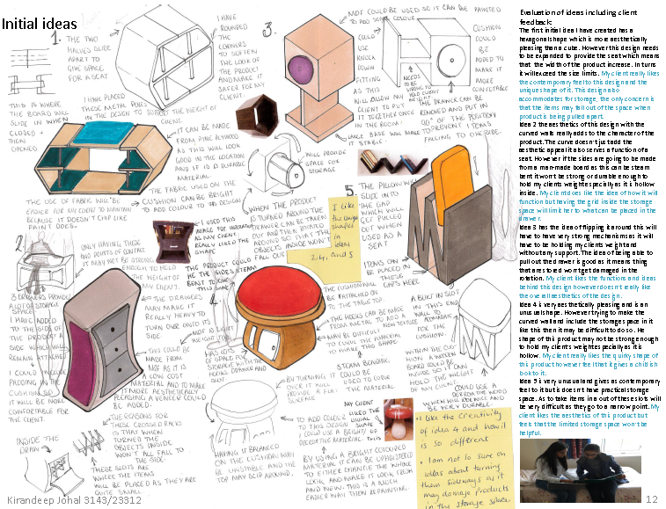
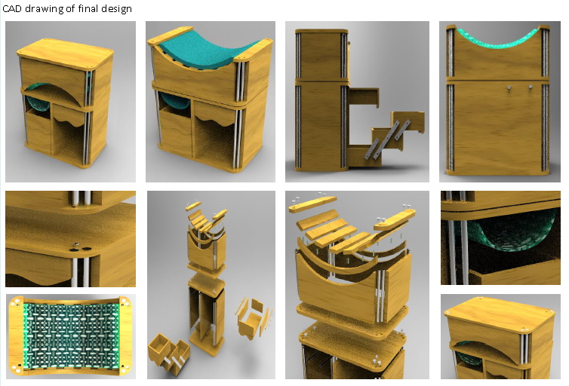
What else will the course involve?
Your projects will require a lot of research, modelling, testing and evaluating.
CAD work will be essential and you will have to produce a lot of sketches.
You will need to speak to a client of your choice, to help your develop a solution to your brief.

Slide 11
What you need to do…
Work hard
Stay organised
Complete all work on time
Use the workshops to improve your practical skills
Be creative
Enjoy the course!

Slide 12
Year 12 Summer Work
https://chellaston.fireflycloud.net/year-11-into-12-transition/year-1112-transition-work-1/product-design-1
Use the link above to find the transition work.
Complete this work to the best of your ability and bring it back to your first A Level Product Design lesson.

