Slide 1
A Design & Make Task

Slide 2
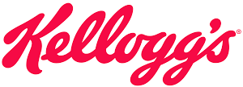
Kellogg’s is the leading UK cereal manufacturer and want to launch a new breakfast cereal for young people.
Your task:
‘Design and make the new cereal packaging.
You can choose the new flavour and style of the box!’
Keywords: DESIGN BRIEF

Slide 3
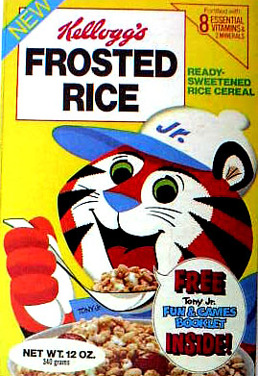
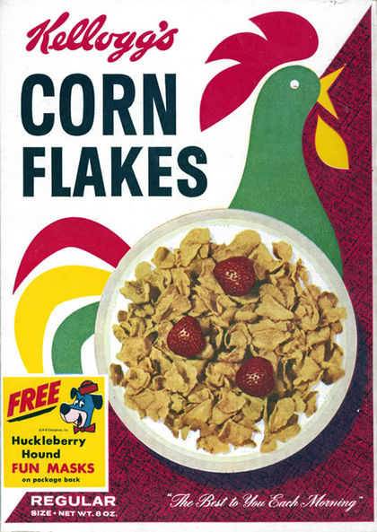
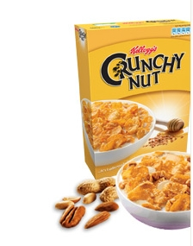
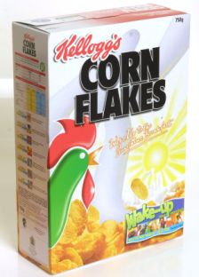
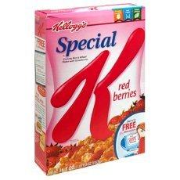
Look at the images below and decide what things are similar about them all.
Keywords: RESEARCH, EXISTING PRODUCTS

Slide 4
Brand name/Logo?
Check
Slogan?
Check
Persuasive devices?
Check
Factual information?
Check
Main Images?
Check
Spend 1 minute talking with your partner about
which parts of the box show the above details.
Then… click through them to see if you were right.
Keywords: COLLABORATION

Slide 5
Things to consider when designing your cereal box…
What would the cereal box look like as a NET?
What materials would be used to make it?
Who is the target audience?
How will you make your design attractive?
How will the box open?
What selling points will be on the box itself and what will the design be?
Keywords: MINDMAPPING

Slide 6
Different types
of packaging

Slide 7
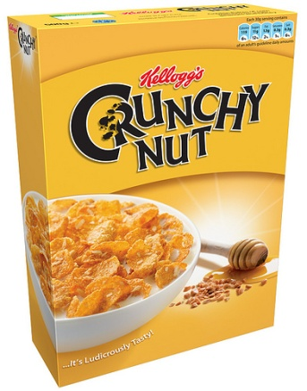
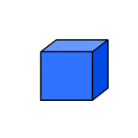
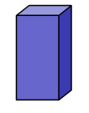
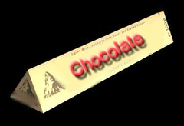
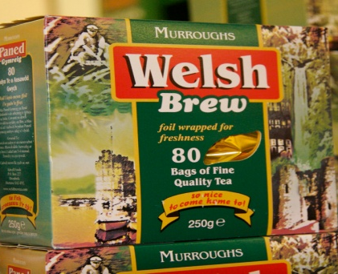
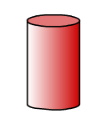
Match the 3D shapes with the correct packaging.
Click the shapes to see if you were right.
Keywords: SHAPE IDENTIFICATION

Slide 8
Can you name the shapes used?
Click the shapes to see if you were right.
Cuboid
Prism
cylinder
Cube
Keywords: SHAPE IDENTIFICATION

Slide 9
Things to consider when designing your cereal box…
Which will be the most suitable shape for a cereal box?
Can you try and explain why you have chosen the shape you have and discarded the other possibilities…
Keywords: REFLECTION

Slide 10
Using Nets

Slide 11
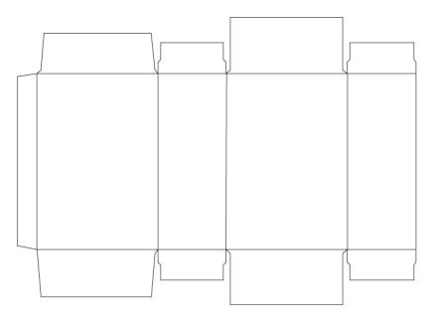
A cuboid net…
…but incomplete!
The tabs are missing.
Tabs are an important part of a package because they help hold it together. Without tabs a package simply wouldn’t work!
In pairs, can you identify how many tabs are missing and where they would go?
Keywords: SURFACE DEVELOPMENT

Slide 12
A cuboid net…
…now complete!
There were 5 missing tabs from the cuboid net.
How many did you say?
Did you guess the right location for them all?
The hatched areas show where they have been included.
Keywords: SURFACE DEVELOPMENT

Slide 13
Designing a logo
What do you need to think about in order to
design a new logo for your cereal box?

Slide 14
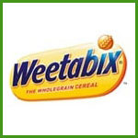
Match up the logo with the blurb...
The block writing gives a clue to the product. The simple use of colour make the product appear clean.
Elegant hand-writing and background colour aim this logo at an older target audience.
Colours are quite bright and bold – the use of gold tells us this is a classy product – not just for kiddies.
The classic lines make us think the product is reliable. There is a small clue to the product in the name.
The 4 colours relate to the product and it also relates to the country where it is produced.
...This will help you to think about what your logo could look like.

Slide 15
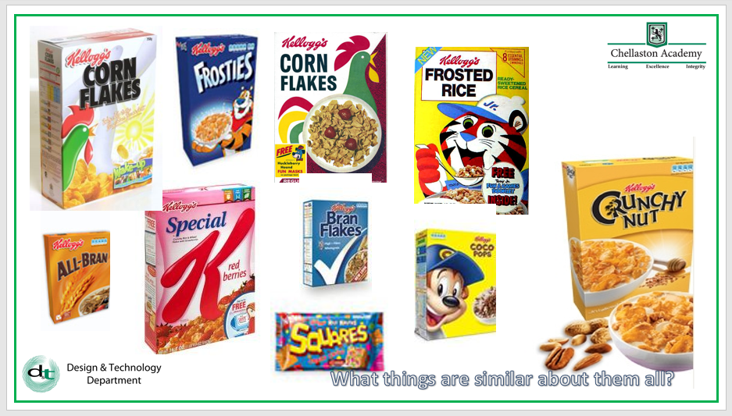
Design a logo for your cereal packaging
What will you need to consider in your design?
Who is your target audience?
Use slide 3 from earlier on in this powerpoint as inspiration for this task.
Keywords: REFLECTION

Slide 16
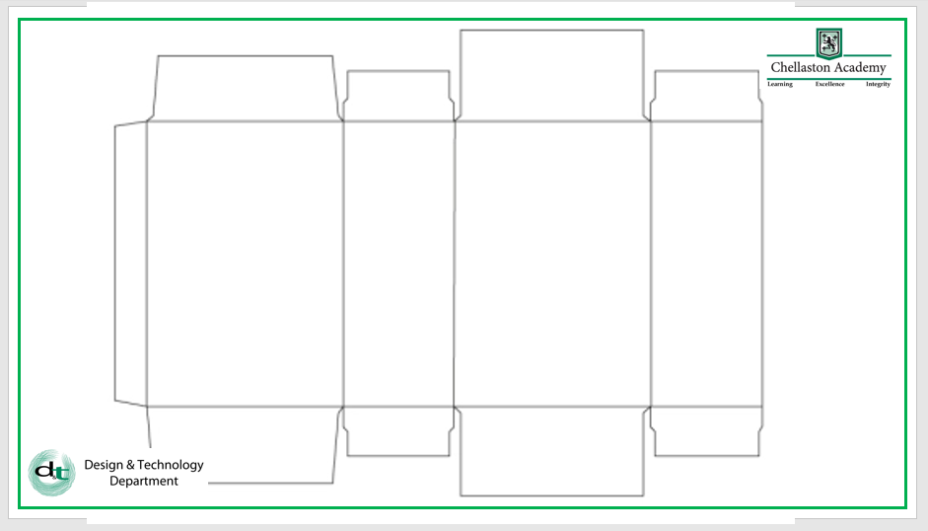
Designing your logo
and cereal box
Collect a cuboid net worksheet from the teacher.
Using a pencil and ruler draw on the 5 missing tabs that we identified earlier.
Decide where the main details are going to feature on your box.
Draw on your own logo.
Finally, begin to draw out your full cereal box design, adding colour if time allows.
Keywords: DESIGN, ITERATION

Slide 17
Notes:
This slide can be photocopied for pupils to use.

