Slide 1
Getting started on the project
Links to the AQA EPQ specification:
https://filestore.aqa.org.uk/subjects/AQA-W-7993-SP-19.PDF
Link to the EPQ production log:
https://filestore.aqa.org.uk/admin/crf_pdf/AQA-7993-CRF-21.PDF

Slide 2
‘What shall I research and write about?’
For many, this is the first opportunity to determine your own course of study but with so many subjects available it can be difficult to select one.
Many students will choose a topic which compliments their main studies. This occurs often where a topic is discussed within a lesson but is not directly assessed and doesn’t appear on a syllabus.
For some students it can help prepare them for their next level of study or provide support to a personal statement and interview.

Slide 3
Choosing a topic!
Choose a subject which you are interested in and enjoy!
A project based on a topic that may be directly related to your A levels but outside your main programme of study…
An extension of an aspect of your A level course.
You may choose a topic link to a future career – midwifery, dentistry, veterinary medicine.
It may link to your university course.
The project may also be based on an area of personal interest - swimming, climbing, literature, figures from history…
Avoid being too general – try to be specific

Slide 4
Choosing a topic!
When choosing a topic you may wish to consider:
Do you have a favourite subject?
Hobbies, interests, activities?
Is there a topic you wish to find more about?
Is this a topic you wish to study at university?
Is there a topic linked to your future career plans?

Slide 5
Choosing a topic.
Decide on a topic.
Decide on a working title – this can change.
It could be a question or a statement.
Try to be as precise and as focused as possible
Aim to allow for debate and drawing conclusions.
A word of warning
You can’t resubmit a piece of work that you have already completed as part of another examination
• You can’t reuse a project that you have already completed as part of another course of study
• You must take into account anything that may affect your ability to remain balanced and unbiased

Slide 6
The EPQ allows you to choose a topic that is of specific interest to you.
How does modern cinema portray people with disabilities?
Is the Amateur Swimming Association’s aim for every child to leave school being able to swim 25 metres unrealistic?
To what extent can Boudicca be considered a feminist role model?
Can mainstream schools learn from the Steiner School model?
Is the NHS prepared for the increased number of obese women when delivering their children?
Should the prison system be focusing more on rehabilitation rather than punishment?
To what extent do attempts to introduce safety measures in the game of rugby compromise the enjoyment of the sport?
Is children’s screen time having a negative influence on their development?
To what extent has marketing contributed to childhood obesity?
Some previous artefact projects:
To design and build a working telescope
To design a data base for the locker system
To create a children’s picture book with an environmental message
To design a bag made out of recycled materials
To design an eco friendly building

Slide 7
‘What do I need to do before September?’
Decide on a topic that interests you.
Do some initial research to check it is viable and to find out a little more about the topic.
From this create a mind map of areas you would like to research.
You may need to add to this list as new areas to research occur to you.
Try to come up with a title – this is usually in the form of a question or statement that allows room for debate.
Make some sort of planner to record when you want to work/research your EPQ.
.

Slide 8
Example of a planning document
GANTT CHARTS A Gantt chart is a bar chart created in a spreadsheet that shows the timing of each task. In the first column is a list of the activities involved in the completion of a project. Along the top is a suitable timescale. A bar represents each activity; the position and length of the bar reflects the start date, duration and end date of the activity.
During the project you will be able to determine whether the project is on schedule at various points.

Slide 9
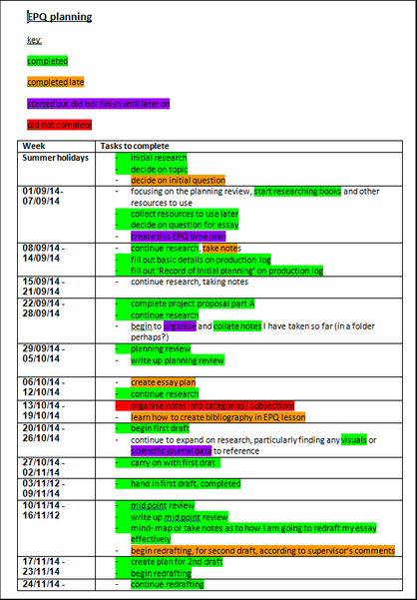
Another example of a planning document.
PLANNING DIARY You may prefer to create a table to plan your project. In the first column is a list of all the weeks over which you will complete your project. You will then list all tasks in the second column. You can use colour coding to tick off your plan as you go and you will be able to make changes and adapt as necessary.

Slide 10
An example of another time plan. You don’t need to do it like this. You can make up your own.

Slide 11
A couple of tips:
Keep a record of all the sources that you use.
Save them in a folder for EPQ on your computer.

Slide 12
Doing some initial research:
You can use physical sources such as books but many of your resources will be online.
Wikipedia is ok as a starting point but don’t rely on it.
Different sources include:
Books
Encyclopaedias
Newspaper articles (Broadsheets such as The Guardian, The Times, The Telegraph and Independent are the most useful)
Journals
Academic university papers
Documentaries
Blogs
TED talks

Slide 13
Good luck with your research.
Feel free to email me with any questions
saradrake@chellaston.derby.sch.uk

Slide 14
‘What do I need to do before September?’
Decide on a topic that interests you.
Do some initial research to check it is viable and to find out a little more about the topic.
From this create a mind map of areas you would like to research.
You may need to add to this list as new areas to research occur to you.
Try to come up with a title – this is usually in the form of a question or statement that allows room for debate.
Make some sort of planner to record when you want to work/research your EPQ. See ideas on the next two slides. There are templates on firefly too.
.

