Slide 1
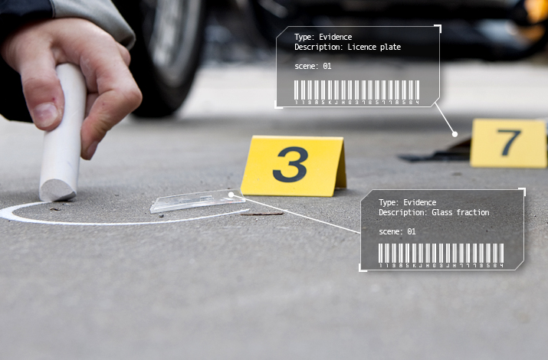
What is evidence? Why would a historian need this?

Slide 2
Sources in History

Slide 3
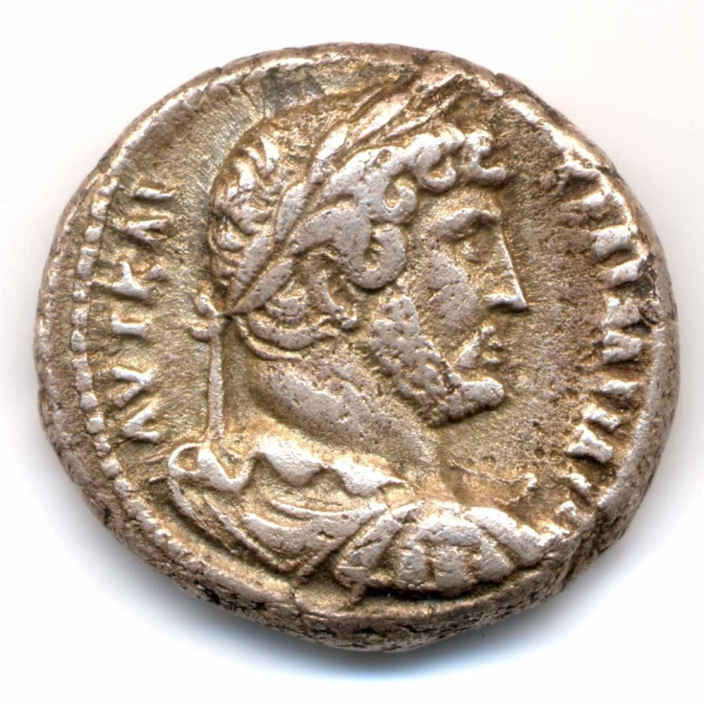
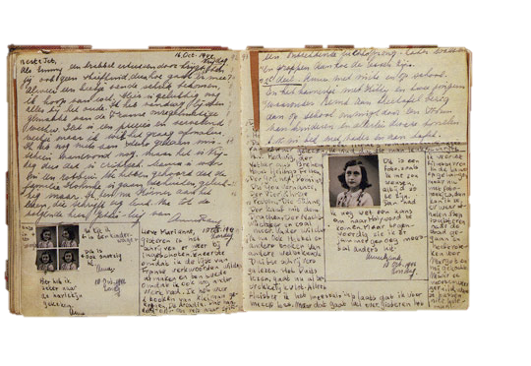
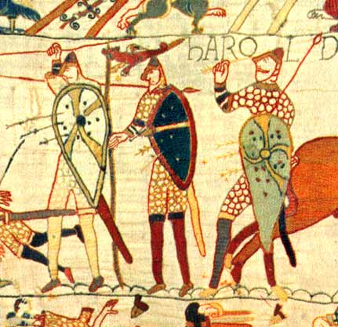
Historians use sources to build up a body of evidence to make decisions about a time or an event.
Historians always question and analyse sources, and this becomes part of the evidence too –
Why would they do this?

Slide 4
Evidence = a collection of information that we can use to make a decision.
Source = an object or item we can use as a clue to tell us about the past.

Slide 5
Task 1:

Slide 6
Today’s lesson
Throughout the lesson you are going to be learning about what happened after the Romans left and a new England was born. The new beginning that emerged focused on the Anglo-Saxons.
You will be looking at sources to discover what they can tell you about Anglo-Saxon England.
Before that however, we need to learn a little bit about what happened after the Romans left.

Slide 7
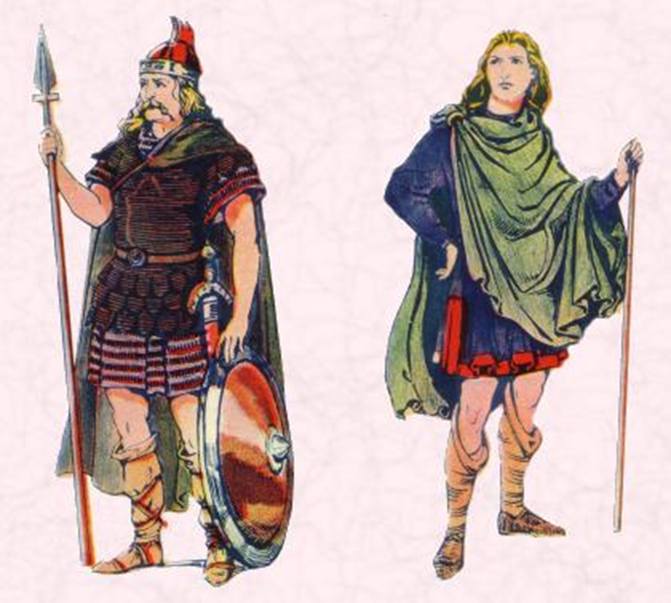
What happened when they left?
From 43 AD until 410 AD southern Britain was part of the Roman world.
After the last Roman soldiers left Britain, new people then came in ships across the North Sea.
Historians call them Anglo-Saxons.

Slide 8
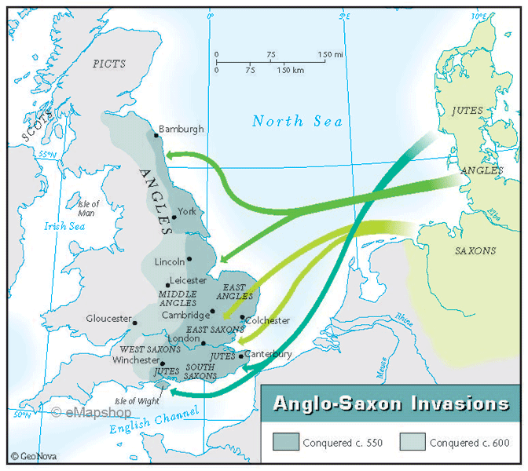
In the years 400-700 AD Britain was invaded and settled by different groups of people coming from northern Germany and southern Scandinavia.
These included the Angles (from Germany), Saxons (from Germany), Jutes (from Denmark) and many other peoples.
The Anglo-Saxons took control over most of Britain.

Slide 9
So…How do we use sources to learn more about the past?
As historians we use sources to make what we call inferences about the past. In essence, these are educated guesses about what the source is trying to tell us about the past.
For example;
Your teacher is in a shop buying bits and bobs. They decide they want a little treat. So they decide to go and buy a Mars chocolate bar. However, when they are looking, they cannot see any at all.
What inference can you make about the Mars chocolate bars in this story?

Slide 10
Your task
You are now going to look at various different sources. Your job is to look at what these sources are, and write down what you think they tell us, as historians, about life in Anglo-Saxon England.

Slide 11
Evidence | What is it? | What does it suggest about life in Anglo-Saxon England?
1
2
3
4
5
6
7
Evidence | What is it? | What does it suggest about life in Anglo-Saxon England?
1
2
3
4
5
6
7
Notes:
These need to be printed.

Slide 12
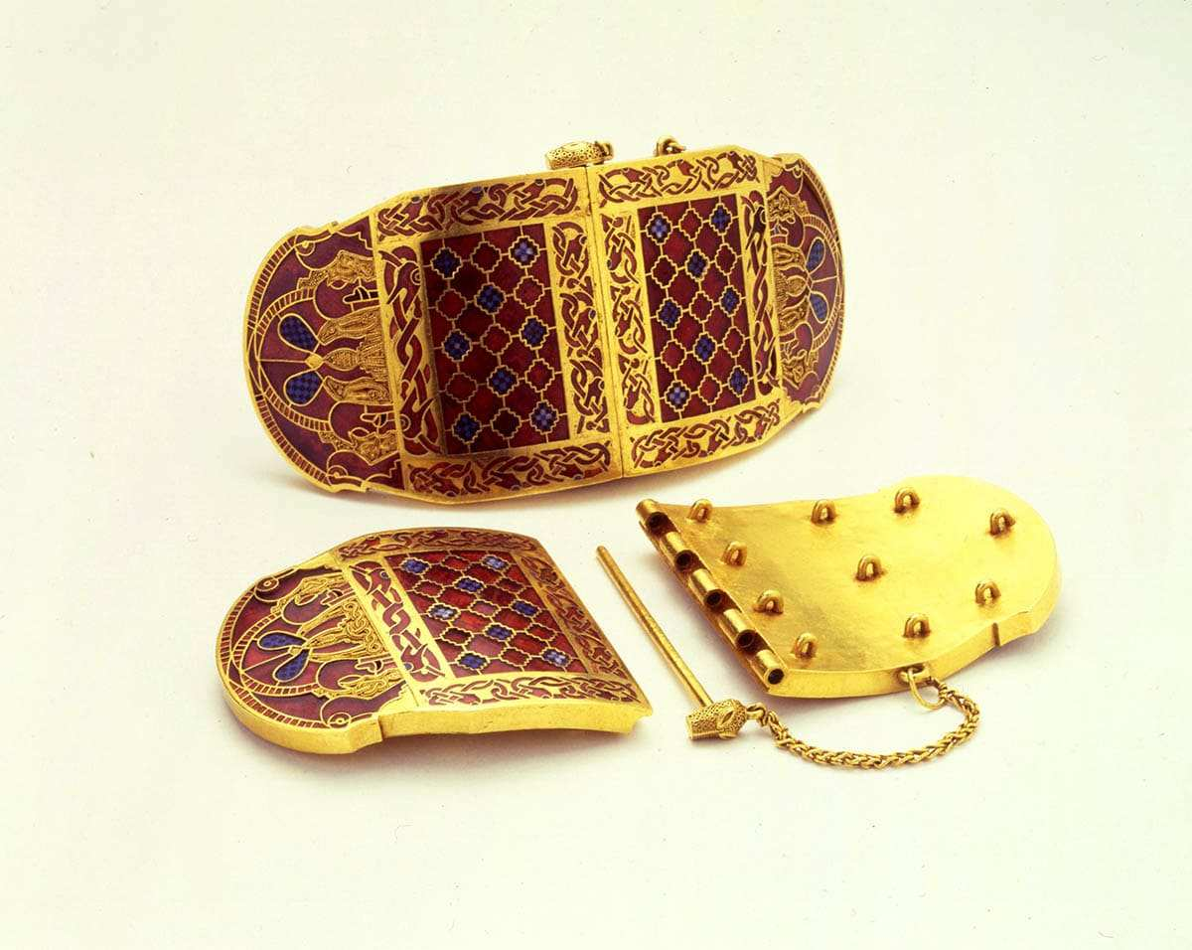
Evidence No.1.
Gold shoulder clasps from the Sutton-Hoo burial site.

Slide 13
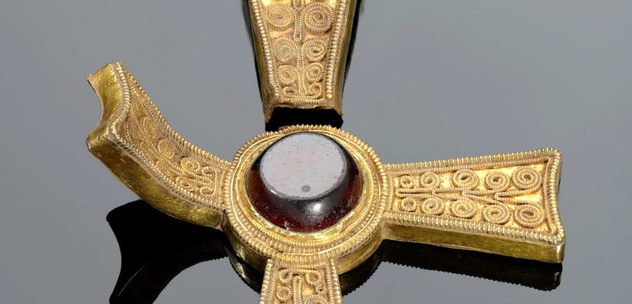
Evidence No.2.
A gold cross from the Staffordshire hoard
Notes:
A hoard is a large number of valuable items found by archaeologists.

Slide 14
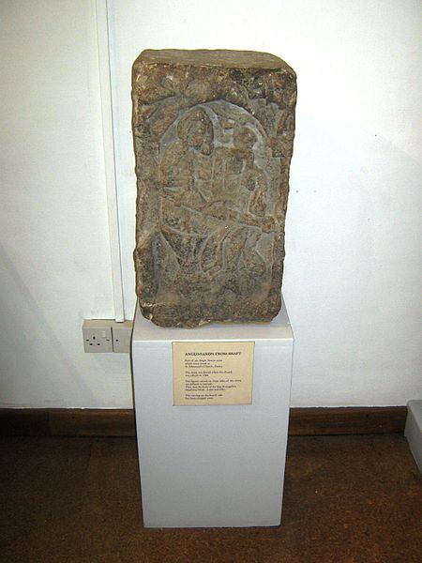
Evidence No.3
Part of an Anglo Saxon cross which once stood at St Alkmund's Church, Derby.
The stone was found when the church was rebuilt in 1844.
The figures carved on three sides of the stone are difficult to identify. They may be three of the four Evangelists, Matthew, Mark, Luke and John.
The carving on the fourth side has been chipped away.

Slide 15
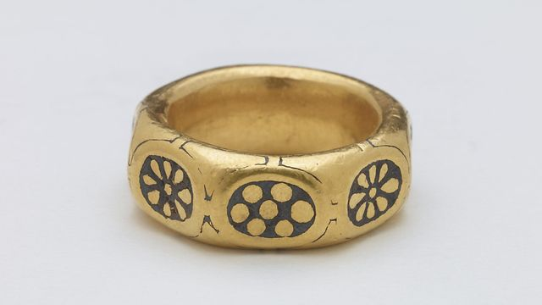
Evidence No.4.
Anglo-Saxon gold ring

Slide 16
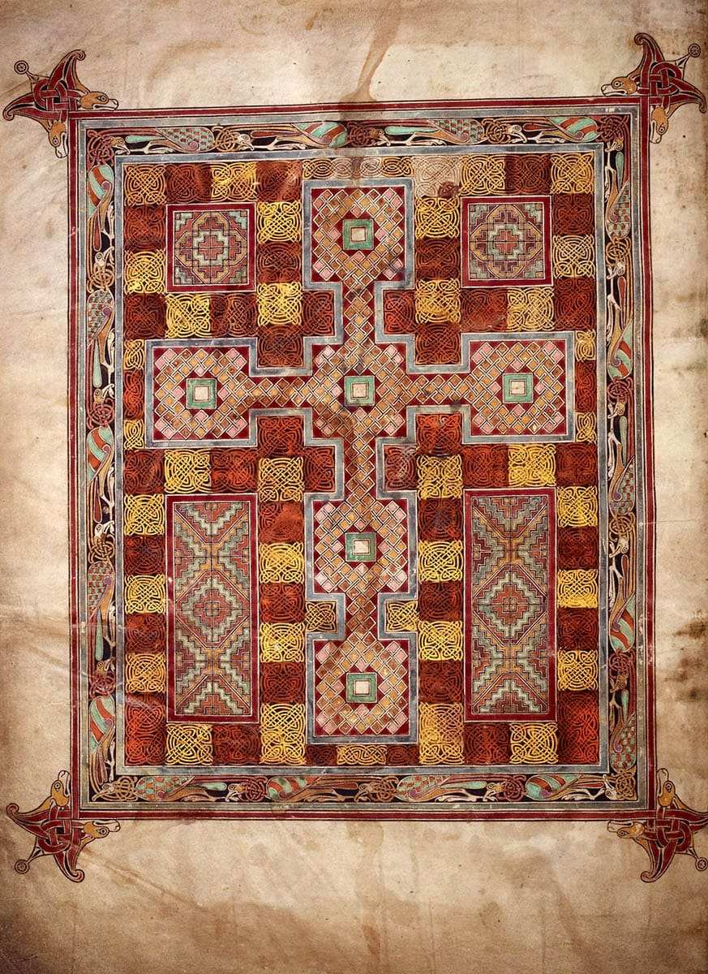
Evidence No.5
A page from the Lindisfarne Gospels.
What does this suggest about their religious beliefs?
Notes:
Look at the cross.

Slide 17
Evidence No.6
“Derby was more than a fortified settlement. Derby was also a place of trade. In the 10th century, it had a mint and a market. Craftsmen would have worked in the little town, men like blacksmiths, coopers, carpenters and comb makers.”

Slide 18
Evidence No.7.
“Derby had a population of about 2,000. That might seem very small to us but by the standards of the time, it was a fair-sized town. (A typical village had only 100 or 150 inhabitants)”

Slide 19
What does all this evidence combined tell us about Anglo-Saxon life in England?

