Slide 1
Level 3 Alternative Academic Qualification AAQ Health and Social Care
OCR Cambridge Advanced National
1 A 'Level equivalent
Notes:
Adapt the presentation to personalise it eg. add in activities, add your school/college logo and contact email
There are notes to refer to for each slide to avoid too much text and an opportunity to discuss and clarify.

Slide 2
Health & Social Care
Health and social care is a subject that has many topic areas and is a good foundation subject for a wide range of careers.
In general, it’s about people, their health, individual circumstances and what affect individuals.
Learning explores what service there are in the UK and how practitioners support people
Notes:
People – growth, health, development and individuality
Circumstances – living conditions, lifestyle choices, illness and the impact of services eg. hospital and practitioners eg. nurses
Foundation subject - in any job there are people, a greater knowledge of people and what affects them can only be a good thing.

Slide 3
Assessments
The AAQ in Health and Social Care is both exam assessed and timed assignment work.
The exams are in January and May and have a resit opportunity and total 40% of your end grade.
The non examined assessments are referred to as NEA’s and are broken into tasks. These are marked by your teacher and have a resubmission element to improve your work
Notes:
NEA – total as 60% of the end grade – a good subject if exams are not your thing.
Resit or resubmission - obviously these are best avoided, and the expectation is that you get it right the first time.
Do you have to pass ALL units? No, you don’t but you have to make it up in other units to achieve a good grade.

Slide 4
First & second year
The qualification is divided into two parts, the 1st year is the Certificate, and the 2nd year is the Extended Certificate.
In year one you will have one exam and three NEA’s, your grade is Pass, Merit or Distinction.
In the second year you will also have one exam and one NEA’s
D
Notes:
Lots of qualifications have 2 years of study to get a qualification.
The AAQ in Health & Social Care has a qualification after one year, an advantage if you decide you don’t like it and want to change subject for your second year (although we hop you stick with us!)

Slide 5
YEAR 12
EXAM UNIT:- WILL BE TAKEN IN JANUARY
Miss Miller will teach this September - December
PRINCIPLES OF HEALTH & SOCIAL CARE
The coursework units will be spread over the whole year
Mrs Warren will teach :
INVESTIGATING PUBLIC HEALTH - September – December
HEALTHY NUTRITION – December – May
Miss Miller will teach:
Person Centred approach to Care - December to May

Slide 6
YEAR 13
An Exam unit Anatomy & Physiology
This will be taught by Miss Miller September to December – sit the exam in January
One coursework unit taught by Mrs Warren Sept to December
Supporting people with Mental Health .

Slide 7
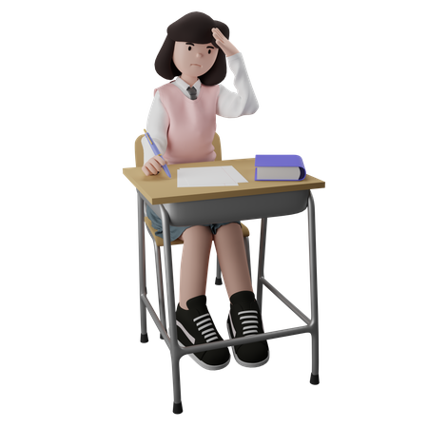
Exam Units
The two exam assessed units, in the first and second year are 1 hour and 30 minutes.
F090: Principles in Health & Social Care
F091: Anatomy and Physiology for Health & Social Care
Exam sittings are Jan & May
Result opportunity
Notes:
"Principles" refer to the fundamental ethical and practical guidelines that shape how care is delivered and how individuals are supported.
F090 Principles topics include:
Equality, diversity, and rights in health and social care settings
Managing hazards, health and safety in health and social care settings
Laws governing practice/services/practitioners in health and social care settings
Best practice in health and social care settings eg. expected behaviour
F091 A&P topics include:
Cardiovascular and Respiratory system
Digestive system and reproductive systems
Musculoskeletal and the body’s Control and regulatory systems eg. the balance of temperature or level of fluid/urine/sweat

Slide 8
Non Exam Assessments
The two mandatory NEA units, are in the first and the second year has two units your teacher has selected as your ‘optional’ units.
F092: Person-centred approach to care
F093: Supporting people with mental health conditions
After you have learned the content, you then sit the NEA with set times for completion.
Notes:
F092 Person-centred care topics include:
Taking a person-centred approach and meeting needs and providing support in a person-centred way as well as communication skills
For this unit there is an element where you communication skills are observed, assessed and evaluated.
Some of the assessment hours are completed without teacher supervision but most are sitting in the classroom writing or presenting your work to your teacher.
F093 Supporting people with mental health conditions topics include:
Definitions and views of mental health
Mental health conditions and mental health services
Treatment and support for mental health conditions
The assessment is carried out in the classroom with your teacher 14 hours of supervised time and 6 hours of unsupervised time, completed outside the classroom

Slide 9
How will I learn?
Your teacher will deliver the content using a wide range of teaching methods.
You will have a booklet which you will be using in lessons and a completed booklet at the end of the unit for revision or NEA practice.
You will be able to tick the content off as you go along and monitor your own learning.
Notes:
Keeping the booklets safe is not your teacher’s responsibility.
Monitoring your own learning is your responsibility.
You may miss a lesson; you will have the content list for that lesson and can ask your teacher who will guide you through the bits you missed.
Homework is set which will help you achieve the very best grade, aim high, a Distinction star!

Slide 10
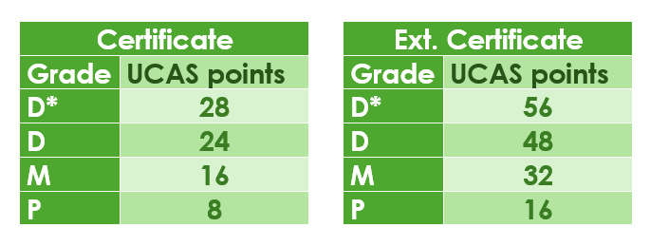
Thinking ahead
You may be considering a career which requires a university degree and are thinking about UCAS points for the AAQ.
Notes:
UCAS points are added together from different subjects, university courses have a UCAS points accumulative total as an entry requirement
Examples;
A nursing degree typically requires around 112 UCAS points, but the exact requirement can vary between universities. Some universities may require a minimum of 96 points, while others might require 120 or more.
To become a social worker, you'll typically need a minimum of 96 UCAS Tariff points. Some universities may require more, potentially as high as 128 points.

Slide 11
After Level 2, what’s next?
This CTEC Level 2 qualification is intended for learners who want to progress into health and social care Apprenticeships.
OR
Who want to progress straight into employment
OR
Who want to progress onto the BTEC Level 3 Health and Social Care (Health Studies) course at UAH (providing you pass your GCSE English, this year and preferably, your Maths GCSE)

Slide 12
After Level 2, what’s next?
It’s alright if you have no idea what job or career direction you intend to take. This qualification explores different jobs and there’s work experience

Slide 13
Careers and job roles
Apprenticeships are on-the-job training and are in a range of careers in health and social care such as SEN School Support Worker or Adult Social Care
https://www.skillsforcare.org.uk/Careers-in-care/Starting-your-career/Apprenticeships/Thinking-of-doing-an-apprenticeship.aspx
OR
Employment – any direction you want not necessarily in health and social care
OR
After Level 3; University Degree jobs such as nursing, social work, teaching, public health, youth and community work etc

Slide 14
Summer Task 1 ☺
Choose a celebrity – can be living or deceased
Find out as much as you can about their life from birth to the age they are at now.
Create a timeline of their life, birth until now (or death) – this can be a line or in another format
This work is due on 12th Sept 2020
Pass – a timeline that is in chronological order
Merit – a detailed timeline including; major events and dates in their lives e.g. Marriage, First job, Winning and Award, addiction, parents illness
Distinction – a timeline that includes details of how these events affected the whole person and their lives

Slide 15
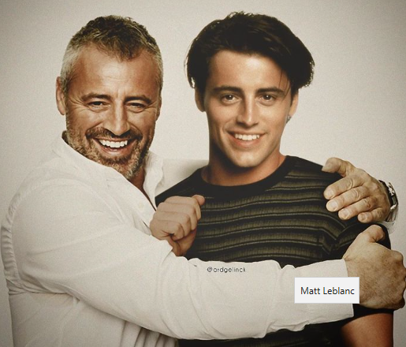
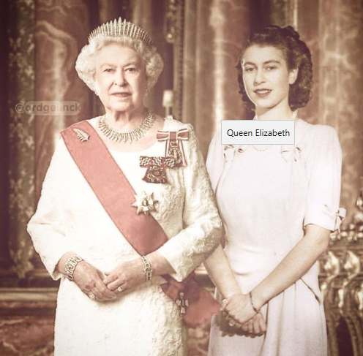
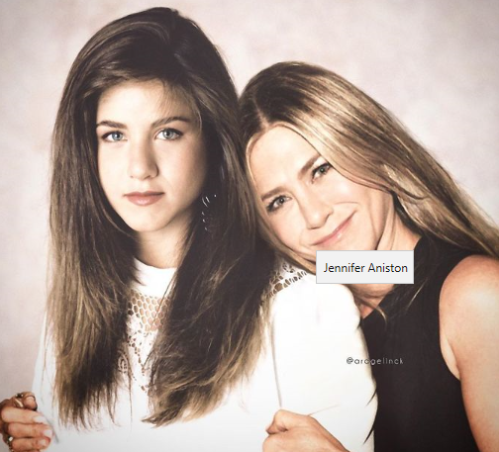
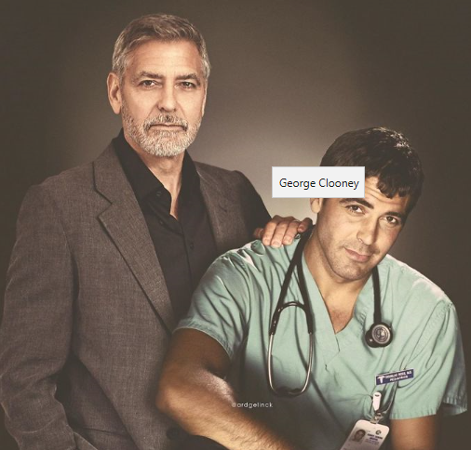

Slide 16
Summer Task content
You may have studied this topic before for the Tech Award in Health and Social Care –in Year 11 or you maybe new to the subject
Merit and Distinction, consider the impact events and family, have had on the below aspects
Physical impact across, their whole life
Intellectual impact, across their whole life
Emotional impact, across their whole life
Social impact, across their whole life.

Slide 17
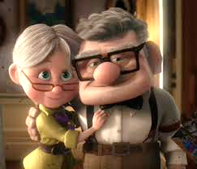
Think about events
Watch this Youtube clip, there’s lots going on, look at the events in their lives and think about the impact this may have had.
https://www.youtube.com/watch?v=YlGg4nt01G8&safe=active

Slide 18
Summer Task guidance
Consider the below factors affecting a person’s life such as attitude, behaviour and motivation
Nature (genetics) and Nurture (surroundings)
Social aspects; family, work colleagues peers
Economic; wealth and possessions
Health behaviours; exercise, diet, addiction, illness, mental health and wellbeing

Slide 19
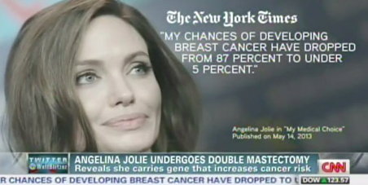
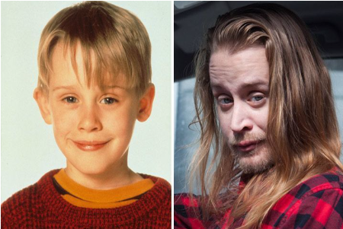
Angelina Jolie genetics
Macaulay Culkin fame, money and addiction

Slide 20
Expected Events
Starting school
Leaving school
Birth of a sibling
Moving house
Development of close relationships
Employment
Living with a partner
Marriage
Parenthood
Retirement
Ageing

Slide 21
Unexpected Events
Death of a partner, relative or friend
Accident/serious injury
Ill health
Exclusion/dropping out of education
Redundancy
Promotion or winning an award
Imprisonment
Divorce
Domestic abuse
Mental health difficulties
Issues with addiction or stress

Slide 22
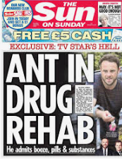
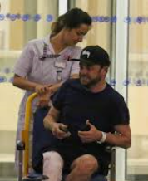
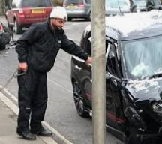

Slide 23
Summer Task 2 ☺
Look at your own life events
Choose 10 of these and then rank them 1-10 according to how stressful you think they are.
1= least stressful
10= most stressful
Think about the impact the event had on you and why you may have felt differently about it than someone else, such as a sibling or friend

Slide 24
Back to school
Bring your work with you when you start Sixth Form
OR….
You may be ask for you to email this summer work (so it must be completed electronically or a photograph of hand drawn work) to your teacher by the deadline date of 8th September 2025

Slide 25
Any questions?
Contact f.miller@chellaston.derby.sch.uk

