Slide 1
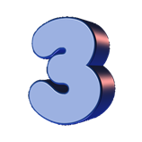
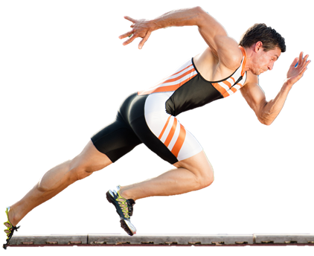
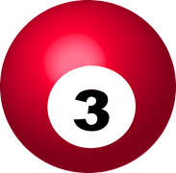
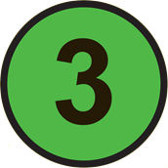
JOINTS, MOVEMENTS AND MUSCLES: WHAT YOU NEED TO KNOW
Types of Synovial Joints
1. Ball & Socket: The shoulder & hip.
2. Hinge: The elbow, knee & ankle
3. Condyloid: The wrist
Antagonistic Muscle Pairs
3 pairs: Muscles of the shoulder joint
1 pair: Muscles of the elbow joint
1 pair: Muscles of the wrist joint
2 pair: Muscles of the hip joint
1 pairs: Muscles of the knee joint
1 pair: Muscles of the ankle joint
Movements
1 Flexion
2. Extension
3. Abduction
4. Adduction
5. Horizontal flexion
6. Horizontal extension
7. Medial rotation
8. Lateral rotation
9. Circumduction
10. Dorsi flexion
11. Plantar flexion
Functional Roles of Muscles
1. Agonist: The muscle responsible for the movement at a joint.
2. Antagonist: The muscle that lengthens or relaxes while the agonist contracts
3. Fixator: The muscle that stabilises the joint where the origin of the agonist sits
Movement analysis:
(must include)
Type of synovial joint
Movement
Plane of movement
Agonist muscle
Antagonist muscle
Fixator
Type of contraction
Sporting example
Planes of Movement
1. Sagittal: divides the body left & right, movement forwards & backwards
2. Transverse: divides body top & bottom, movement rotational
3. Frontal: divides body front from back, movement lateral
Types of Contraction
Isotonic Concentric: Causes movement, the muscle shortens exerting a force.
Isotonic Eccentric: controls movement, the muscle lengthens exerting a force
Isometric: Stops movement, the muscle remains the same length exerting force
.
3

Slide 2
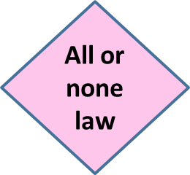
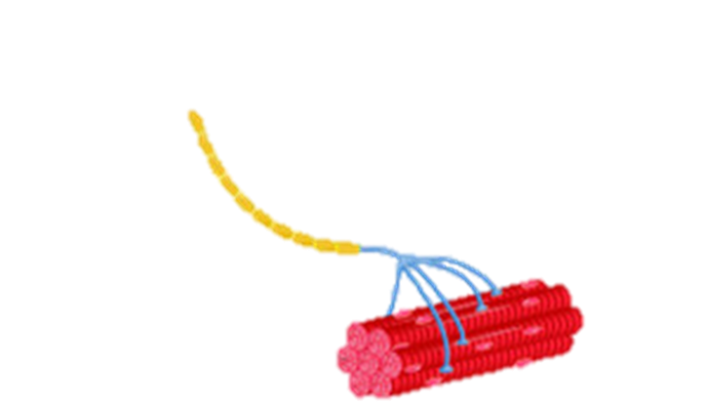
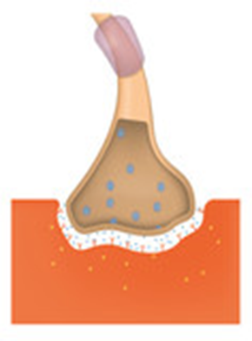
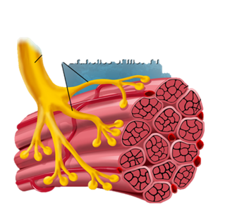
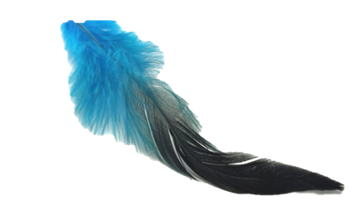
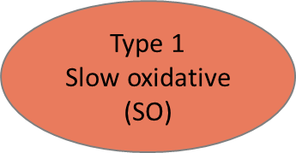
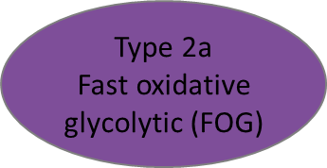
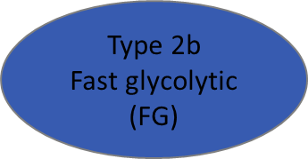
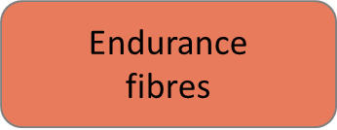
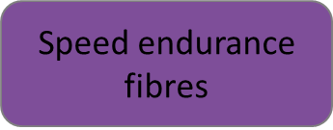
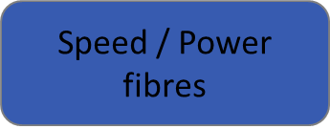
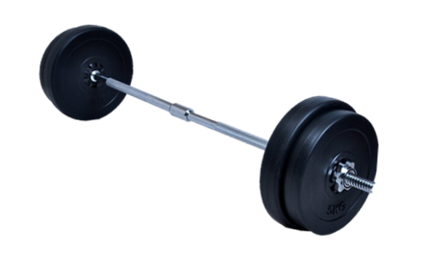
SKELETAL MUSCLE CONTRACTION: WHAT YOU NEED TO KNOW
Motor Unit: A motor neuron and all the muscle fibres it innovates
Motor Unit Function: To carry impulses from the CNS to the muscle fibres to initiate muscular contraction
Nervous Stimulation of the Motor Unit: how?
Nervous Stimulation of the Motor Unit
Resting Potential
Action Potential
Neurotransmitter
Once the threshold is met all the muscle fibres contract
if the threshold is not met no muscle fibres contract.
Acetyl Choline
Neuron
Neuromuscular junction
Motor end
plate
synapse
motor neuron
Axon
Structural characteristics: Fibre size / Neuron size / Number of Capillaries / Myoglobin content / Number of mitochondria / Glycogen stores / PC store.
Functional Characteristics: Speed of contraction / Force of contractions / Rate of fatigue / Aerobic or anaerobic / Recovery rate
Applied sporting examples…
3 Types of Motor Units
Effect of type of motor unit recruited…
Type 1: small in size & low force over long duration
Type 2a: size of unit, force & time of contraction between type 1 & 2b motor units
Type 3: large in size, high force, short duration.
Effect of number of motor units recruited…
Effect of synchronisation of motor units recruited…
3 Types of Muscle Fibre
muscle fibres

Slide 3
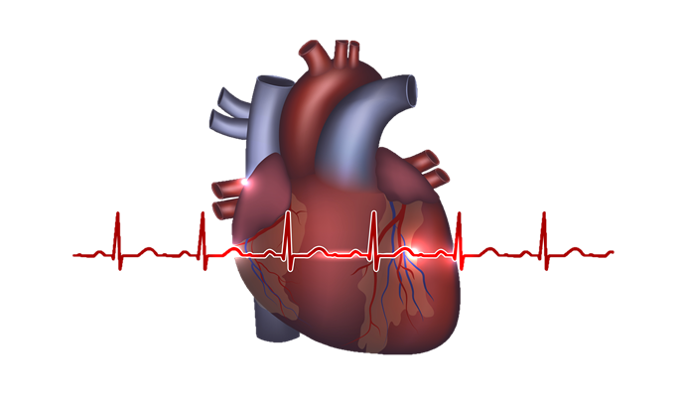
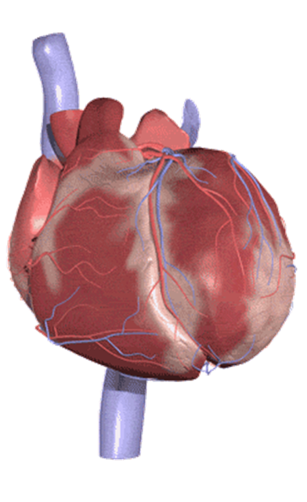
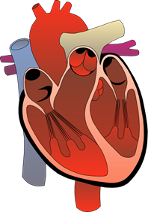
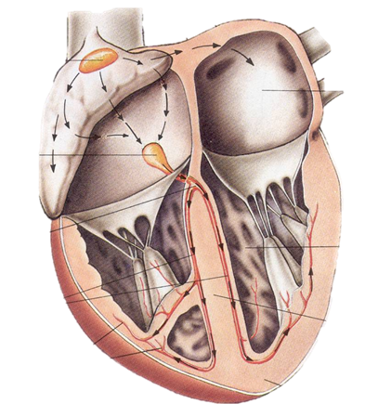
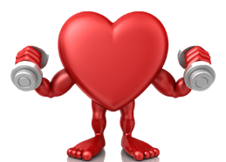
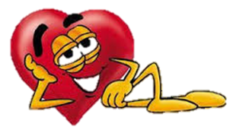
THE CARDIOVASCULAR SYSTEM AT REST: WHAT YOU NEED TO KNOW
Blood Flow Through The Heart.
Right Side:
Vena cava > Right atrium > Tricuspid valve > Right ventricle > Pulmonary semilunar valve > Pulmonary artery > Lungs
Left side
Pulmonary vein > Left atrium > Bicuspid valve > Left ventricle > Aortic semilunar valve > aorta > Body tissue
The Conduction System
Specialised bundles of tissue that transmit the electrical impulses through the heart causing a coordinated contraction. Consisting of 4 features:
1. SA node
2. AV node
3. Bundles of His
4. Purkinje fibres
Cardiac Cycle
(1 complete heartbeat controlled by the conduction system)
Diastole: relaxation phase receiving blood.
1. Atrial diastole
Blood enters the Atria from the Vena cava.
3. Ventricular diastole
Blood enters the ventricles from the atria
Cardiac Cycle
(1 complete heartbeat controlled by the conduction system)
Systole: contraction phase pumping blood out.
2. Atrial systole
Pumps blood into ventricles.
4. Ventricular systole
Pumps blood into pulmonary artery & aorta
Q = SV X HR
Cardiac output (Q)
Av. rest = 5 l/min
Trained = 5 l/min
Stroke volume (SV)
Av. rest = 70 ml
Trained = 100 ml
Heart rate (HR)
Av. rest = 70 bpm
Trained = 50 bpm
Bradycardia caused by…
Starling’ law states…
Venous return is…

Slide 4
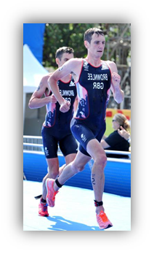
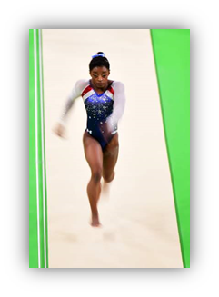
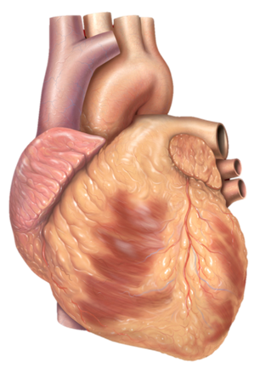
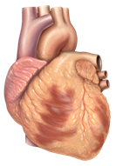
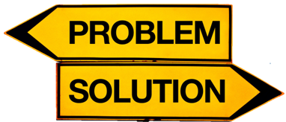
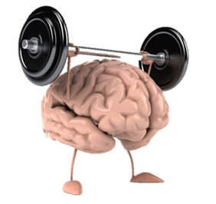
CV SYSTEM DURING EXERCISE & RECOVERY: What you need to know
HR
(bpm)
Submaximal Exercise on HR
HR
(bpm)
Rest
Exercise
Recovery
120
2
3
Redistribution of Q During Exercise & Rest
1
4
5
60
Describe explain & compare
1. Start & end of exercise detected
by receptors.
2. Receptors send info to the VCC.
3, VCC stimulates sympathetic
nervous system to control blood flow
4. Increased stimulation causes
vasoconstriction
5. Decreased stimulation causes
vasodilation
0
Time (mins)
60
Describe
& explain
Maximal Exercise on HR
200
Rest
Exercise
Recovery
HR
(bpm)
2
3
4
60
1
5
0
2
Time (mins)
E
Submaximal Exercise on SV
Mechanisms of VR During Recovery & Rest
200
submaximal
maximal
State &
compare
SV
(ml)
2
3
Problem 1: 0 blood pressure in veins
Problem 2: Q fighting gravity
Solution 1: Pocket valves
Solution 2: Skeletal muscle pump
Solution 3: Smooth muscle
Solution 4: Respiratory pump
Solution 5: Gravity above the heart
1
Starling’s
Law
Cardiovascular
drift
Describe & explain
100
Describe
& explain
Exercise intensity (km/hr)
Average Values for HR, SV & Q
SV during recovery
SV remains high
Remove LA & CD
Reduces slowly; cool down maintains SV
 | Rest | Submaximal | Maximal
HR | 70 bpm | 100 bpm | 220bpm - age
SV | 70 ml | 100 ml | 100 ml *
Q | 5 l/min | 10 l/min | 20 l/min
40
Submaximal Exercise on Q
Regulation of HR During Exercise & Recovery
40
submaximal
maximal
*but lowers due to CV drift
Q
(l/min)
2
Athlete Values for HR, SV & Q
1
Intrinsic Factors:
Temperature & VR
Neural Factors*:
Chemoreceptors, Baroreceptors
& Proprioceptors
Hormonal Factors*:
Adrenaline
* Both extrinsic factors
5
 | Rest | Submaximal | Maximal
HR | 50 bpm | 120 bpm | 220bpm – age
SV | 100 ml | 200 ml | 200 ml*
Q | 5 l/min | 24 l/min | 40 l/min
de
Exercise intensity (km/hr)
Describe & explain
Describe
& explain
Q during recovery
SV remains high but HR lowers quickly
Q reduces slowly; cool down maintains Q
* But lowers due to CV drift

Slide 5
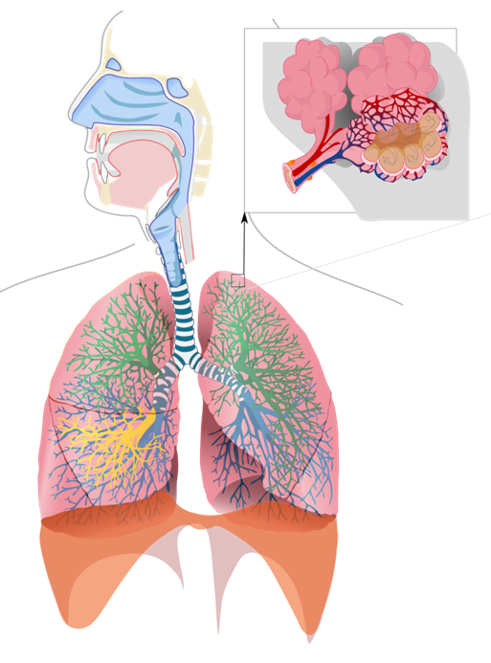
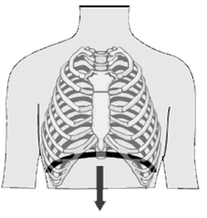
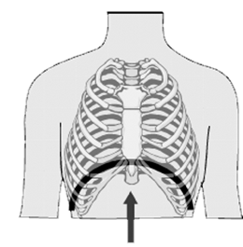
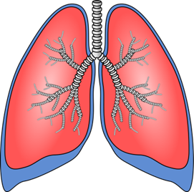
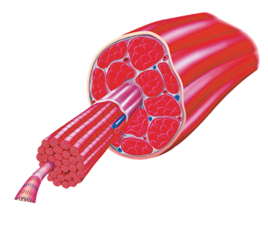
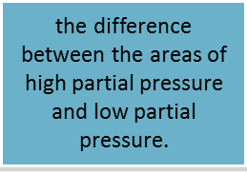
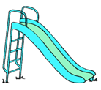
RESPIRATORY SYSTEM AT REST: WHAT YOU NEED TO KNOW
Anatomy of the Respiratory System
02 & C02 transportation in blood: 02 in Oxyhaemoglobin & plasma. C02 in Carbaminohaemoglobin, plasma & carbonic acid
Passage of air into the lungs…
VE = TV X F
Minute Ventilation (VE)
Av. rest = 6 l/min
Trained = 5 l/min
Tidal Volume (TV)
Av. rest = 0.5 l
Trained = 0.5 l
Breathing Frequency (f)
Av. rest = 12 breathes/min
Trained = 10 breathes/min
Mechanics of Breathing
INSPIRATION = active
Diaphragm & external intercostals: contract.
Rib cage moves: up & out.
Volume of thoracic cavity: increases
Pressure of air inside lungs: decreases
Air rushes: into lungs
Mechanics of Breathing
EXPIRATION = passive
Diaphragm & external intercostals: relax.
Rib cage moves: down & in.
Volume of thoracic cavity: decreases.
Pressure of air inside lungs: increases
Air rushes: out of lungs
External Respiration
…between alveoli & blood
Where does it happen?
Between what?
Movement of 02?
Movement of C02?
How does 02 move?
How does the C02 move?
Internal Respiration
…between blood & muscle
Where does it happen?
Between what?
Movement of 02?
Movement of C02?
How does )2 move?
How does the C02 move?

Slide 6
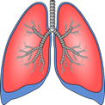
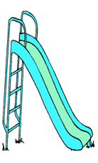
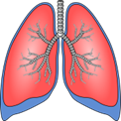
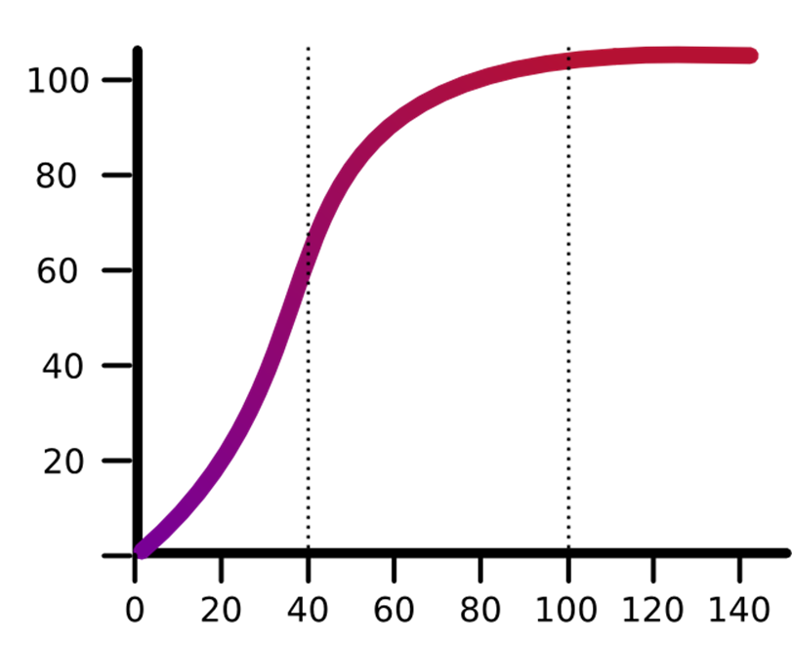
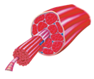
RESPIRATORY SYSTEM DURING EXERCISE & RECOVERY:
What you need to know...
HR
(bpm)
Submaximal Exercise on VE
VE
(l/min)
Rest
Exercise
Recovery
INSPIRATION = ACTIVE
… depth of breathing increases
additional muscles:
Sternocleidomastoid & Pectoralis Minor.
more, more, more, more, more, more
120
2
3
Effects of Exercise on Gaseous Exchange
1
4
5
5
Describe explain & compare
At the alveoli during exercise…
Oxygen Carbon Dioxide
Muscles use more
Steeper diffusion
Faster & more efficient
More 02 combines with
haemaglobin
0
Time (mins)
60
Describe
& explain
Maximal Exercise on VE
200
Rest
Exercise
Recovery
VE
(l/min)
2
3
4
EXPIRATION = ACTIVE
…rate of breathing increases
additional muscles:
Internal Intercostals & Rectus Abdominus.
more, more, more, more, more, more
5
1
5
0
2
Time (mins)
E
Submaximal Exercise on TV
Oxyhaemoglobin Dissociation Curve
3
100%
TV
(l)
submaximal
maximal
The Bohr Shift
Describe & explain
Compare
to rest
Describe
& explain
0.5
2
3
75%
Oxygen
Carbon Dioxide
Body Temperature
Acidity
% saturation of haemoglobin with 02
1
Average values for F, TV & VE
40%
Exercise intensity (km/hr)
 | Rest | Maximal
F | 12 breaths/min | 50 breaths/min
TV | 0.5 l | 2.5 l
VE | 6 l/min | 125 l/min
40
pp02 (mmHg)
Submaximal Exercise on F
Regulation of Breathing During Exercise & Recovery
60
submaximal
maximal
f
(Breaths
/min)
1
2
RCC informed by Thermoreceptors
Chemoreceptors, Baroreceptors
& Proprioceptors.
IC controls inspiration
Phrenic nerve stimulation
Herring Breuer Reflex
EC controls expiration
Intercostal nerve stimulation
Athlete values for F, TV & VE
10
 | Rest | Maximal
F | 10 breaths/min | 60 breaths /min
TV | 0.5 l | 3 l
VE | 5 l/min | 180 l/min
de
Exercise intensity (km/hr)
Describe & explain
Describe
& explain
VE, TV & E during recovery
VE reduces gradually
Resaturate 02 & remove C02
cool down maintains VE

Slide 7
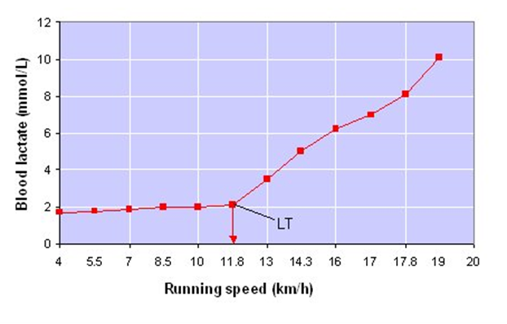
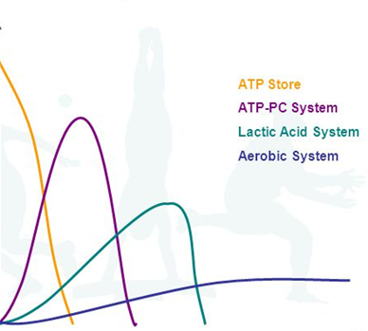
ENERGY SYSTEMS: WHAT YOU NEED TO KNOW
The ATP-PC (phosphocreatine) System
The Glycolytic System
The Aerobic System
Creatine Kinase
GPP
PFK
2ATP
S1: aerobic glycolysis
S2: Kreb’s cycle
1ATP
Glycogen
S3: ETC
(exothermic reaction)
(exothermic reaction)
Acetyl CoA
+ oxaloacetic
Hydrogen
GPP
PC
P + C +
Glycogen
Glucose
Pyruvic acid +
Glucose
2 ATP
H+
+
02
e-
LDH
PFK
Citric acid
Coupled reaction
Coupled reaction
Pyruvic acid +
(Endothermic reaction)
Lactic acid
C02
hydrogen
+ ADP + P
ATP
+ 2 ADP + 2P
2ATP
Acetyl CoA
H20
(endothermic reaction)
34ATP
Advantages
Disadvantages
Advantages
Disadvantages
Advantages
Disadvantages
2ATP
**fats as fuel?
ATP
What is the definition?
What is the structure?
Where is it stored?
What enzyme breaks it down?
What is released when ATP is broken down?
What type of reaction is this ?
How is it resynthesised?
What type of reaction is this?
10
Factors for each system
Lactate Threshold & OBLA
Predominant Energy System
Type of reaction
Fuel used
Site of reaction
Controlling enzyme(s)
ATP yield
Stages within each system
By-products
Intensity of system
Duration of system
Sporting examples
threshold
% contribution
of energy
system to ATP
resynthesis
High
intensity
Time (seconds)
Low
intensity
2
10
180

Slide 8
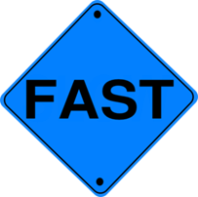
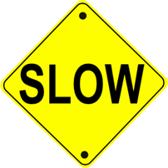
THE RECOVERY PROCESS: WHAT YOU NEED TO KNOW
Rest
Maximal
exercise
Recovery
V02
(ml/kg/min)
Rest
Submaximal
exercise
Recovery
V02
(ml/kg/min)
Steady state
EPOC
Alactacid
Lactacid
EPOC
Alactacid
Lactacid
0
60
Time (mins)
0
3
Time (mins)
Factors Affecting Recovery
Understanding the Recovery Process
C02 removal:
3 reasons why C02 levels are high after exercise
2 ways C02 is carried: carbaminohaemoglobin & carbonic acid
2 roles of chemoreceptors
Glycogen replenishment
2 systems deplete glycogen
Cori cycle, glucogenisis & carbohydrates replenish glycogen
Carbohydrate 30 min window
Techniques to speed up recovery
1. Ice bath
2. active recovery
3. gels, powders, shakes
compression tights
5. sleep, foam rollers, massage
6. Cherries
7. Rehydration
8. pre-event supplements
Energy system | Work:relief ratio | Improves…
ATP-PC | 1:3 | Speed & power
Glycolytic | 1:2 | Lactate threshold
Aerobic | 1:1 or 1:1.5 | V02 max
Alactacid component of EPOC
Lactacid component of EPOC
2
Processes that occur
Replenishment of ATP & PC
Resaturation of myoglobin &
haemoglobin with oxygen
4
Processes that occur
Elevated circulation
Elevated ventilation
Elevated body temperature
Removal of lactic acid
(Cori Cycle: glucogenesis)
2
Duration of fast component
Reasons:
30 seconds = 50%
180 seconds = 100%
Duration of fast component
1.
During exercise to allow repeated
bouts of high intensity exercise.
How?
100% = 1hr to 24hr
Volume of 02 consumed
Up to…
Volume of 02 consumed
2.
After exercise to allow maximal
performance in following events.
How?
4 litres
Between…
5 to 8 litres
(during the aerobic system)
(during the aerobic system)

Slide 9
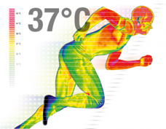
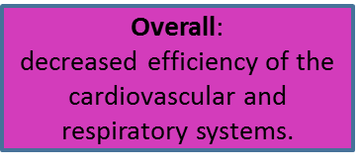
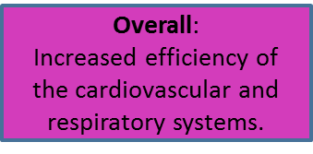
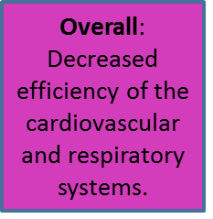
EFFECTS OF ALTITUDE & HEAT : WHAT YOU NEED TO KNOW
A rise in ATP breakdown = rise in core body temperature
Heat detected by thermoreceptors & informs the
hypothalamus
Exercise in the Heat
Impact of Exercise in the Heat
Effect on CV system
Increased blood to skin
Blood pooling at skin
Decrease in SV
Increase in HR
Increase in sweat production
Decrease in volume of blood plasma
Increase in HR
2.
2. Evaporative techniques
Defence mechanisms:
non-evaporative
techniques
Cardiovascular drift
Effect on Respiratory system
Increase in F
Increase risk of asthma
n
Impact of Exercise at Altitude
Exercise at Altitude
Hypoxia – shallower diffusion gradient
Effect on CV System
Capillarisation
Increase in EPO
Increase in haemoglobin
Increase in 02 carrying capacity
REST EXERCISE ALTITUDE
Gaseous exchange of 02 during external respiration
Transport of 02 between lungs & muscles
Gaseous exchange of 02 during internal respiration
Effects on Respiratory System
Increased surface area of alveoli
Increased diffusion capacity
Increased strength of respiratory muscles
Submaximal intensity deteriorates – WHY???
Maximal intensity maintained – WHY???
Post acclimatisation – submaximal intensity improves – WHY???

