Slide 1
Starting secondary school - Making the best start

Slide 2
Starting at a new school
Secondary school is a big transition and it can be very difficult to get used to. However, it's also an exciting opportunity to make new friends and experience new activities.
This is the start of the next step on your educational journey, so what can you do to ensure you make the best start possible?

Slide 3
Notes:
https://www.youtube.com/watch?v=HWNJCuJc41E

Slide 4
How are you feeling?
How are you feeling about starting secondary school?
Do you feel nervous?
Do you feel excited?
Do you feel scared?
Do you feel relaxed?

Slide 5
It is normal to feel that way
When starting a new school it is perfectly normal to feel the way you do. You are not alone and there are probably many other students that feel exactly the same way.

Slide 6
Starting Secondary school
Lets look at some top tips at making the best start possible at your new school.

Slide 7
Try not to be scared
Even if you are scared, try to think positive! Think about how more in-depth your favourite lessons will now be, and think of all the new friends you'll make besides your old friends. Chellaston Academy is graet and if you make the most of the opportunities on offer when you join us in September you will learn lots of new skills.

Slide 8
Talk to other students
You will end up with many new friends and be sure to find people with similar interests to you. Many people make friends for life in Secondary school.

Slide 9
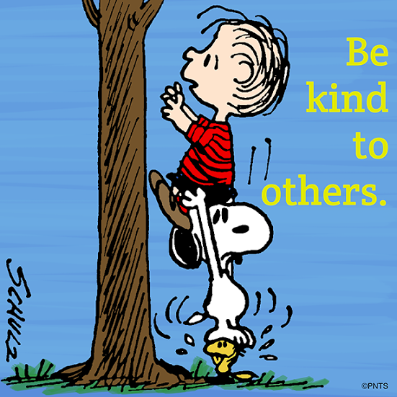
Be nice to others
Try to get along with everyone. If a classmate is rude to you, walk away, and make friends with other classmates .Treat others how you would like to be treated yourself. We do not tolerate bullies at this school!

Slide 10
Get involved
Try to participate in all of your lessons. Even if the answer is wrong, it is alright! You might even understand the topic better if you try. In fact, getting the answer wrong can sometimes help you understand it better. You will also enjoy your lessons more if you get fully involved.

Slide 11
Extra-curricular Clubs
When the time comes, attend lunch and after school clubs that you think sound fun. It's a great way to make new friends and have something fun to do! You may try clubs and think some are not for you, the important thing is to give it a go!

Slide 12
Get Homework Done
You will get more homework that you did in Primary school. It’s a good idea to get it done as soon as you get home. This will stop you forgetting about it. It will also ensure you remember more from your lessons and achieve better results! The LS department runs a homework every morning and every night after school which is free for anyone who wants to attend.

Slide 13
Attendance
The Department of Education conducted research in 2015 and found there was a strong relationship between those that attend school and those that achieve.
Your attendance target this year is 97+%

Slide 14
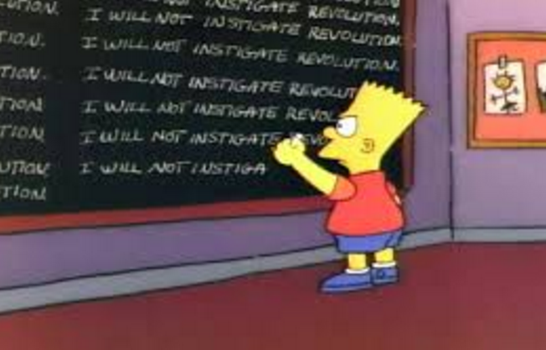
Behaviour
Ofsted claim that students could be losing up to 38 days of learning every year due to low-level disruption. The report identified students calling out, rocking on chairs or not having the right equipment as common problems that hamper learning and waste lesson time.
Good behaviour could be the difference between getting the GCSEs that lead to opportunities for further learning and successful careers or leaving school with little hope of a steady job with good prospects.

Slide 15
School Equipment
Each lesson requires different equipment. Without that equipment you are not able to fully engage in the lesson.
Without a pen, how can you write in English? Without your PE kit how can you participate in PE? Without your calculator, how will you answer those difficult Maths questions?

Slide 16
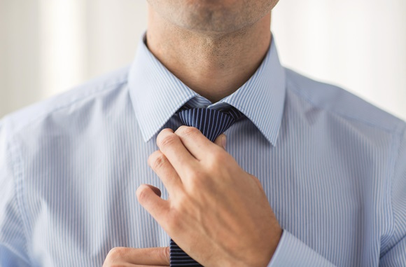
Uniform
Remember that whether you are in school or out of school, when you are wearing our uniform you are representing the school. Ensure you are wearing it appropriately (shirts tucked in, skirts the proper length) and make sure you are presentable. Would you get hired for a job if you wore business clothes in the same way you wear your uniform?

Slide 17
Ask for help
If you need help with anything next year, there are always people in school to help you! Though we are not mind readers, so if you need help then please speak to someone. Mrs Grimwood will allocate some current year 7’s and year 10’s to act as student mentors to help you to settle in September. Some of you may also have a teacher mentor allocated to you as an extra layer of support to help you to settle.

Slide 18
Enjoy Yourself
Be open to new experiences, challenges, activities and people. Secondary school can be really fun. Embrace it. Just do the best you can in all subjects and you'll get along just fine.

Slide 19
Notes:
https://www.youtube.com/watch?v=ziK5wRYfhhA

Slide 20
Reflection
Do others feel they way you do about starting school?
How will you ensure you make the best start at your new school?
What do you hope to achieve at this school?

