Slide 1
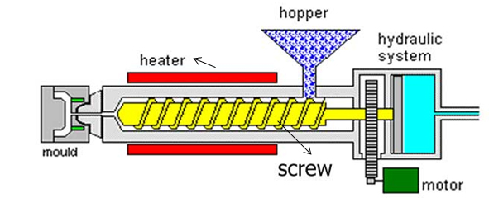
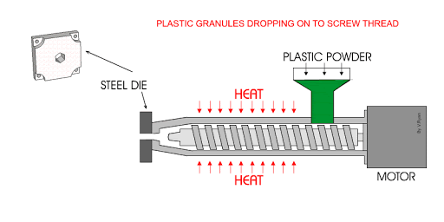
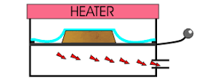
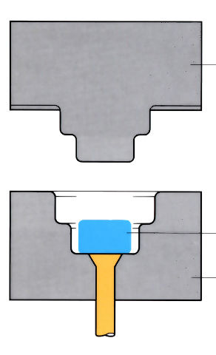
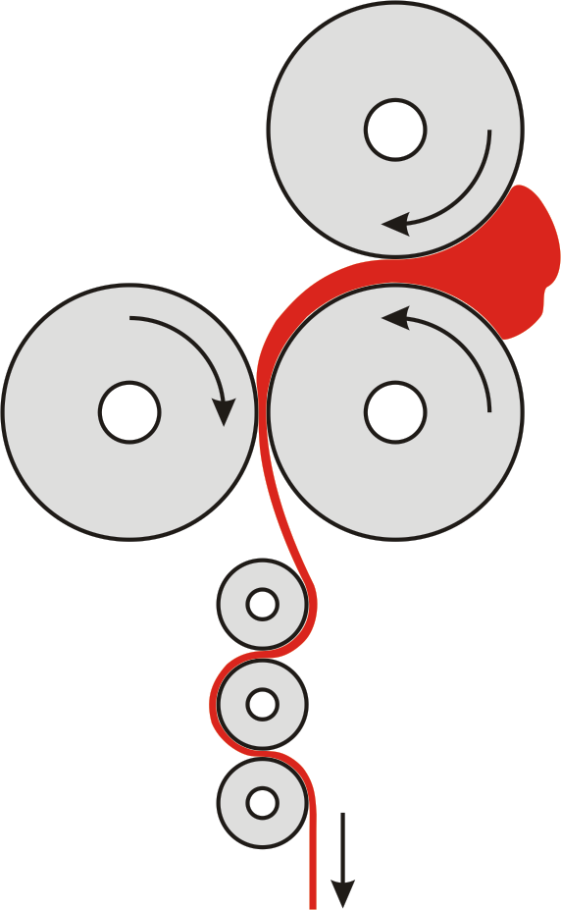
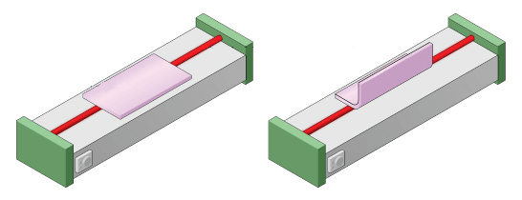
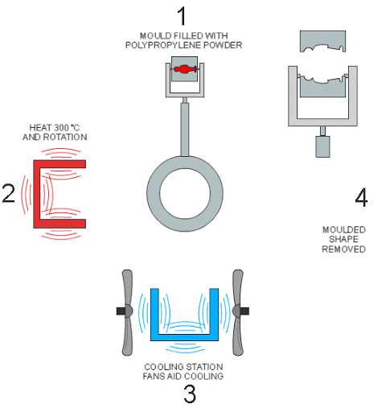
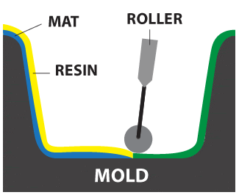
3.1.4 Polymer Processes
Knowledge Organiser
Shaping Process | Diagram
Vacuum Forming
Heats sheets of thermoplastics around moulds. Moulds need draft angles, air holes and rounded corners to work. Ideal for batch and mass production
Shaping Process | Diagram
Injection Moulding
Complex 3D shapes are made quickly for mass or continuous production. Tooling and set-up costs are high https://www.youtube.com/watch?v=ckWi-rOxPzo
Shaping Process | Diagram
Extrusion
Follows same process as injection moulding, but melted polymer goes through a die rather than a mould. Good for continuous production
Shaping Process | Diagram
Calendering
Heated rollers squash and stretch polymer pellets to make thinner. Used for continuous production
Shaping Process | Diagram
Blow Moulding
Parison stretched to fit a mould, using hot air. High set-up costs but ideal for mass and continuous production of thin-walled components like bottles https://www.youtube.com/watch?v=8W6P5KU5ONQ
Shaping Process | Diagram
Compression Moulding
Polymer slug is placed in the lower mould and pressed into shape. Good for large-scale batch production
Forming Process | Diagram
Line Bending
Heats along a line, on thermoplastic sheeting. Suitable for one-off and batch production, especially in schools
Forming Process | Diagram
Rotational Moulding
Mould filled with thermoplastic granules or powder. Then continuously rotated through heating and cooling chambers. Ideal for batch or mass production
Forming Process | Diagram
Lamination (Lay-up)
Fibre reinforced composite sheets are rolled into a mould and resin cast over the top.

