Slide 1
A level Spanish.
What’s it all about?

Slide 2
A 2 year course with an A level qualification from A – E at the end of the 2 years.
3 parts to the exam……….
An oral ( 1 role play card and an individual research project on a topic of your choice- 30% of the final exam)
A listening , reading and translation paper.( 50% of the final exam)
An essay paper based on a novel and a film we study together over the two years.( 20% of the final exam)

Slide 3
How many lessons per fortnight?
You will have 10 lessons a fortnight with two language teachers who will teach different topics and grammar and a timetabled study session in which guided work will be set.

Slide 4
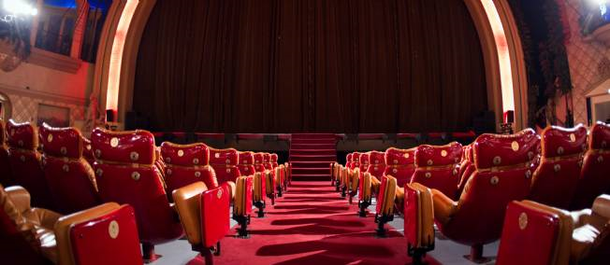
What are the topics we cover in Year 12?
The changing nature of the family in Spain.
New technology
Gender Equality
Influence of Celebrities
Regional Identity in Spain
Cultural heritage in the Spanish speaking world.

Slide 5
What skills do you need for the A level course.
As with Spanish in KS3 and 4, you will need to practise your listening, reading , writing and speaking skills.
We will also look at developing our research skills in preparation for the IRP part of the oral exam.
Above all learning a foreign language requires you to be an autonomous learner. There are lots of tips in the transition booklet to help you become an independent linguist.

Slide 6
What will I need to do in preparation for the course?
Over the summer we will expect you to complete the research project and the exercises in the transition booklet.
Aim to look over your grammar notes from GCSE
Listen to some Spanish songs on You Tube, watch a Spanish film and try to read some extracts from Spanish magazines or newspaper but there are lots of other suggestions in the holiday booklet

Slide 7
What will I need for the course
Make sure you download the word reference. com app on to your phone. This includes a verb conjugation section.

