Slide 1
A Level Geography
Chellaston Academy

Slide 2
Why is Geography so relevant?
The world in which we live is likely to change more in the next 50 years than it ever has before. Geography explains why this is and it helps to prepare you for those changes.
“Geography is the subject which holds the key to our future”
Michael Palin

Slide 3
Geography and employment
Compared to other subjects, students who have a university degree in geography are the most employable.
Geography trains you in the range of skills that employers want.
These include scientific, communication and IT skills.

Slide 4
What the course involves
Year 12
Physical
Tectonics
Coasts
Human
Globalisation
Regeneration

Slide 5
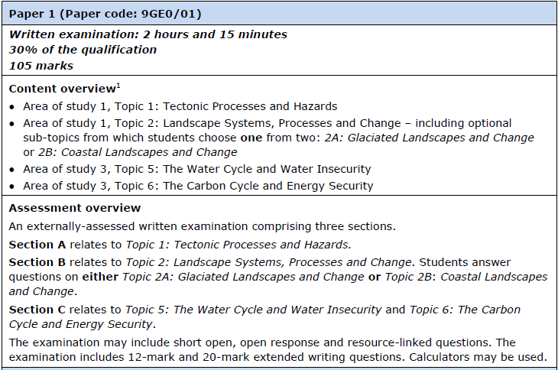
Paper 1

Slide 6
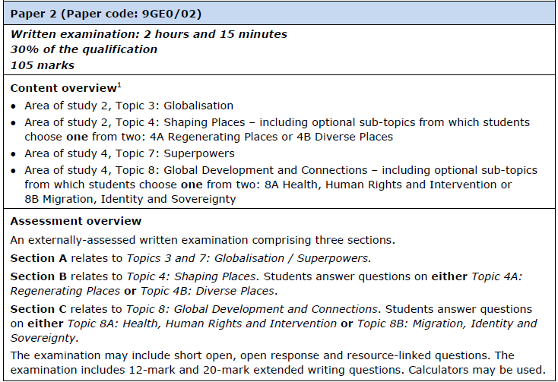
Paper 2

Slide 7
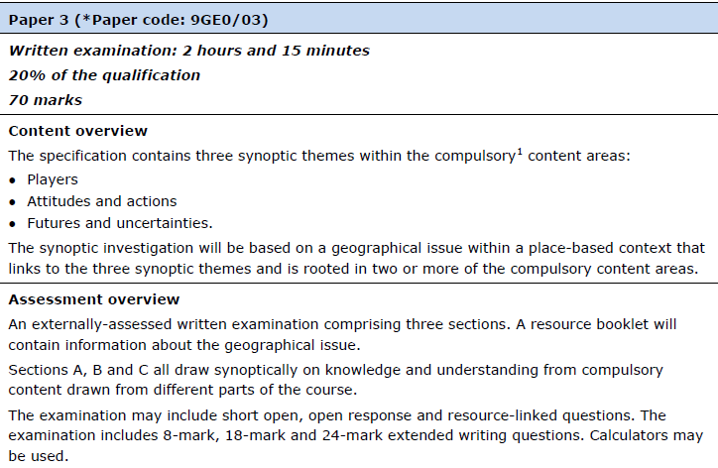
Paper 3

Slide 8
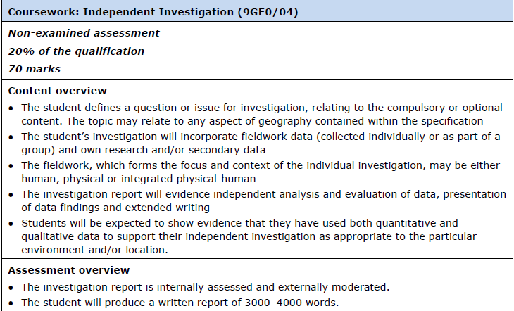
Coursework

Slide 9
Progression from GCSE Geography
Edexcel Geography has been designed to work with which ever GCSE you have followed. It builds on existing knowledge and skills you all have.

Slide 10
Modern and fresh
Edexcel A Level Geography is modern, topical and cutting edge.
At Chellaston Geography is delivered by very experienced, committed teachers with an interesting and innovative approach. You will have separate teachers to deliver the Human & Physical aspects of the course
Allowing everyone to achieve their potential is our only focus.

Slide 11
Expectations
Good attendance and punctuality
Good commitment and effort
Attend and work hard on fieldtrips
Buy the course textbook
Buy the revision guide and journal subscription

Slide 12
Fieldwork
Fieldwork is a requirement of the new Edexcel A Level.
All students must complete a minimum of 4 days of fieldwork in order to be entered for the exams.
A fieldtrip to Iceland is also offered but this is optional.

Slide 13
Costs involved
You will need to buy of at least one textbook. This could be a hard copy or a digital copy to work on your laptop/tablets/phones. (£25 for a hardcopy)
Geography revision guide (£14)
Subscribe to the Geographical review (£15)
4 days compulsory fieldwork – Costs minimal

Slide 14
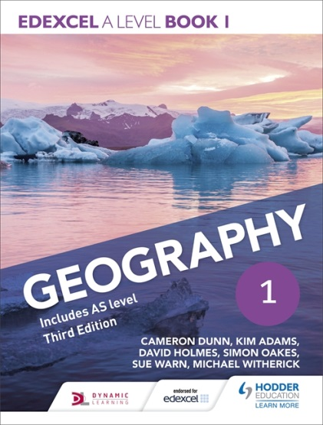
Resources
The school will provide 2 of the core books.

Slide 15
Time for your questions???

