Slide 1
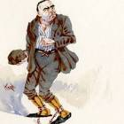
Welcome to English at Chellaston!
LO: To be able to write analytically.
Key words:
Research
Context
Literature
Victorian
Knowledge
Do Now:
What can you predict about this man?
Where do you think he has been and why?
What do you think he will be like?

Slide 2
An escaped convict
What impression do you get about the characters from the extract?
Have a read of the extract from the beginning of ‘Great Expectations’.
Do the characters link to any of the ideas you came up?
Discussion point:
What were the key differences and similarities between your impression of Magwitch and the way he is portrayed in the extract?
Was there anything in the extract that you weren’t expecting?

Slide 3
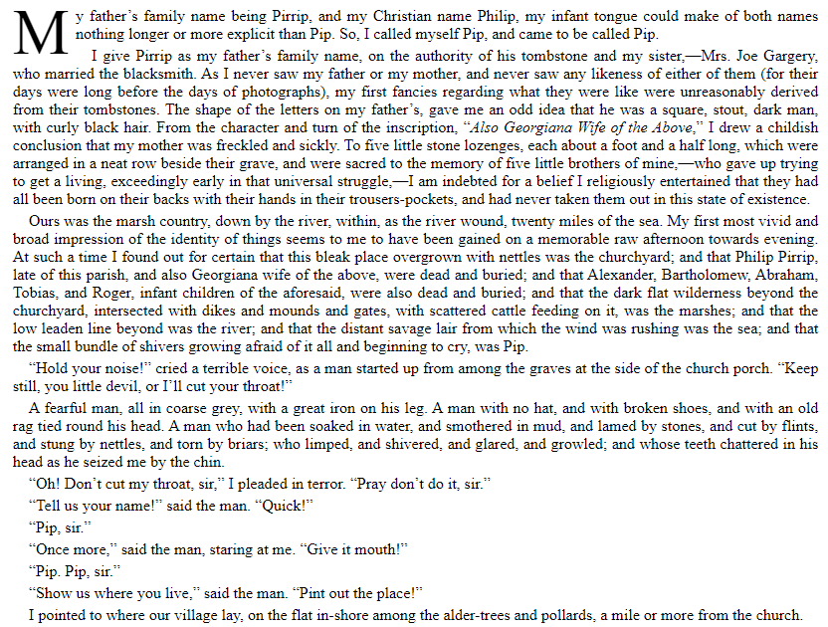
Great Expectations
In this extract, the protagonist, Pip, meets an escaped prisoner for the first time.
Notes:
Discuss what is happening in the extract and how people are feeling here - is this what you were expecting? How could it link to any of the ideas on your mindmap?

Slide 4
Plan it out
Words / Sentences / Figurative lang.
How has language been used to describe Magwitch?
By
Because
Dangerous
Find your proof - for each inference that you have made, find a line in the extract to support it.

Slide 5
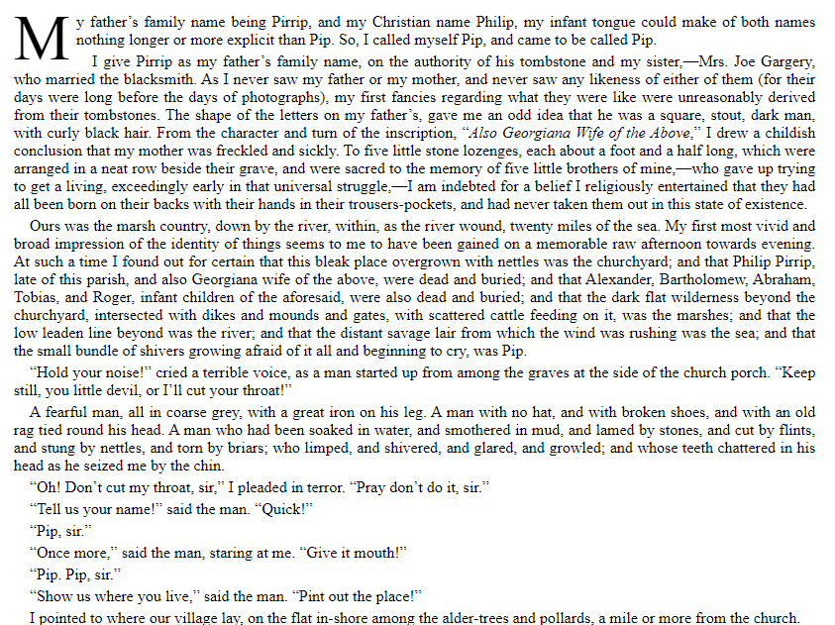
Dangerous

Slide 6
Talking the talk!
When we analyse, we need to say more than just ‘the writer shows us something’...
Demonstrate
Imply
Educate
Suggest

Slide 7
Writing analytically
When we write analytically, we focus on the writer’s intent: what is the purpose of their work?
What (This is where you make your inference) | The writer suggests that the escaped convict is dangerous.
How (This is proof from the text) | He is described as ‘ starting up from among the graves’
Why (This is where you explain your idea and think about purpose) | This implies that he has been lurking for some time and watching Pip, or perhaps that he is undead and haunting the main character.

Slide 8
What have you learned?
Time to sum up what you’ve learned!
What have you learned about the 19th Century today? | What have you learned about English at Chellaston today? | What have you learned about analysis today?

