Slide 1
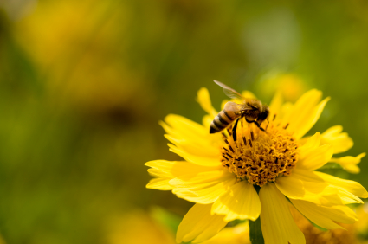
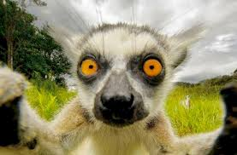
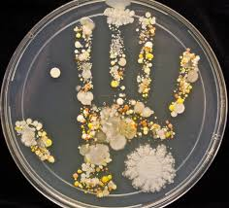
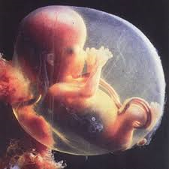
Chellaston Academy
Transition Pack for A Level Biology
A guide to help you get ready for A-level Biology.
All written tasks are compulsory and must be completed for the first week of term in September.
This pack contains a programme of activities and resources to prepare you to start A level in Biology in September. It is aimed to be used after you complete your GCSE throughout the remainder of the Summer term and over the Summer Holidays to ensure you are ready to start your course in September.

Slide 2
Pre-Knowledge Topics
A level Biology will use your knowledge from GCSE and build on this to help you understand new and more demanding ideas. Complete the following tasks to make sure your knowledge is up to date and you are ready to start studying:
Cells
The cell is a unifying concept in biology, you will come across it many times during your two years of A level study. Prokaryotic and eukaryotic cells can be distinguished on the basis of their structure and ultrastructure. In complex multicellular organisms cells are organised into tissues, tissues into organs and organs into systems. During the cell cycle genetic information is copied and passed to daughter cells. Daughter cells formed during mitosis have identical copies of genes while cells formed during meiosis are not genetically identical
Take a look at these videos:
https://www.youtube.com/watch?v=gcTuQpuJyD8
https://www.youtube.com/watch?v=L0k-enzoeOM
https://www.youtube.com/watch?v=qCLmR9-YY7o
Task:
Produce a one page revision guide to share with your class in September summarising one of the following topics: Cells and their Organelles, Prokaryotes and Eukaryotes, or Mitosis and Meiosis.
Whichever topic you choose, your revision guide should include:
Key words and definitions
Clearly labelled diagrams
Short explanations of key ideas or processes.

Slide 3
Pre-Knowledge Topics
Cells – revision page

Slide 4
Pre-Knowledge Topics
Exchange and Transport
Organisms need to exchange substances selectively with their environment and this takes place at exchange surfaces. Factors such as size or metabolic rate affect the requirements of organisms and this gives rise to adaptations such as specialised exchange surfaces and mass transport systems. Substances are exchanged by passive or active transport across exchange surfaces. The structure of the plasma membrane enables control of the passage of substances into and out of cells
Take a look at these videos:
http://ed.ted.com/lessons/insights-into-cell-membranes-via-dish-detergent-ethan-perlstein
http://ed.ted.com/lessons/what-do-the-lungs-do-emma-bryce
Task:
Make notes to answer the following questions.
Define diffusion, osmosis and active transport
Give examples of where diffusion, osmosis and active transport are used in both animals and plants
Explain why oxygen and glucose need to be absorbed and waste products removed

Slide 5
Pre-Knowledge Topics
DNA and the Genetic Code
In living organisms nucleic acids (DNA and RNA have important roles and functions related to their properties. The sequence of bases in the DNA molecule determines the structure of proteins, including enzymes.
The double helix and its four bases store the information that is passed from generation to generation. The sequence of the base pairs adenine, thymine, cytosine and guanine tell ribosomes in the cytoplasm how to construct amino acids into polypeptides and produce every characteristic we see. DNA can mutate leading to diseases including cancer and sometimes anomalies in the genetic code are passed from parents to babies in disease such as cystic fibrosis, or can be developed in unborn foetuses such as Downs Syndrome.
Take a look at these videos:
http://ed.ted.com/lessons/the-twisting-tale-of-dna-judith-hauck
http://ed.ted.com/lessons/where-do-genes-come-from-carl-zimmer
Task:
Make notes to answer the following questions.
Define gene, chromosome, DNA and base pair
Describe the structure and function of DNA and RNA
Explain how DNA is copied in the body
Outline some of the problems that occur with DNA replication and what the consequences of this might be

Slide 6
Pre-Knowledge Topics
Evolution
Transfer of genetic information from one generation to the next can ensure continuity of species or lead to variation within a species and possible formation of new species. Reproductive isolation can lead to accumulation of different genetic information in populations potentially leading to formation of new species (speciation). Sequencing projects have read the genomes of organisms ranging from microbes and plants to humans. This allows the sequences of the proteins that derive from the genetic code to be predicted. Gene technologies allow study and alteration of gene function in order to better understand organism function and to design new industrial and medical processes.
Take a look at these videos:
http://ed.ted.com/lessons/how-to-sequence-the-human-genome-mark-j-kiel
http://ed.ted.com/lessons/the-race-to-sequence-the-human-genome-tien-nguyen
Task:
Make notes to answer the following questions.
Describe, using an example, how evolution occurs
Explain what a genome is
Give examples of how this information has already been used to develop new treatments and technologies

Slide 7
Pre-Knowledge Topics
Biological Molecules
Biological molecules are often polymers and are based on a small number of chemical elements. In living organisms carbohydrates, proteins, lipids, inorganic ions and water all have important roles and functions related to their properties. DNA determines the structure of proteins, including enzymes. Enzymes catalyse the reactions that determine structures and functions from cellular to whole-organism level. Enzymes are proteins with a mechanism of action and other properties determined by their tertiary structure. ATP provides the immediate source of energy for biological processes.
Take a look at these videos:
https://www.youtube.com/watch?v=H8WJ2KENlK0
http://ed.ted.com/lessons/activation-energy-kickstarting-chemical-reactions-vance-kite
Task:
Make notes to answer the following questions.
Describe the structure of an enzyme
Explain what enzymes do inside the body
Explain how both high and low temperatures affect enzymes

Slide 8
Pre-Knowledge Topics
Biodiversity
The variety of life, both past and present, is extensive, but the biochemical basis of life is similar for all living things. Biodiversity refers to the variety and complexity of life and may be considered at different levels. Biodiversity can be measured, for example within a habitat or at the genetic level. Classification is a means of organising the variety of life based on relationships between organisms and is built around the concept of species. Originally classification systems were based on observable features but more recent approaches draw on a wider range of evidence to clarify relationships between organisms. Adaptations of organisms to their environments can be behavioural, physiological and anatomical. Adaptation and selection are major factors in evolution and make a significant contribution to the diversity of living organisms.
Take a look at these videos:
http://ed.ted.com/lessons/why-is-biodiversity-so-important-kim-preshoff
http://ed.ted.com/lessons/can-wildlife-adapt-to-climate-change-erin-eastwood
Task:
Make notes to answer the following questions.
Define what is meant by species and classification
Describe how species are classified
Explain one way scientists can collect data about a habitat, giving an example
Explain adaptation and how habitat change may pose a threat to species

Slide 9
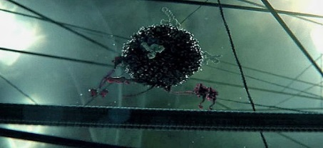
Science websites
These websites all offer an amazing collection of resources that you should use again and again through out your course.
Probably the best website on Biology….
Learn Genetics from Utah University has so much that is pitched at an appropriate level for you and has lots of interactive resources to explore, everything from why some people can taste bitter berries to how we clone mice or make glow in the dark jelly fish.
http://learn.genetics.utah.edu/
In the summer you will most likely start to learn about Biodiversity and Evolution. Many Zoos have great websites, especially London Zoo. Read about some of the case studies on conservation, such as the Giant Pangolin, the only mammal with scales. https://www.zsl.org/conservation
At GCSE you learnt how genetic diseases are inherited. In this virtual fly lab you get to breed fruit flies to investigate how different features are passed on. http://sciencecourseware.org/vcise/drosophila/
DNA from the beginning is full of interactive animations that tell the story of DNA from its discovery through to advanced year 13 concepts. One to book mark!
http://www.dnaftb.org/
Ok, so not a website, but a video you definitely want to watch. One of the first topics you will learn about is the amazing structure of the cell. This BBC film shows the fascinating workings of a cell… a touch more detailed than the “fried egg” model you might have seen.
http://www.dailymotion.com/video/xzh0kb_the-hidden-life-of-the-cell_shortfilms
If this link expires – google “BBC hidden life of the cell”

Slide 10
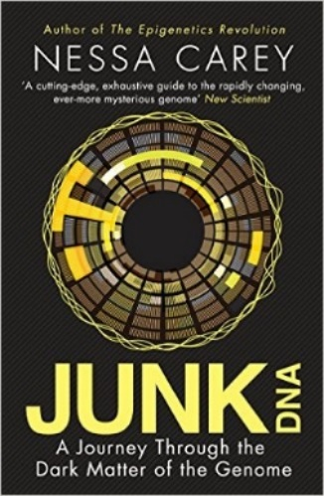
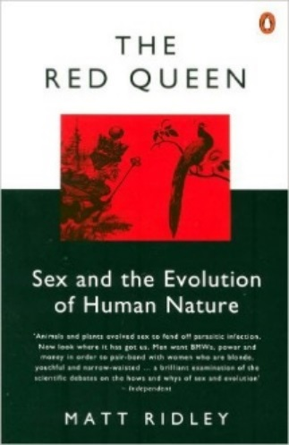
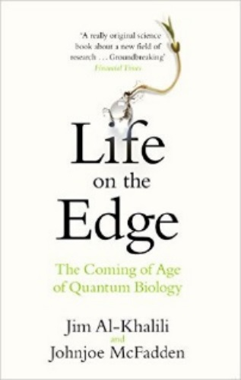
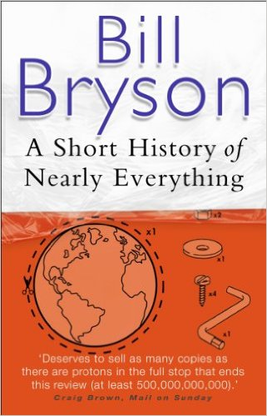
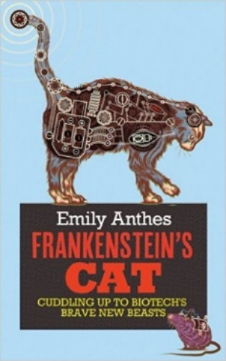
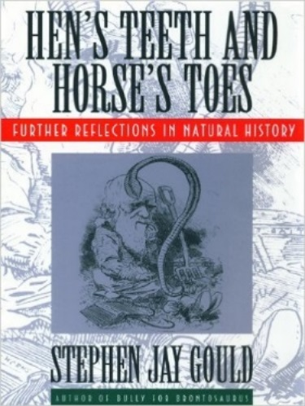
Book Recommendations
Kick back this summer with a good read. The books below are all popular science books and great for extending your understanding of Biology
The Red Queen
Its all about sex. Or sexual selection at least. This book will really help your understanding of evolution and particularly the fascinating role of sex in evolution. Available at amazon.co.uk
Junk DNA
Our DNA is so much more complex than you probably realize, this book will really deepen your understanding of all the work you will do on Genetics. Available at amazon.co.uk
A Short History of Nearly Everything
A whistle-stop tour through many aspects of history from the Big Bang to now. This is a really accessible read that will re-familiarise you with common concepts and introduce you to some of the more colourful characters from the history of science! Available at amazon.co.uk
Studying Geography as well?
Hen’s teeth and horses toes
Stephen Jay Gould is a great Evolution writer and this book discusses lots of fascinating stories about Geology and evolution. Available at amazon.co.uk
An easy read..
Frankenstein’s cat
Discover how glow in the dark fish are made and more great Biotechnology breakthroughs. Available at amazon.co.uk

