Slide 1
Drawing basic shapes in one point perspective
This is an approximate representation of 3D shapes, drawn on a flat surface.
All lines are either horizontal, vertical or come out from a single point on the paper.

Slide 2
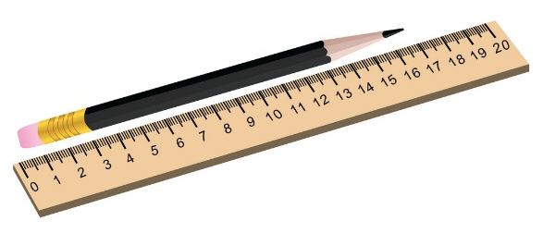
Equipment required
You will need:
A4 Plain paper
Pencil
Ruler
Pencil crayons (if you have them)

Slide 3
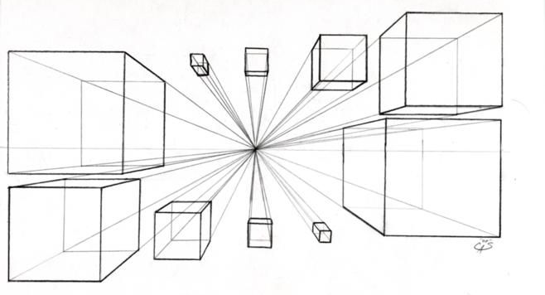
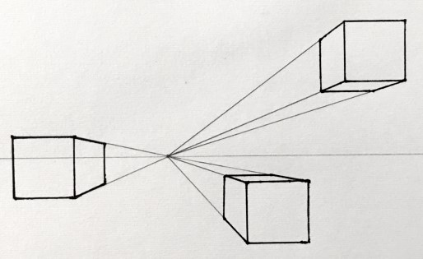
Take a look at some examples…

Slide 4
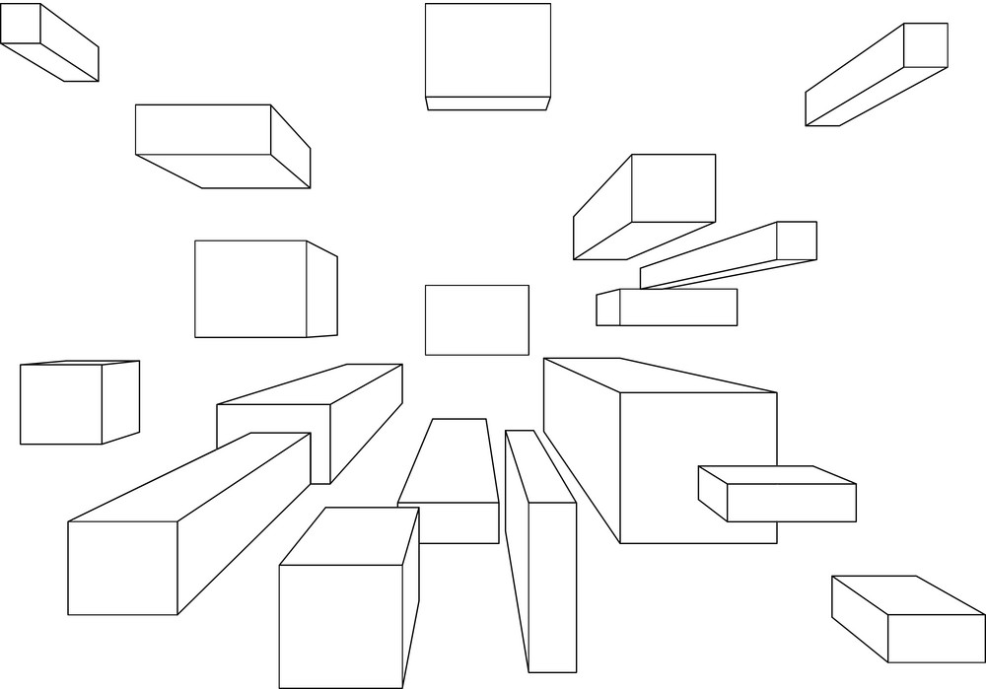
example

Slide 5
Draw around the outside edges of your cube, to make it stand out from the page. This is called ‘Thick and thin line technique’.
Use a ruler to draw a square on your paper. The exact position of the square isn’t important, just try to copy the example to help you, as you start.
Add lines from your cross (VP) to the three corners of the square, as shown.
Add a vertical and horizontal line to set the size of your cube.
Start by drawing a small cross, in the centre of A4 paper. The page should be landscape (this means the long sides are top and bottom of the drawing). The rectangle should be above the centre point on the page. The small cross is what we call the vanishing point, or VP.

Slide 6
Use pencil crayons to shade your cubes. If you don’t have any colours, use your drawing pencil to add shade.
Now draw a range of other cubes. Each time, draw the square first, then take the corners back to the cross. Set the size of the cube with vertical and horizontal lines. Draw at least six cubes on your page.
Look back at the example slides, to see how the cubes look different, depending upon where you place them on the page.

