Slide 1
Sample program:
// Number data types
using System;
namespace ConsoleApp1
{
class Program
{
// Subroutine to calculate VAT
static double VAT(double Total)
{
return Total * 0.05;
}
//Main program
static void Main(string[] args)
{
const double Total = 100.12;
double ValueAddedTax = VAT(Total);
double ToPay = Total + ValueAddedTax;
Console.WriteLine("Total £{0:0.00} :: VAT £{1:0.00} :: To Pay £{2:0.00}", Total, ValueAddedTax, ToPay);
}
}
}
Notes:
Predict what you think this program does.
Type in the code and run it to see if you were right.
If your code does not work, check the following:
Have you typed every line of code exactly as you see it?
Have you got the brackets and semi-colons in the right place?
Are letters that are capitalised correctly entered?

Slide 2
This program calculates VAT and outputs the total cost of an item.
Understand how the code works:
// Number data types
using System;
namespace ConsoleApp1
{
class Program
{
// Subroutine to calculate VAT
static double VAT(double Total)
{
return Total * 0.05;
}
//Main program
static void Main(string[] args)
{
const double Total = 100.12;
double ValueAddedTax = VAT(Total);
double ToPay = Total + ValueAddedTax;
Console.WriteLine("Total £{0:0.00} :: VAT £{1:0.00} :: To Pay £{2:0.00}", Total, ValueAddedTax, ToPay);
}
}
}
The function VAT takes a decimal number parameter called Total and returns a decimal number which is the total multiplied by 0.05 (5%)
Using functions for such small operations may seem pointless, but it gets you into good habits for when you write larger programs.
“const” tells the computer this value will never change when the program is running.
Numbers can be formatted inside strings. Curly brackets indicate a formatting string. The first number is an identifier, followed by a colon, followed by the format required. 0.00 means two decimal places.
Notes:
Change the program so that VAT is 20% instead of 5% and the value of the goods is £99.99 instead of £100.12. If your program works, the total to pay should be £119.99.
Change the program so that the VAT function takes two parameters, the total and the VAT rate as either, “Standard”, “Reduced” or “Zero”. Standard returns 20% VAT, Reduced returns 5% VAT, Zero returns 0% VAT. You will need to use the “if” command from objective 2.

Slide 3
Sample program:
// Number data types
using System;
namespace ConsoleApp1
{
class Program
{
// Subroutine to generate a random number
static int RollDice()
{
Random Number = new Random();
return Number.Next(1,7);
}
//Main program
static void Main(string[] args)
{
int Dice = RollDice();
Console.WriteLine("Rolled a {0}", Dice);
}
}
}
Notes:
Predict what you think this program does.
Type in the code and run it to see if you were right.
If your code does not work, check the following:
Have you typed every line of code exactly as you see it?
Have you got the brackets and semi-colons in the right place?
Are letters that are capitalised correctly entered?

Slide 4
This program outputs a random number between 1 and 6.
Understand how the code works:
// Number data types
using System;
namespace ConsoleApp1
{
class Program
{
// Subroutine to generate a random number
static int RollDice()
{
Random Number = new Random();
return Number.Next(1,7);
}
//Main program
static void Main(string[] args)
{
int Dice = RollDice();
Console.WriteLine("Rolled a {0}", Dice);
}
}
}
Number is a new random number. The number is the next one in a random sequence between 1 and 6. The highest number that can be returned is one less! Number is returned to Dice in the main program.
The program starts here by executing the subroutine called RollDice. That function returns a random number between 1 and 6 and stores it in a variable called Dice.
START HERE
Dice is output using string formatting which is a more modern approach to concatenation.
Notes:
Change the program so that it outputs the result of a 12-sided dice instead.
Change new Random(); to be new Random(20); instead. Run the program a few times to see what affect this has on the dice roll. Try a different number to 20 and run the program a few more times to see the effect. Random is in fact a deterministic sequence!

Slide 5
Sample program:
// Number data types
using System;
namespace ConsoleApp1
{
class Program
{
// Subroutine to return odd or even
static string OddEven(int Number)
{
if (Number % 2 == 0)
{
return "Even";
}
else
{
return "Odd";
}
}
//Main program
static void Main(string[] args)
{
Console.WriteLine(OddEven(8));
}
}
}
Notes:
Predict what you think this program does.
Type in the code and run it to see if you were right.
If your code does not work, check the following:
Have you typed every line of code exactly as you see it?
Have you got the brackets and semi-colons in the right place?
Are letters that are capitalised correctly entered?

Slide 6
This program outputs whether a number is even or odd.
Understand how the code works:
// Number data types
using System;
namespace ConsoleApp1
{
class Program
{
// Subroutine to return odd or even
static string OddEven(int Number)
{
if (Number % 2 == 0)
{
return "Even";
}
else
{
return "Odd";
}
}
//Main program
static void Main(string[] args)
{
Console.WriteLine(OddEven(8));
}
}
}
OddEven is a function that takes an integer parameter and returns a string.
% is the mathematical operator for modulus.
Modulus is the remainder from a division. E.g. 11 divided by 4 is exactly 2 with 3 left over.
If the modulus is zero, the number is exactly divisible.
Notes:
Check the program works with a full range of numbers, both odd, even, zero, positive and negative. Remember testing functions for the different possibilities is essential in programming.
Change the condition so that the function still works if the line return “Even” is swapped with the line return “Odd”.

Slide 7
Sample program:
// Number data types
using System;
namespace ConsoleApp1
{
class Program
{
// Subroutine to demonstrate casting and operators
static void MathsDemo(double X, double Y)
{
double DivisionResult = X / Y;
Console.WriteLine("{0} divided by {1} is {2}", X, Y, DivisionResult);
int IntDivisionResult = Convert.ToInt32(X / Y);
Console.WriteLine("{0} integer division by {1} is {2}", X, Y, IntDivisionResult);
int ModResult = Convert.ToInt32(X % Y);
Console.WriteLine("{0} modulus {1} is {2}", X, Y, ModResult);
double OldX = X;
X++;
Console.WriteLine("{0} incremented is {1}", OldX, X);
}
//Main program
static void Main(string[] args)
{
MathsDemo(10, 7);
}
}
}
Notes:
Predict what you think this program does.
Type in the code and run it to see if you were right.
If your code does not work, check the following:
Have you typed every line of code exactly as you see it?
Have you got the brackets and semi-colons in the right place?
Are letters that are capitalised correctly entered?

Slide 8
This program illustrates casting and operators.
Understand how the code works:
// Number data types
using System;
namespace ConsoleApp1
{
class Program
{
// Subroutine to demonstrate casting and operators
static void MathsDemo(double X, double Y)
{
double DivisionResult = X / Y;
Console.WriteLine("{0} divided by {1} is {2}", X, Y, DivisionResult);
int IntDivisionResult = Convert.ToInt32(X / Y);
Console.WriteLine("{0} integer division by {1} is {2}", X, Y, IntDivisionResult);
int ModResult = Convert.ToInt32(X % Y);
Console.WriteLine("{0} modulus {1} is {2}", X, Y, ModResult);
double OldX = X;
X++;
Console.WriteLine("{0} incremented is {1}", OldX, X);
}
//Main program
static void Main(string[] args)
{
MathsDemo(10, 7);
}
}
}
Convert.ToInt32 converts (casts) a double number with decimal places into an integer without rounding.
Integer division is dividing and discarding the remainder.
++ is a shorthand for adding one (incrementing) a variable. This is the same as X = X + 1
Notes:
Study this program carefully to understand what each operation does.

Slide 9
Learning points from this objective:
The code a programmer writes is called source code. This is translated into machine code instructions the computer can execute.
Stating the data type and whether an identifier will be a constant or a variable is called a declaration.
Declaring a value as a constant will make the machine code more efficient because constants can be fetched by the processor from memory with the instruction at the same time. Variables are fetched in a subsequent operation.
It is good practice to declare constants for values that never change. Another example of a constant is Pi.
Strings can be formatted so that values are output in a particular way, e.g. to two decimal places. This is known as string formatting.
String formatting is a more modern approach to concatenation. It results in more efficient machine code and gives the programmer lots of easy to use options for the format of data.
Random numbers from a computer are not truly random. It is possible to use hardware random number generators that read environmental attributes to create random numbers, e.g. the time between key presses on a keyboard, but usually they are generated mathematically from what is called a seed. That makes them deterministic. E.g. Dividing 22 by 56 will give you a sequence of seemingly random digits, but if you always use 22 and 56 you will always get the same sequence. Changing the numbers you divide is changing the seed.
Modulus is the remainder from a division. % is the mathematical operator for modulus in C#.
Integer division is the whole number part from a division with the remainder or decimal places discarded. The number is said to be truncated. Integer division is achieved in C# by casting the result to an integer.
Casting is converting one data type to another. E.g. changing a float to an integer. This is necessary because different data types are stored in the memory in different ways. This means you cannot perform arithmetic on two different data types without casting the values or result.
Adding one to the value of a variable is called an increment. In C# this can be done with ++. Subtracting one from a variable is called a decrement. In C# this can be done with --.
Notes:
Read the summary of the key learning points for this objective.
Watch this interesting video about how lava lamps are used to secure data transfer: https://www.youtube.com/watch?v=1cUUfMeOijg

Slide 10
Program comprehension:
using System;
namespace ConsoleApp1
{
class Program
{
static void MathsDemo(double X, double Y)
{
double DivResult = X / Y;
int IntDivResult = Convert.ToInt32(X / Y);
int ModResult = Convert.ToInt32(X % Y);
Y++;
}
static void Main(string[] args)
{
MathsDemo(3, 2);
}
}
}
ITEM | Identify the modulus operator in this program.
 | Identify the incrementing operator in this program.
 | Identify a command that casts a double to an integer.
PURPOSE | What is the value of Y at the end of the program?
 | What does Convert.ToInt32(1.5) do, as used in line 9?
Notes:
Answer the questions in the tables using the sample code on this slide.
Enter your answer in the row under the question.

Slide 11
Program comprehension:
using System;
namespace ConsoleApp1
{
class Program
{
static void MathsDemo(double X, double Y)
{
double DivResult = X / Y;
int IntDivResult = Convert.ToInt32(X / Y);
int ModResult = Convert.ToInt32(X % Y);
Y++;
}
static void Main(string[] args)
{
MathsDemo(3, 2);
}
}
}
REASON | Why is it necessary to cast data types?
 | Why do you need to use double instead of int in line 8?
 | What would happen if line 15 was MathsDemo(3,0)?
APPROACH | How could the problem be prevented with code within the MathsDemo function?
Notes:
Answer the questions in the tables using the sample code on this slide.
Enter your answer in the row under the question.

Slide 12
Keywords introduced in this objective:
const int X = 40; | Declares X as a constant. A value that can never change when the program is running.
{0:0.00} | String formatting. This outputs the first value to two decimal places.
Random X = new Random(); | Declares X as a new sequence of random numbers using the time of day as the seed.
W = X.Next(Y, Z); | W is assigned to be the next random number in a sequence between Y and less than Z.
X = Y % Z; | X is assigned to be the modulus of Y and Z. The remainder from dividing Y by Z.
X = Convert.ToInt32(Y); X = Convert.ToInt32(Y / Z); | X is assigned to be an integer from Y. Casts a data type to an integer. If Y is “5”, X is 5. Also used to perform integer division.
X = Math.Pow(Y, Z) | X is assigned to be the exponentiation of Y and Z, or Y to the power of Z.
X = Convert.ToDecimal(Y); | X is assigned to be a number with a fractional part from Y. Casts a data type to a number with decimal places (floating point number). If Y is “5.2”, X is 5.2.
X++; | X is incremented. One is added to its current value.
X--; | X is decremented. One is subtracted from its current value.
Notes:
Use these keywords you learned as a handy reference when you make your own programs.

Slide 13
// Save the change problem
using System;
namespace ConsoleApp1
{
class Program
{
Save the change problem:
1 point
Online bank accounts offer a “save the change” feature. When a purchase is made, the difference between the cost of the item and the next whole pound rounded up is transferred to a savings account.
E.g. £24.50 would result in £25 being debited with 50p being put into savings.
Write a function that takes the cost of an item and returns the savings account credit. Output the result, formatted appropriately.
{ NearestPound = Convert.ToInt32(Amount) + 1; }
{ NearestPound = Convert.ToInt32(Amount); }
double Price = 1.20;
double Savings = SaveTheChange(Price);
Console.WriteLine("Debit - Purchase: £{0:0.00}", Price);
Console.WriteLine("Debit - Save the change: £{0:0.00}", Savings);
Console.WriteLine("Credit - Save the change: £{0:0.00}", Savings);
int NearestPound;
// Main program
static void Main(string[] args)
{
else
if (Convert.ToInt32(Amount) != Amount)
// Subroutine to calculate difference to nearest 1
static double SaveTheChange(double Amount)
{
}
}
}
return NearestPound - Amount;
Notes:
Have a go at some of the problems using what you have learned in this objective.
Only use the commands that you have been shown in the example programs.
Avoid using commands that you have not been taught because you may not be able to use these when answering exam questions.
If your teacher does not direct you, aim to achieve 6 points in total in this objective.

Slide 14
Polyhedral dice problem:
1 point.
In role playing and board games it is common to have dice with more or less than six sides. D2, D4, D8, D10, D12, D20 are often used. Write a function that takes one parameter: the number of faces on a dice. The function should return a random roll of the dice.
Clamp problem:
1 point.
A popular function in games design used in acceleration algorithms is to clamp a value. A value cannot exceed a maximum limit. E.g. Clamp(6,50) means return the number 6 or the number 50, whichever is the lowest. 6 would be returned. Clamp(56,50) would return 50 because 56 is greater than 50. Write a function that clamps a variable, always returning an integer..
Notes:
Have a go at some of the problems using what you have learned in this objective.
Only use the commands that you have been shown in the example programs.
Avoid using commands that you have not been taught because you may not be able to use these when answering exam questions.
If your teacher does not direct you, aim to achieve 6 points in total in this objective.

Slide 15
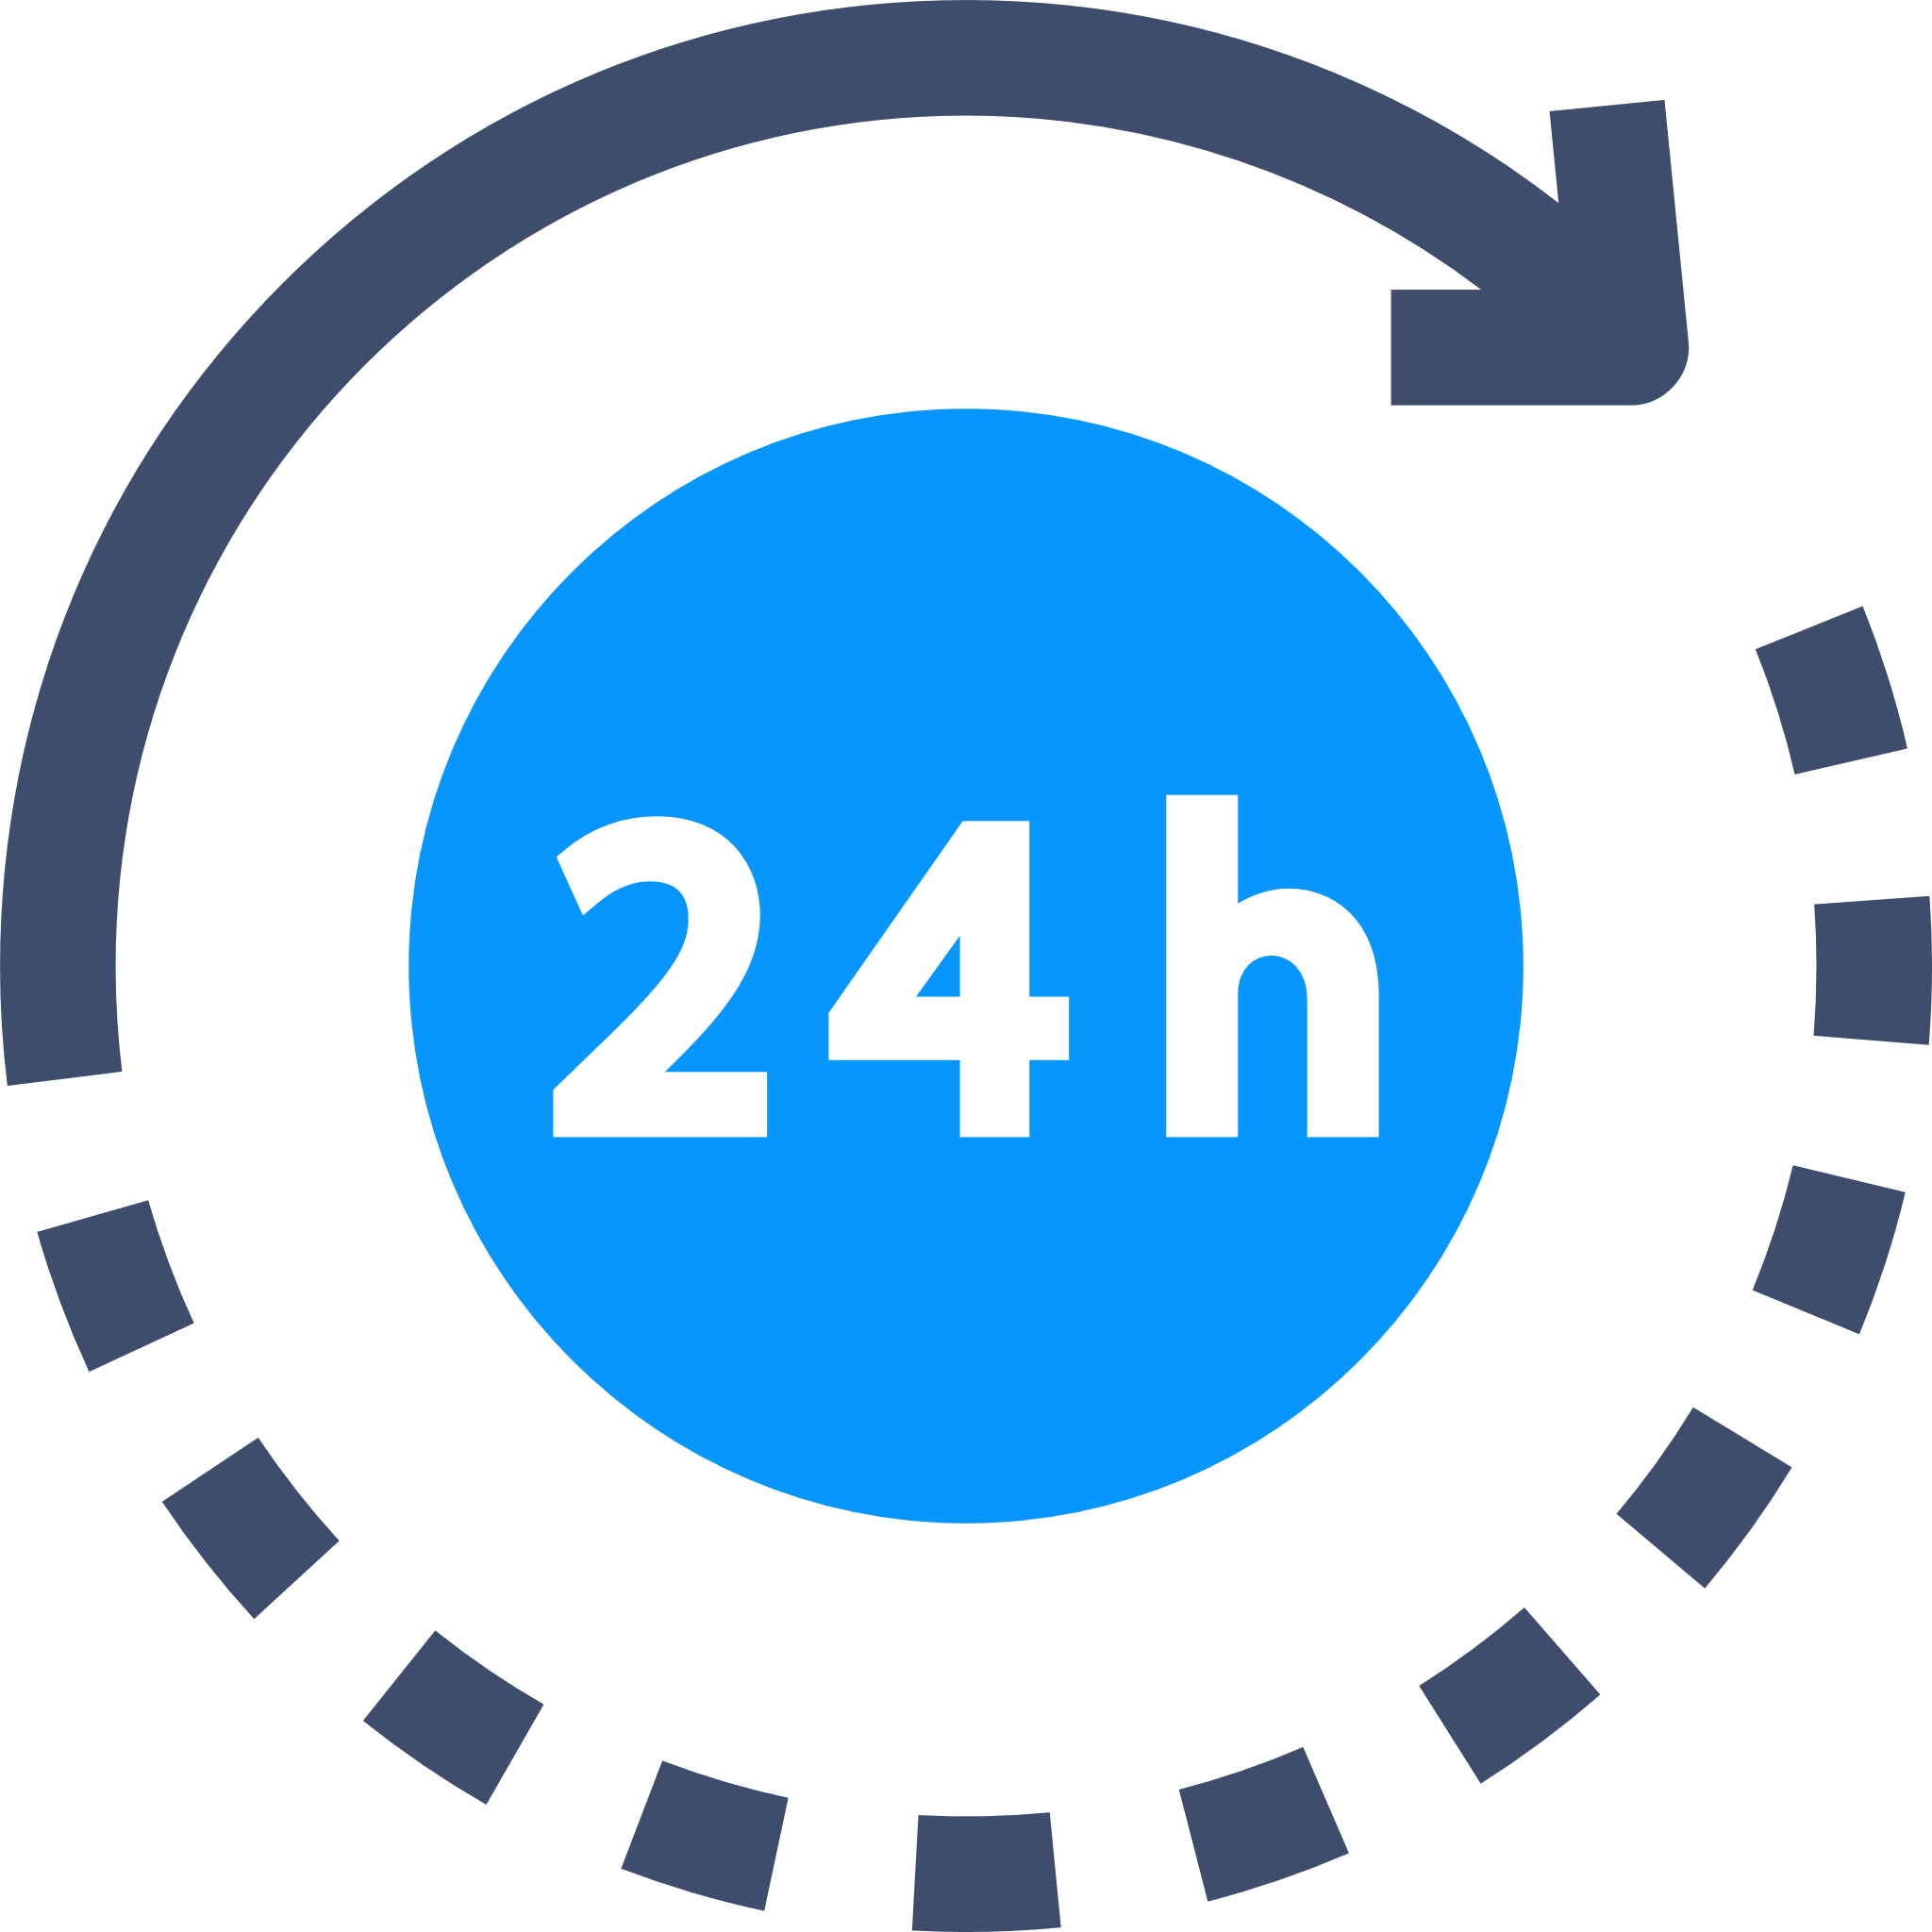
Leap year problem:
2 points.
Write a function that takes the year as a parameter and returns true if the year is a leap year and false if it is not.
If the year is divisible by 4, it is a leap year.
If the year is divisible by 100, it is not a leap year.
If the year is divisible by 400, it is a leap year.
All other years are not leap years.
Hours in a day problem:
2 points.
Write a function that returns the number of days from the number of hours. E.g. 48 = 2. 36 = 1.
Notes:
Have a go at some of the problems using what you have learned in this objective.
Only use the commands that you have been shown in the example programs.
Avoid using commands that you have not been taught because you may not be able to use these when answering exam questions.
If your teacher does not direct you, aim to achieve 6 points in total in this objective.

Slide 16
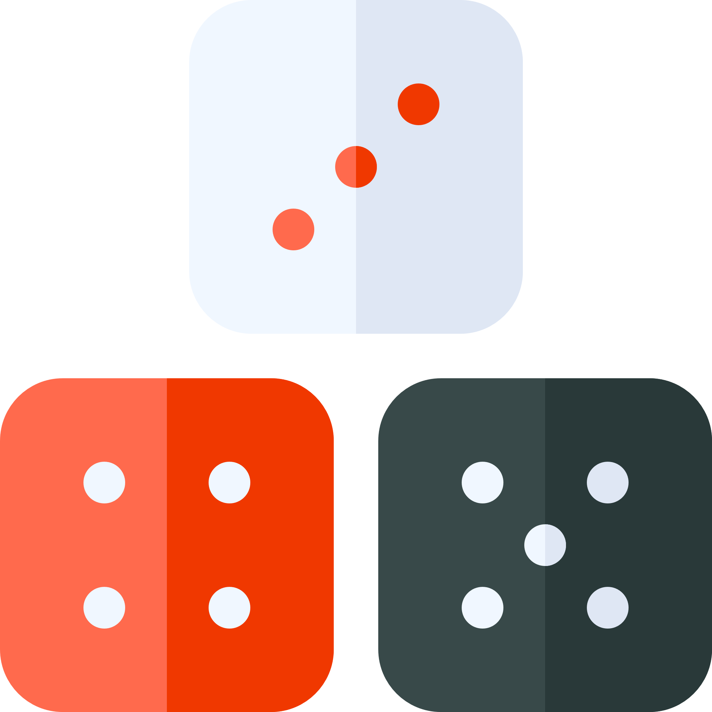
Dice game problem:
2 points.
Write a function to calculate the score in this simple dice game.
The program should generate three random numbers between 1 and 6. The score is calculated by a functon called ScoreDice.
Output the result of the function.
Function ScoreDice(Dice1, Dice2, Dice3)
Are all three dice equal?
Yes
No
Are two of the dice equal?
Yes
Score = total of the 3 dice
Score = sum on the two-equal dice
No
Score = Score minus the number on the other dice
Score = 0
Return score
End Function
Notes:
Have a go at some of the problems using what you have learned in this objective.
Only use the commands that you have been shown in the example programs.
Avoid using commands that you have not been taught because you may not be able to use these when answering exam questions.
If your teacher does not direct you, aim to achieve 6 points in total in this objective.

Slide 17
Divisible problem:
3 points.
Write a function that takes two number parameters and divides them by each other. If the division is not possible because the second parameter is zero it should return False. If the second number is exactly divisible by the first number, it returns True. If the second number is not exactly divisible by the first number, it returns False.
Dogs life problem:
3 points.
Write a function that returns the age of a dog as an integer in dog years. The parameter can be a decimal number. E.g. 6.5 means six and a half actual years. A dog that is actually 6.5 years old is 51 in dog years.
If the actual years is 2 or less, the dog’s age is twelve times the years.
If the actual years is more than 2, the dog is 24 plus six for every year, minus two years.
Notes:
Have a go at some of the problems using what you have learned in this objective.
Only use the commands that you have been shown in the example programs.
Avoid using commands that you have not been taught because you may not be able to use these when answering exam questions.
If your teacher does not direct you, aim to achieve 6 points in total in this objective.

Slide 18
Electric car problem:
3 points.
At a charging point in a supermarket, customers can charge their electric vehicle while they shop. They also gain points to redeem against the cost of their shopping. Customers are charged £1 per session and 20p per minute. There is a minimum 15-minute charge time. The customer is still charged that minimum even if they disconnect before 15 minutes are used. They also gain the minimum number of points though at 22.
Customers gain 1.5 points per minute, rounded down.
Write a function that takes the number of minutes charged and returns two values: the total cost and the points gained.
The program should output the result with the currency formatted with a pound sign and two decimal places.
Notes:
Have a go at some of the problems using what you have learned in this objective.
Only use the commands that you have been shown in the example programs.
Avoid using commands that you have not been taught because you may not be able to use these when answering exam questions.
If your teacher does not direct you, aim to achieve 6 points in total in this objective.

Slide 19
Test tables:
Problem:
Parameter 1 | Parameter 2 | Expected output | Pass/Fail Test
Problem:
Parameter 1 | Parameter 2 | Expected output | Pass/Fail Test
Notes:
You should always “white box” test your programs against a range of valid inputs to check all paths of a selection statement work. Complete the test tables above for at least two of your programs. You can add and delete columns and rows as necessary.

Slide 20
Review your solutions:
Did you: | Self-assess: Yes/No
Complete all the requirements for the problems you solved?
Start your programs with a comment to describe what they do?
Use a subroutine for the main algorithm in your code?
Use a comment to describe what the subroutine does?
Use a comment after each program branch to explain the purpose of the section?
Use variable names that describe the data they hold?
Test your programs against different types of data to check they work?
Notes:
Self assess your work by evaluating your solutions against these criteria. Enter yes or no in the “Self-assess” column.
Once you have completed the objective, show your programs to your teacher so you can review them together.

