Slide 1
12BTEC Bridging Day 2024 – Art and Design

Slide 2
What do you think the BTEC is?
What do you want to gain from it?
Why have you chosen this?
How does this work with your other subjects?
What are you most nervous about?

Slide 3
BTEC UNITS
Unit 1: Visual recording and communication (Exam unit)
Unit 2: Critical and contextual studies in Art and Design (Exam unit)
Unit 3: The Creative Process (SHP)
Unit 4: Materials, Techniques and Processes in Art and Design (CAT)
Unit 5: Developing an Art and Design Portfolio (JHN)
Unit 7: Developing and realising creative intentions (Exam unit)
Unit 12: Fine Art materials, techniques and processes (BOO)
Unit 14: Textiles materials, techniques and processes (TVY)

Slide 4
Sketchbook Walkthroughs
Unit 12: Fine Art materials, techniques and processes
- The experimental start to the book, exploring materials and the way they are used

Slide 5
Unit 12: Fine Art materials, techniques and processes
Once you have completed the first stage of this unit, you will then create a mini project based on something of your interest.
Think creatively!

Slide 6
Class Activity
Front Cover Page
Use the unit title:
Unit 12
Fine Art materials, techniques and processes
BOO

Slide 7
Summer homework
Complete your front cover
Complete your Biro image
Complete your graphite image
Find 3 artists ready for your first lesson back for EACH artist

Slide 8
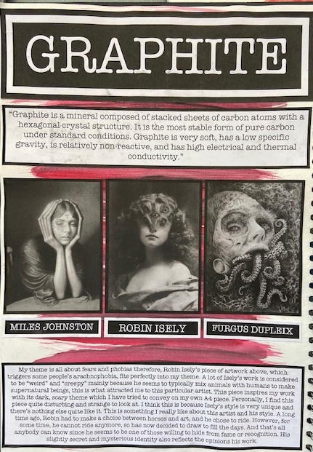
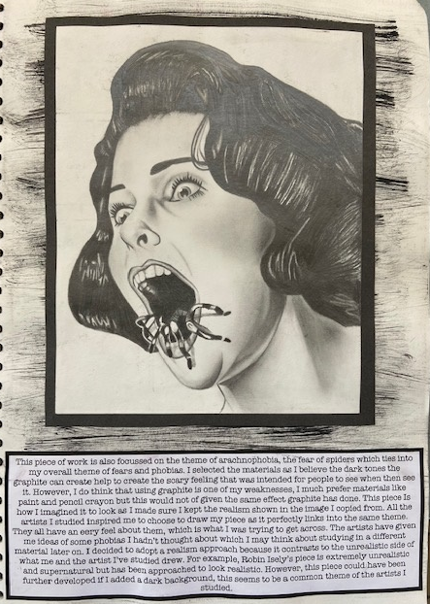
Graphite

Slide 9
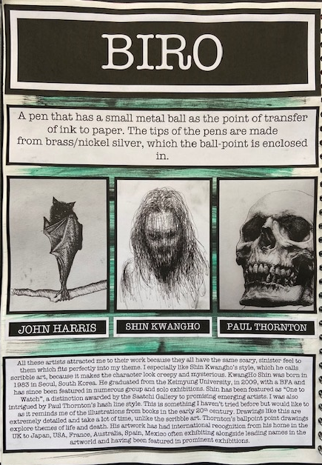
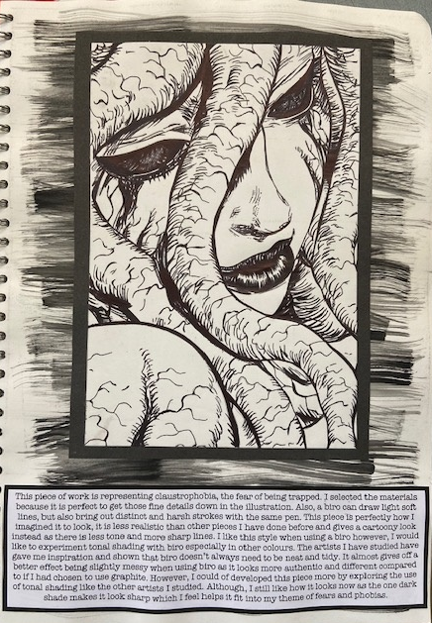
Biro

