Slide 1
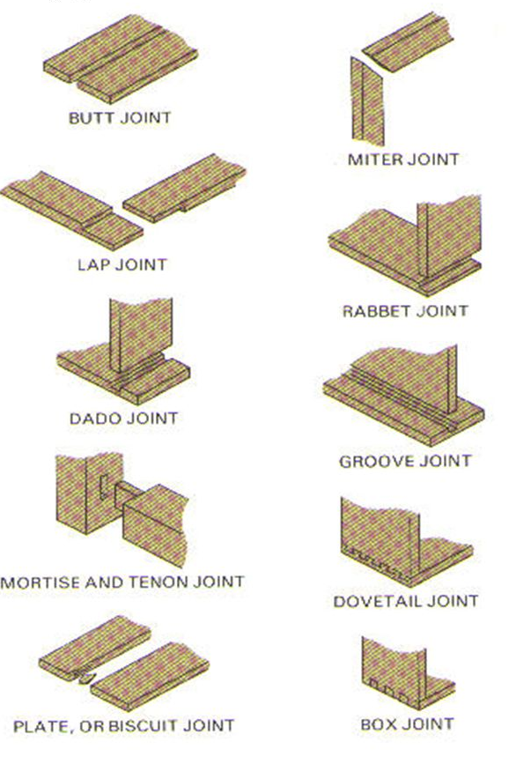
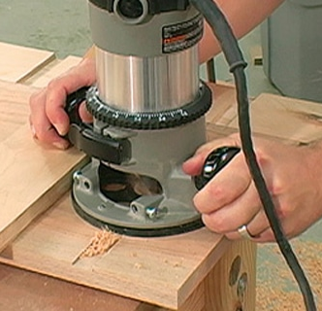
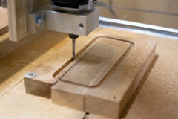
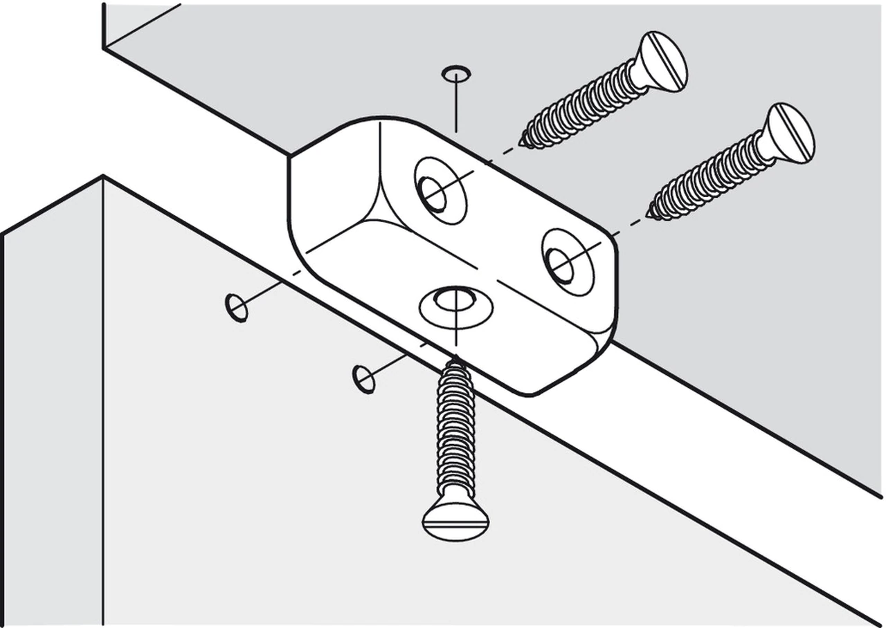
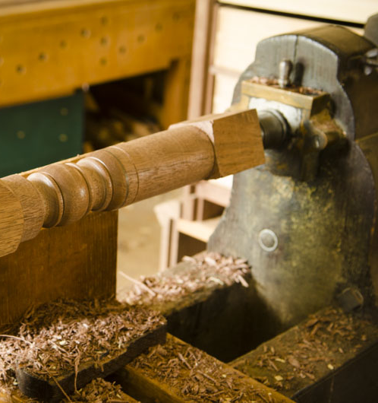
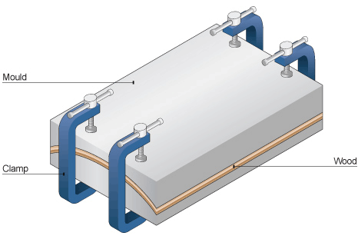
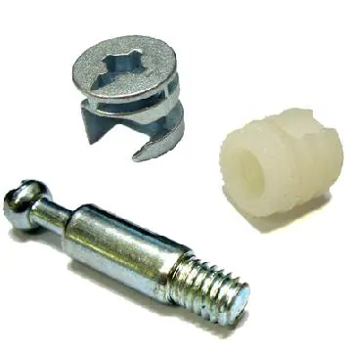
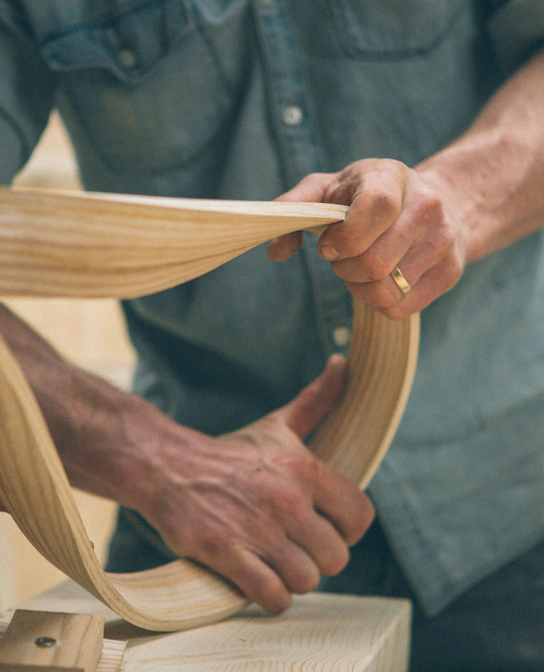
3.1.4 Woods Processes
Knowledge Organiser
Addition Process | Diagram
Traditional Wood Joining
Different joints are used for purposes, and generally the larger the gluing contact area, the stronger the joint.
Forming Process | Diagram
Milling
Can be done using CNC or by hand but uses high speed bits to cut holes and/or channels in wood blocks
Forming Process | Diagram
Routering
Can be CNC or hand controlled. Can be used to make channels, holes, mouldings, etc
Addition Process | Diagram
Component Jointing
Knock-down fittings are commonly used for flat-pack furniture. Standard components can also be used e.g. wood screws, coach bolts, etc
Forming Process | Diagram
Turning
Turning is done on a wood lathe. The wood is spun at high speed, while either a worker with manual tools or automated tools, cut into the wood to shape it.
Forming Process | Diagram
Lamination
Wood veneers or thin man-made boards are bend over a former/jig and glued together. When dried reveals a layered, shaped, sheet
Forming Process | Diagram
Steam Bending
Heat and steam makes wood strips pliable and can be shaped. Then it is clamped in place and left to dry.

