Slide 1
What is History?

Slide 2
Have a think for me before you start about these 2 questions:
1. Something you know about the subject of ‘History’.
2. What you think about studying History.

Slide 3
To Historians, the past is a MASSIVE place – and it needs to be sorted into an order:
Chronological order

Slide 4
To make the history of the human race easier to organise, our past has been split into two sections:
BC
AD
What happened at this point?
Why is this point special?

Slide 5
BC
AD
BC = Before Christ
AD = Anno Domini (The year of our Lord)

Slide 6
BC
1 AD
AD
300 BC
200 BC
100 BC
100 AD
200 AD
300 AD
What is happening to the dates on:
The BC side?
The AD side?

Slide 7
How do historians work out centuries?
A Century is another way of working out historical events. One century is a period of 100 years.
Two centuries is a period of 200 years etc.
We are currently in the 21st Century. How do we work that out?
A little bit of maths for you!!
To work out what century you are looking at you simply add 1 to the first two numbers of the year.
E.g. 2020 = (20 + 1) 21st century
Here is another. What century is the year 1690 in?
Remember, we add 1 to the first TWO numbers.
16 +1 = 17th century
TASK:
Now that you know how to work out centuries, have a go at the following dates:
1776
1066
1814
1918
1536
Remember, if asked to work out the century from the year, you do the opposite. E.g 17th century = 17-1 = 1600s (any year beginning with 16 will be in the 17th century

Slide 8
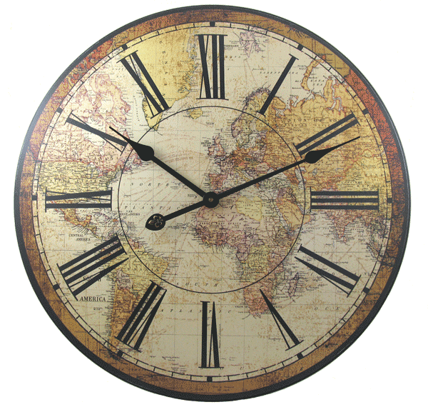
Have a go at the historical time questionnaire document on Firefly.

Slide 9
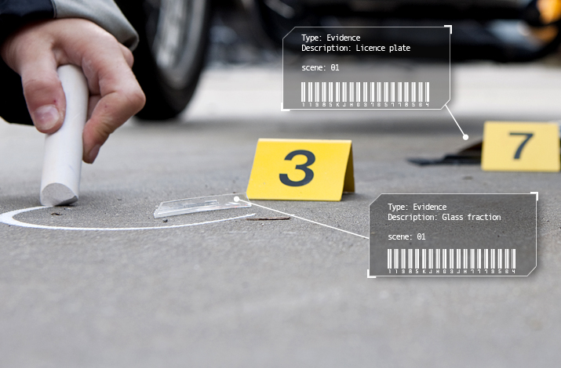
What is evidence?
Where do you find evidence?
Why do you need evidence?

Slide 10
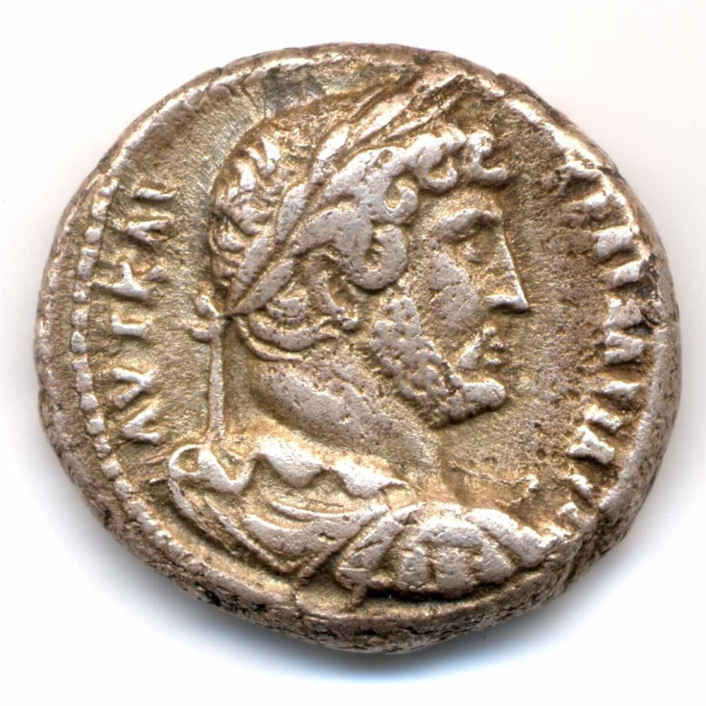
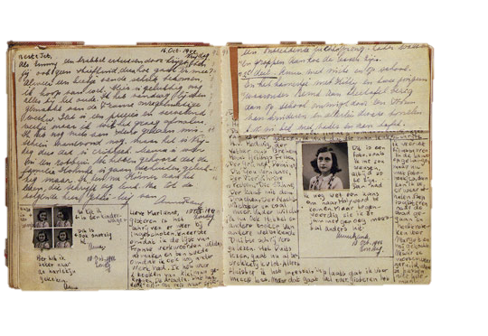
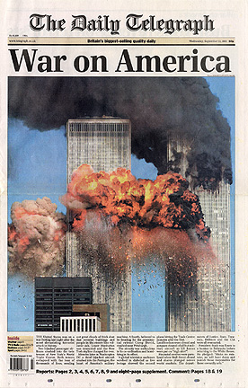
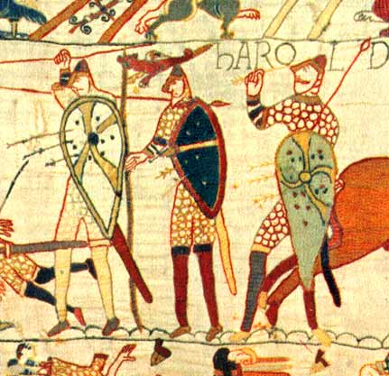
Historians use sources to build up a body of evidence to make decisions about a time or an event.
Historians always question and analyse sources, and this becomes part of the evidence too –
Why would they do this?

Slide 11
Evidence = a collection of information that we can use to make a decision.
Source = an object or item we can use as a clue to tell us about the past.

Slide 12
Now complete your important Historical event.
You can find the form on the ‘What is History’ word document on Firefly.
Imagine that somebody in the future wanted to find out about this event.
What kind of sources could they use?
Sources

Slide 13
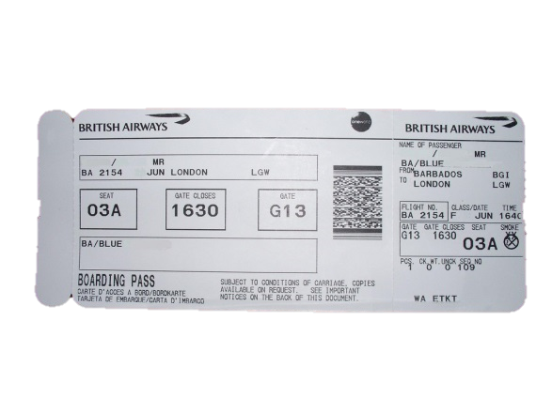
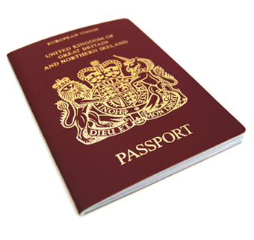
EXAMPLE: Mr Donaghy’s trip to New Zealand
Sources from my trip to new Zealand
What would these sources tell you?
Photographs
Private diary
Speak to family member who came on the trip

Slide 14
You’ve had your thinking caps on for today so…
On a scale of 1 – 10, how ready are you to start studying History?
10 – totally ready
1 – not ready

Slide 15
EXTENSION – Separate Word document on Firefly.

