Slide 1
The 24 game…
Try this with your family – who is the quickest?
One of our favourite things to do on transition is to play the 24 game. The aim of the game is to be the first person to make the number 24.
For each game you have 4 numbers, you have to use ALL four numbers, you can add, subtract, multiply or divide these to make 24.
Example:
2 2 6 8
To make 24, I can do (8 - 2) x (6 – 2)
8 -2 = 6
6 -2 = 4
6 x 4 = 24
Now it’s your turn, the 24 cards are below they get harder as you go through.
One Dot - Easiest

Slide 2
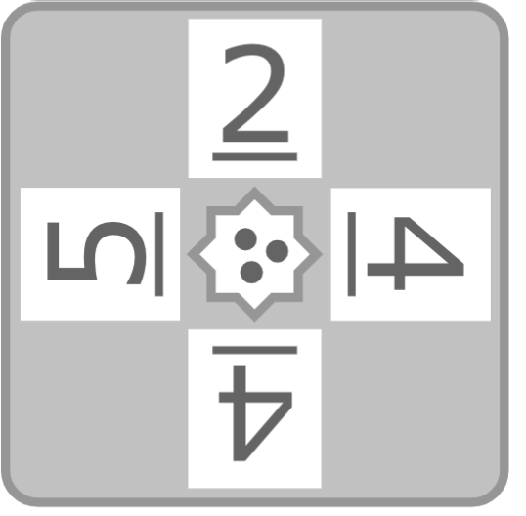
The 24 game…
two Dot - medium
three Dot - harder

Slide 3
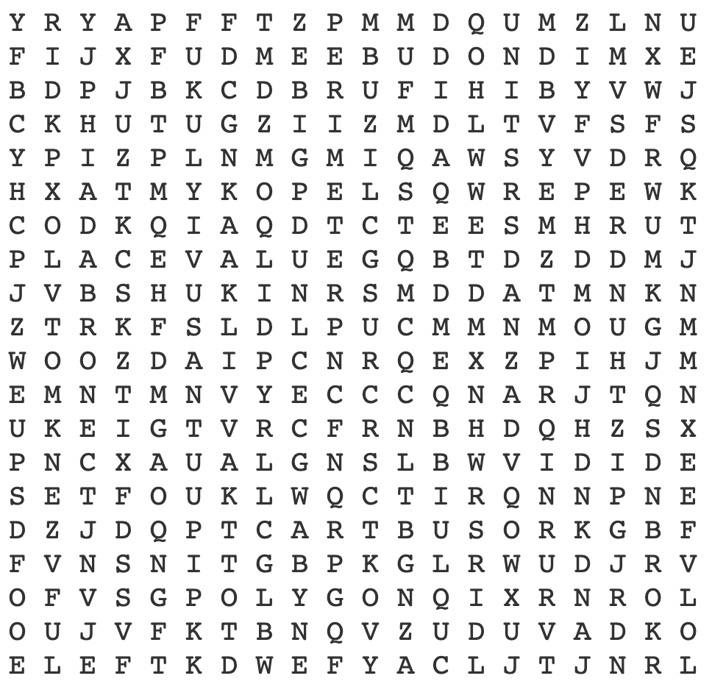
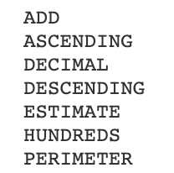
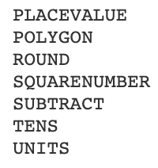
Maths Keywords…

Slide 4
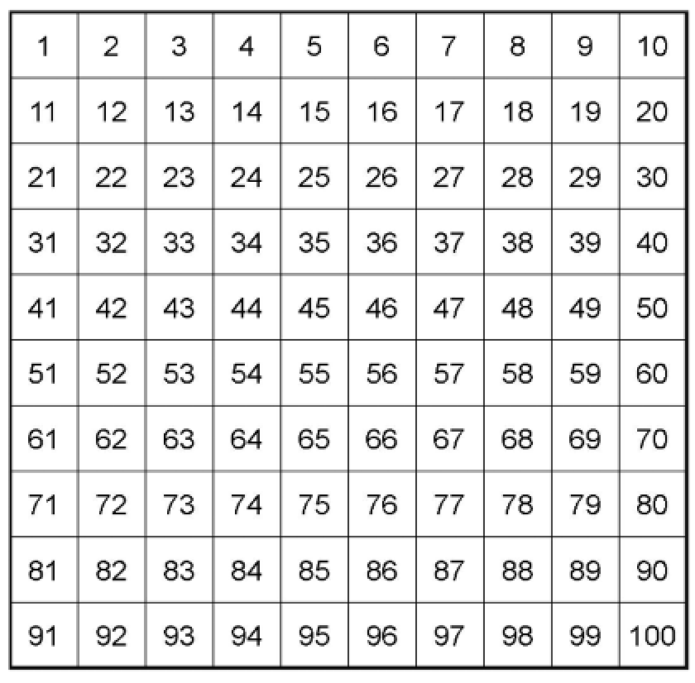
Find the Number

Slide 5
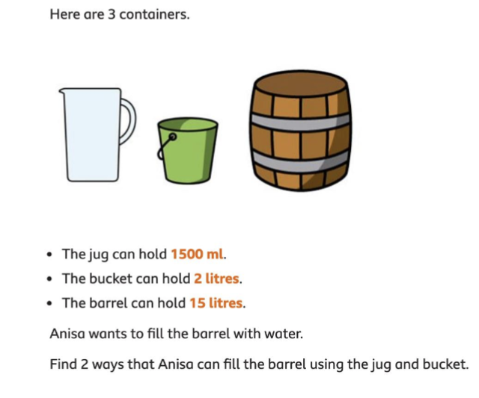
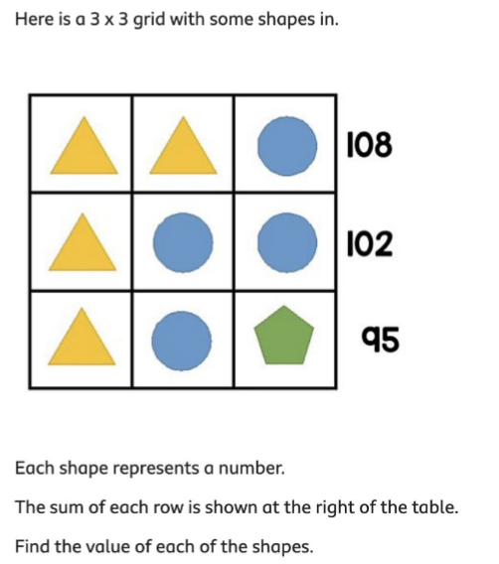
Maths Challenges…
Can you solve all the Maths challenges?
They get more difficult as you get them..

Slide 6
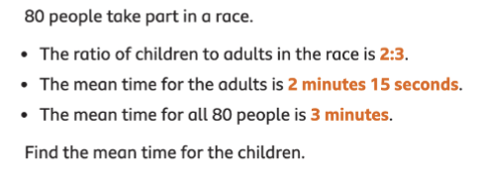
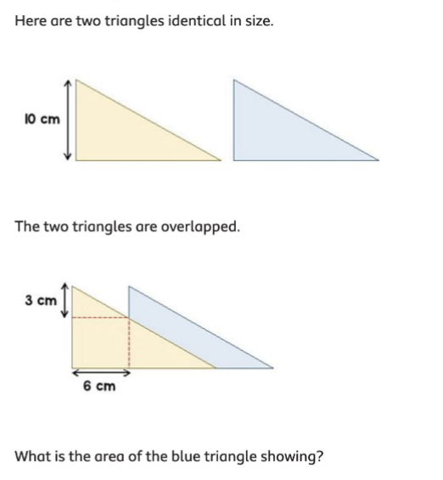
Maths Challenges…
Can you solve all the Maths challenges?
They get more difficult as you get them..

Slide 7
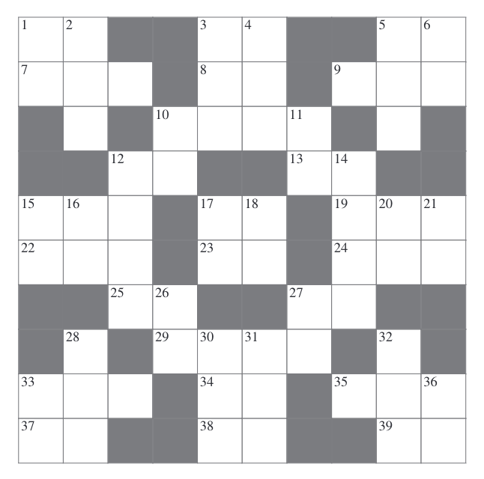
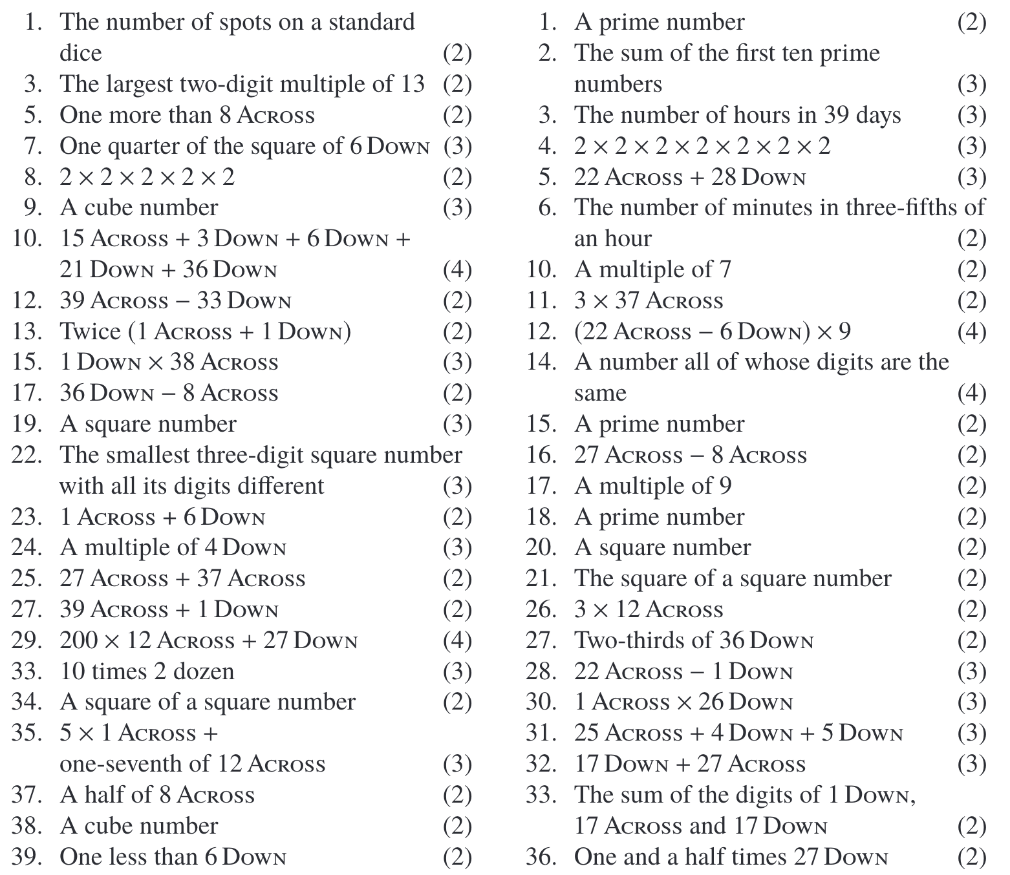
Cross Number…
Use the questions below to complete the cross number.
2
1
Across
down

