Slide 1
Level 3 Cambridge Technical in Digital Media

Slide 2
STARTER
Choose a word from the image and explain why it might be linked to this course?

Slide 3
What are Cambridge Technicals?
Cambridge Technicals are vocational qualifications for students aged 16+. They are designed with the workplace in mind and provide a high-quality alternative to A-levels.
Vocational education is about educating people in the knowledge and skills required for employment and for the community as a whole. It is also about developing the behaviours and attributes needed to progress and succeed in education and in work.
This is a recognised and accepted qualification by UCAS.

Slide 4
Why did you choose this course?
What do you hope to gain from it?

Slide 5
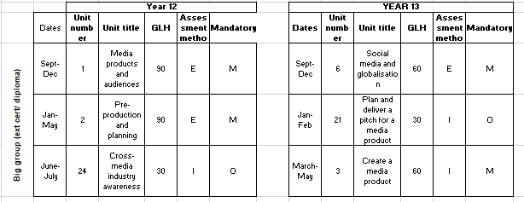
Delivery of the course
E – External Exam
I – Internal coursework
M = Mandatory
O = Optional
This is a 2 year course, you will need to complete the 2 years to gain a qualification

Slide 6
Delivery of the course
E – External Exam
I – Internal coursework
M = Mandatory
O = Optional
For the A level you will the units highlighted in red
Extended certificate

Slide 7
Delivery of the course
E – External Exam
I – Internal coursework
M = Mandatory
O = Optional
For the Diploma you will complete all the units = 2 A levels
Diploma

Slide 8
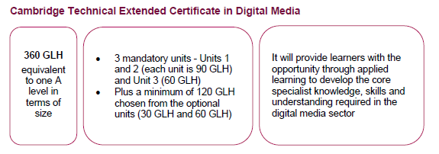
Qualification Overview – A LEVEL

Slide 9
Grading
Grading - The units are graded Pass, Merit and Distinction.
- The qualification is graded Pass, Merit, Distinction, Distinction*. Coursework:
These units are assessed by your teacher and externally moderated by OCR.
Each unit has specified grading criteria for Pass, Merit and Distinction.
A summative unit grade can be awarded at Pass, Merit or Distinction:
- to achieve a ‘Pass’ a learner must have satisfied all the ‘Pass’ grading criteria
- to achieve a ‘Merit’ a learner must achieve all the ‘Pass’ grading criteria and all the ‘Merit’ grading criteria
- to achieve a ‘Distinction’ a learner must achieve all the ‘Pass’ grading criteria and all the ‘Merit’ grading criteria and all the ‘Distinction’ criteria.
However if you do not achieve a pass in one of the unit’s it may be possible to achieve a Near Pass grade.

Slide 10
Click here for spec

Slide 11
Unit 1 – Media Products & Audiences (Exam)
Whichever sector of the media you want to work or specialise in, all media institutions work to create products that meet the needs of specific target audiences. The aim of this unit is for you to: > develop your understanding of how different media institutions operate. You will therefore learn: > The different ownership models in the media industries > How to analyse different media products within the sector > The fundamentals of how meaning is created for audiences > How audiences are categorised, researched and targeted > How media institutions distribute and advertise their products.
Click here for example of Exam Paper

Slide 12
Unit 2 - Pre-production and planning (Exam)
This is a mandatory unit that forms the foundation of the course. The knowledge and understanding developed in this unit is transferable to a number of other units.
The aim of this unit is for you to: - Understand the pre-production process the creative media industry follows when creating a product.
You will therefore learn how to: - carry out research in the planning stage of a media production and about the various acts of legislation that need to be considered.
- understand the constraints that need to be considered when planning a new media production, including timescales and resources.
-how to create preproduction documents in relation to client requirements and how to plan projects to meet these needs.
Click here for example of Exam Paper

Slide 13
Unit 6 - Social Media & Globalisation (Exam)
Social media has revolutionised the way in which people connect and we can interact in an instant with someone on the other side of the world. In terms of media production, social media has also fundamentally changed the way in which media institutions and creative professionals reach and interact with target audiences who are now global.
The aim of this unit is for you to: understand the ways in which online technologies and social media products have created a globalised, connected society and how such tools are used by media producers.
You will therefore learn how to: - evaluate the positive and negative impacts of social media on businesses, individual users and producers. - issues surrounding censorship and regulation of social media, and the impact this has on media production and distribution. - investigate how media producers use contemporary social media to generate ideas, fund and plan projects with other professionals and how social media is used commercially to create awareness and advertise products to global audiences.
Click here for example of Exam Paper

Slide 14
Exam structure
Unit 1 – Media Products and Audiences
• 90glh unit
• 2-hour exam
• 80 marks
• Combination of short, medium and long answer
questions
• Available in both January and June series
• This is currently a paper-based assessment only
Unit 2 – Pre-production and planning
• 90glh unit
• 2-hour exam
• 80 marks
• Combination of short, medium and long answer questions
• Available in both January and June series
• This is currently a paper-based assessment only
Unit 6 – Social media and globalisation
• 60glh unit
• 1 hour 30 minutes exam
• 60 marks
• Combination of short, medium and long answer questions
• Available in both January and June series
• This is currently a paper-based assessment only
Extended certificate- Year 12
Extended certificate- Year 12
Extended certificate- Year 13
You are able to re-sit the exam if you didn’t do well the first time

Slide 15
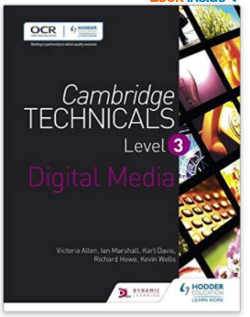
Resources
A4 Folder
Dividers
USB
Textbook paper back (Amazon £20)
Highlighters
A4 lined paper – notebook.

Slide 16
Is this course for you?
Are you creative?
Do you want to learn new skills in IT and Media?
Do you want to learn something that’s current and relatable?
Do you want to learn something that’s different to what you have already been learning in school?
Do you want to open doors for opportunities in the future?
Do you like the idea of doing coursework and exams?

Slide 17
Summer work
Visit the sixth form firefly page to see the research tasks to complete.
You will need to bring this in with you on the first week- either email it to Mrs Shillingford/ email it to yourselves/save it on your USB etc.

