Slide 1
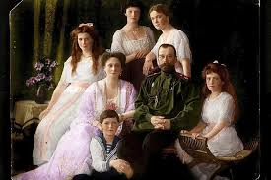
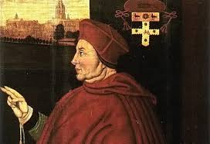
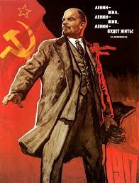
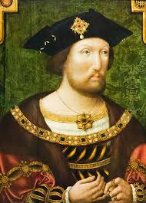
History Transition Work Summer 2024
Lead teachers for the 2 units…
Russia = Mr Luckhurst
Tudors = Mrs Skinner
(D block)
From GCSE to A level – skills and knowledge…

Slide 2
Getting ready…
In order to be fully prepared for the course- have a look at the tasks on the following slides.
Please complete the following activities…..

Slide 3
Tasks for 1H- Tsarist and Communist Russia, 1855–1964 - Breadth study
Early Russian leaders. Research and create factfiles about these famous Russian leaders (all from before the time our course starts). Find out about the key dates and main events of their reigns, leadership styles, controversial moments, why they are famous.
Ivan the Terrible
Peter the Great
Catherine the Great
2. Famous wars involving Russia. Research Russia’s role in the following major conflicts:
The Napoleonic Wars – victory for Russia
Crimean War – defeat and embarrassment for Russia
World War One – chaos, courage, confusion and civil war.
World War Two – Stalin’s role from zero to hero???
3. Timeline / chronology task – 1854 to 1914 (Crimean War to WW1) Create a timeline of key events during that period – you should use the factfiles I have put on Firefly for you on this page.
1. Basically what did they do, when and how they ruled – were they controlling, cruel, clever, devious, demanding, determined, disastrous?
2. Maybe find 5 specific factual details about Russia’s actions in these wars.
3. You could make this electronically or by hand – find any political events or economic events from the factfiles and add to yours.

Slide 4
Tasks for 2D- Religious conflict and the Church in England c.1529-1570 The Depth Study
Who are the Tudor monarchs? Make a timeline showing who was monarch and when. Write down key facts about each monarch on the timeline.
Read the following article on Henry VIII and his childhood/upbringing. https://www.historyextra.com/period/tudor/young-henry-viii-what-like-as-child-childhood-boy-david-starkey/ Using the information make a fact-file on the King and identify areas of strength and weakness.
Thomas Wolsey will become a King figure you will study. Using the next few slides, complete the following 2 tasks;
a) Do a timeline on the life of Thomas Wolsey- make it clear the different roles and jobs he had.
b) Complete the source grid looking at which is most valid for studying Wolsey’s influence.

Slide 5
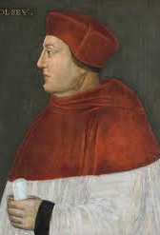
Who was Thomas Wolsey?
http://www.bbc.co.uk/history/historic_figures/wolsey_thomas.shtml
https://spartacus-educational.com/TUDwolseyT.htm
https://tudortimes.co.uk/person-of-the-month/thomas-wolsey

Slide 6
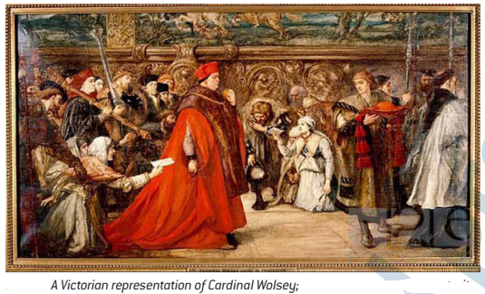
Which is the most valid source for studying Wolsey’s influence?
A: A poem on the condition of religion and the Church in England. This was published in Strasbourg in 1528:
As for bishops take no care,
They drink from golden bowls
the blood of poor simple souls,
Perishing for lack of sustenance.
Their hungry cures they never teach
Nor will suffer none other to preach
But such as can lie and flatter.
As for Wolsey, to be brief,
In all England they have the chief
And most pleasant man
Who’s goodly soils, and goodly land
Wrongfully he holds their lands
He is the cause of misery
of whoredom, theft and beggary.
B: Sebastian Giustiniani was the Venetian Ambassador to the court of Henry VIII in 1519. As an ambassador, Giustiniani had been in England since 1515, and had regular meetings with Cardinal Wolsey.
The Cardinal of York rules both king and the entire kingdom. He is very handsome, learned, extremely eloquent, of vast ability and untiring. At first he used to say to me ‘His majesty will do so and so’. Subsequently, by degrees, he went forgetting himself and commenced saying ‘We shall do so and so’. He had then reached such a pitch that he used to say ‘I shall do so and so’. All state affairs, both civil and criminal are managed by him. He does more than all the magistrates, oficers and councils of Venice. He has the reputation of being extremely just: he favours the people, especially the poor, hearing and passing judgement of their cases without delay
C: A Victorian Painting of Cardinal Wolsey.
D: Polydore Vergil was the ambassador to the Vatican. He was invited by Henry VII to write Anglica Historia, an influential account of English history which he began in 1502. The following critical account of Wolsey was not included in his published History of England until 1555:
Wolsey was, indeed, detested by everyone, because he assumed that he could undertake nearly all the offices of state by himself. It was indeed, a fine sight to see this fellow, untrained in the law, sitting in the court and giving judgement. Wolsey with his arrogance and ambition aroused against himself the hatred of the whole country. The government of Wolsey had, at first an appearance of justice for the common people, but this impression quickly disappeared, since it was only a shadow

Slide 7
Evaluation of sources- go through each source and assess its validity.
 | Source A | Source B | Source C | Source D
What is the BIG message of the source about Wolsey?
What are the mini messages about Wolsey?
Provenance (author, date, purpose, agenda)
Tone (style)
THRUST- What are we being told? What can we learn?
What does it reveal to us beyond the BIG message?
Is who wrote it informed, impartial, objective, subjective?
Is the person speculative or an eyewitness?
Was It written to persuade?
Is the language emotive, sensational?

Slide 8
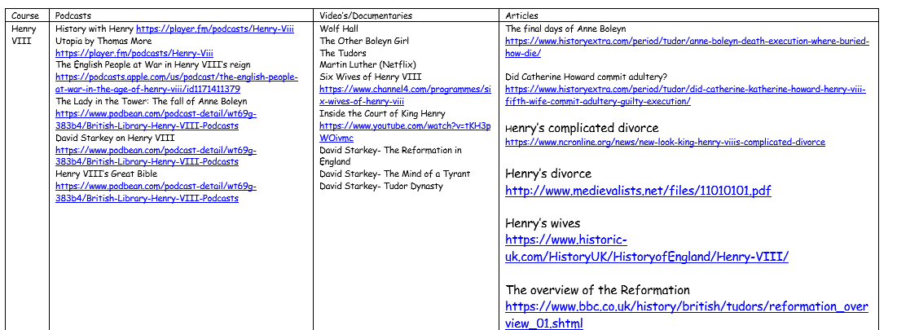
Support moving forward
Lastly- the more reading, watching and listening you do will help massively. Click on the following link to take you to firefly to the list of podcasts, videos and books you can use to help build up your knowledge. https://chellaston.fireflycloud.net/history/a-level-1/religious-conflict-and-the-church-in-england-c1529-1570/course-admin-and-expectations-

Slide 9
What books can I buy?

